Slide 1
Basic public health Medical questions

Slide 2
1) Sexually transmitted infections
Are disorders spread principally by intimate contact:-sexual intercourse, close body contact, kissing, transplacental spread, passage through the birth canal and lactation during the neonatal period.
Five key points about all STIs today
STIs affect men and women of all backgrounds and economic levels
The incidence of is rising
Most of the time, STIs cause no symptoms, particularly in women
STIs tend to be more frequent and severe for women than men.
STIs can be passed from a mother to her baby before, during or immediately after birth
Notes:
WHO recommends that the term STD be replaced by the term STI. because it better incorporates asymptomatic infections.

Slide 3
Organisms transmitted sexually
Bacteria-N.gonorrhoea, T. pallidum, H. ducreyi
Viral- HIV, HSV,HBV,HPV
2) tuberculosis
Is a disease caused by mycobacterium tuberculosis
Commonly affects the lungs(pulmonary tuberculosis) but it can be systemic.
Medications are available to treat TB, although the medication must be taken every day for at least six months, it remains a leading cause of death.
Epidemiology
  Prevalence of infection: 1.7billion worldwide
  Incidence of infection: 8-10 million worldwide
  1.6 million deaths each year

Slide 4
Transmission
person to person-via inhalation of droplet nuclei
Animal to person- cow’s milk
Dx (clinical findings)
1. Skin testing-also called the purified protein derivative or PPD(most commonly used test)
If the person is newly infected, the skin test usually becomes positive with in 4 to 10 wees after exposure.
2. Chest x-ray

Slide 5
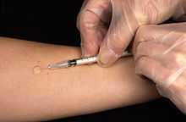
tuberculin skin test

Slide 6
treatment
Consists of acombination of drugs that are considered to be first line therapy, including isoniazid, rifampin,etc…
Second line antituberculosis therapy drugs are reserved for the treatment of TB in special situations in which there is drug intolerance or resistance to first line therapy(MDR-TB) or XDR-TB

Slide 7
3) malaria
Is a protozoan disease transmitted by the bite of infected anopheles mosquitoes.
75% of the country is malarious (<2000m),with about 50 million people at risk.
Five species of the genus plasmodium cause nearly all malarial infections.
P.falciparum
P. vivax
P. ovale
P. malariae
P. knowlesi
Notes:
he vast majority of deaths are caused by P. falciparum(60%) and P. vivax, while P. ovale, and P. malariae cause a generally milder form of malaria that is rarely fatal. The zoonotic species P. knowlesi,

Slide 8
Clinical manifestations
Malaise, headache, vomiting, fever, cough, diarrhea, jaundice
Tender hepatosplenomegaly, anemia
In severe cases:-ARDS, renal failure, hepatic failure
Predisposing factors
Extremes of age, pregnancy
Immunosuppressed patients:- patients on steroids, anti cancer drugs
Immunocompromised patients:-patients with advanced TB, HIV, cancer

Slide 9
Dx
Epidemiology and clinical pictures
Microscopic thin and thick blood films
Thick smears-detect parasite……….high sensitivity
Thin smears……….for low sensitivity
Extremely high ESR.
Treatment
Quinine and quinidine

Slide 10
Prevention
Mosquito vector control
ITN(insecticide treated net)
IRS(indoor residual spraying) like DDT
Larval control
Mosquito repellents
Notes:
Dicloro diphenyl trichloro ethane
Mosquito repellents---repellants applied to exposed skin may be used to protect against mosquito bites

Slide 11
4) Maternal and child health
Sexual assault
Any sexual act performed by one or more person(s) on another without consent.
It may include the use of threat of force.in some cases, the person doesn’t give consent to have sex because he/she is unconscious or other wise incapacitated.
Rape:- is a legal term and in USA it refers to any penetration of a body orifice(mouth, vagina or anus) involving force, the threat of force or incapacity(i.e associated with young or old age, cognitive or physical disability, or drug or alcohol intoxication) with out consent.

Slide 12
Sexual assaults are facilitated by the use of alcohol and drugs, which in some cases ingested voluntary by the victim and are more common than classic forcible assaults among college students.
The following steps are recommended after sexual assault
Find a safe environment away from the assailant
Call a close friend or relative
Seek a medical care:- do not change any clothes, bath, douche, or brush your teeth until evidence is collected.
A complete medical evaluation includes evidence collection, physical examination, treatment and/or counselling.

Slide 13
Clinical presentation
The majority of rape victims who come to emergency rooms don’t openly admit to having been sexually assaulted. they may complain of having been mugged or may voice concerns about AIDS or other STIs. Others may present with psychiatric symptoms including depression, anxiety, or a suicide attempt.
SEEK MEDICAL CARE-it is important to seek medical care ASAP.
The best chance of collecting accurate information is with in 24hrs of the sexual assault.
Preventive treatments
Prophylactic medical treatment may be indicated for prevention of STIs and pregnancy.

Slide 14
5) ABORTION
It is termination of pregnancy before the foetus reaches the stage of viability
TYPES OF ABORTION
Spontaneous abortion:-also known as miscarriage, is the unintentional expulsion of an embryo or foetus before the 24th week of gestation
Induced unsafe abortion:-a procedure for terminating unwanted pregnancy either by persons lacking the necessary skills or in an environment lacking the minimal medical standard or both(WHO)
(Induced safe abortion) therapeutic abortion:- An abortion is medically referred to as a therapeutic abortion when it is performed to save the life of the pregnant woman; prevent harm to the woman's physical or mental health.

Slide 15
studies indicate that unsafe abortion accounts for up to 25-35% of maternal deaths In Ethiopia. Therefore, it is critical public health concern in Ethiopia.
Between 10-50% of all women who undergo unsafe abortions need medical care for complication, like incomplete abortion, haemorrhage, shock, genital tract injuries and infections.
Major reason for abortion
High prevalence of unwanted pregnancy from unmet need for family planning.
Unable to raise that child.Ex. students, youngsters
Notes:
80 000 deaths world wide due to complications
2/5 pregnancies are unplanned

Slide 16
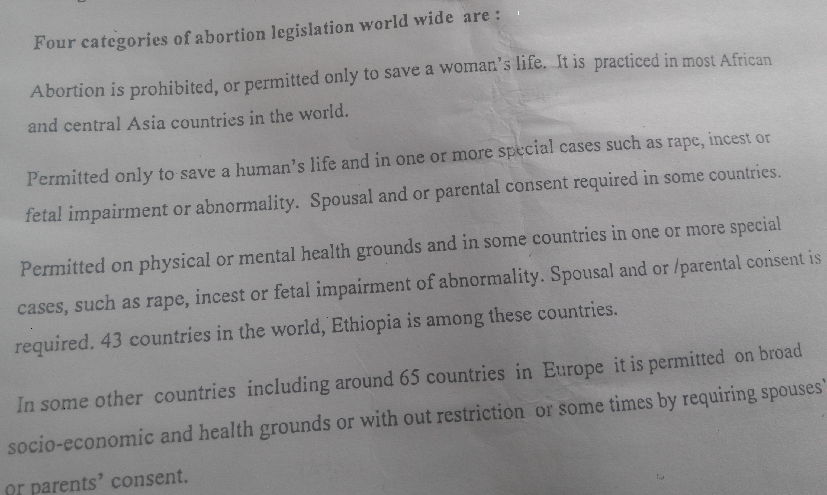
Four categories of abortion legislation world wide are

Slide 17
Penal code of Ethiopia Regarding abortion
The deliberate termination of pregnancy, at whatever stage or how ever affected, is punishable except otherwise provided.
However termination of pregnancy is not punishable where it is done to save pregnant women from grave and danger to her life or health. These include pregnancy resulting from rape or incest when the pregnancy risks the health or life of the women in case of foetal abnormality and for other physical, psychological and social factors.

Slide 18
6) Harmful traditional practices
Early marriage
Promissory marriage
Child marriage:-usually the girl is less than 10 years.
“Madego” the girl is given to in-laws after wedding ceremony to serve until maturity.these is worse bcause of sexual and physical abuse
“Melesles” The girl does frequent visits to the in-laws to serve till maturity
Early adolescent marriage:- age of the girl is 10-15 years
Notes:
More prominent in Amhara. By z age of 15 50% of children marry

Slide 19
7) Health related problems of early marriage
Sexual abuse, vaginal, anal and perineum tear, early pregnancy, child bearing and unwanted pregnancy
Maternal morbidity due to fistula, Haemorrhage, obstructed labour.
Denied education and own choices, illiterate mother usually raise illiterate child.
Urban migration, fistula patients
psychological trauma from first sexual experience, many children(early pregnancy)
Notes:
an abnormal passage that leads from an abscess or hollow organ or part to the body surface or from one hollow organ or part to another and that may be surgically created to permit passage of fluids or secretions

Slide 20
Abduction
It is defined as unlawful kidnapping or carrying away a girl for marriage
In almost all cases rape follows it
Complications:- excess bleeding, infection, pain, loss of sexual stimulation and orgasm, infertility
FGM(FGC)
All procedures that involve partial or total removal of the external female genitalia, or other injury to the female genital organs for non-medical reasons

Slide 21
8) Immunization
The process of inducing immunity against specific disease.
Two types
Active immunization:-stimulation of immune system to produce antibodies and cellular/humoral immune response against infectious agent.
Passive immunization:- providing temporary through administration of exogenously produced anti bodies.
Vaccination:-administration of whole or part of a microorganism to prevent infectious disease.

Slide 22
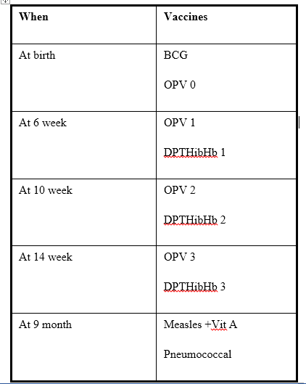

Slide 23
9) Public health
Health is a state of complete physical, mental and social well being and not merely absence of a disease
Disease indicates
Indicates a wrong stage of physiology or anatomy
Interferes with normal functions of the body

Slide 24
Health care system in Ethiopia
Eth. Is a country having the poorest health system in the world.
Maternal and infant mortality rates are among the highest
It comprises four tiers
Primary Health Care Unit
District/zone hospitals
Regional referral hospitals
Central referral or teaching hospitals

Slide 25
Public health terminologies
EPIDEMIC:-the occurrence of health related condition in excess of the usual frequency in a given area or among a specific group of people over a particular period of time.Ex. Cholera, influenza,small pox, measeles
PANDEMIC:-an epidemic involving several countries or continents and affecting a large number of people.For Ex. HIV/AIDS

Slide 26
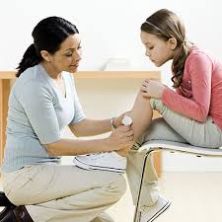
10) First Aid

Slide 27
First aid – is the temporary & immediate care given to a person who is injured/sick.
It includes recognizing life threatening conditions & taking effective action to keep the injured/sick person alive & in the best possible condition until medical treatment can be obtained.
It does not replace permanent medical treatment.

Slide 28
In primary survey the first thing to do is to make sure the scene is safe
Electrical shock
Active haemorrhage
Fire
And other related cases

Slide 29
In primary survey identify threatening situations like
Airway obstruction, chest injuries with breathing difficulties , severe internal or external haemorrhages
What's the ABCDE survey
A=airway obstruction… asses he airway. Can the patient talk and breath freely?? If obstructed the steps to follow are…chin lift jaw thrust, suction, intubation
Always be aware for cervical injuries

Slide 30
B=breathing…adequate or not?? If in adequate he steps to follow are decompression, closure of open chest injuries
C=circulation…asses the circulation, stop external haemorrhage, administer blood if available ,in cade of cardiac failure CPR(cardiac pulmonary resuscitation)
D=disability… rapid neurological assessment
A=awake P=painful response V=verbal U=unresponsive
E=exposure…undress the patient and look for any injuries

Slide 31
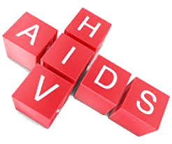

Slide 32
11) HIV AND AIDS
HIV is the name of the virus that depress the body’s immune system
AIDS is the last stage of HIV infection when the immune system is very weak
What are the symptom of hiv??
Non specific like fever, sore throat, headache etc.
Infection like eye infection oral yeast infection

Slide 33
HIV TESTING METHODS
RAPID TEST… sample is taken from saliva or blood from a finger prick. Result available with in 5-40 mints.
A positive test always require another test
STANDARDIZED TEST… sample taken from vein. result available within a few days.
Treatment … HAART allow body to re build its immune system

Slide 34
What if I am pregnant or want to become pregnant??
Baby can become infected too…during pregnancy breastfeeding or birth
Talk to your doctor about ways to reduce the chance of spreading infections.

Slide 35
Can I lower my chance of getting HIV even after being exposed to the virus
In cases like rape unprotected sex or unfortunately the condom broke???
There are medicines called preventive medicines that you should start within 3 days of being exposed
Will not work in someone who always get involved in risky business
Or if you have wounds or sores on your genitalias risk gets high.

Slide 36
Staging
Measure t cell or CD4
T cell or CD4 count below 200 …AIDS develops
Stage 1.>200
2.200-499
3.50-199
4.<50

Slide 37
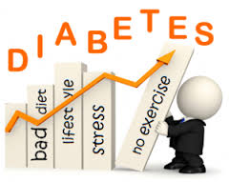

Slide 38
12) Diabetes mellitus
Term describe several diseases of abnormal carbohydrate metabolism that are characterized by hyperglycaemia
Two types of diabetes
Type 1… pancreas does not make enough insulin
Type 2…combination of peripheral resistance to insulin action and an inadequate compensatory response of insulin secretion by the pancreatic β cells ("relative insulin deficiency").
Insulin is a hormone that helps body to absorb and us glucose
Notes:
Store fat and build up protein without insulin blood sugar levels go up

Slide 39
DX- symptoms and blood tests
Symptom…high blood sugar levels which manifest with excessive thirst, feeling tired, needing to urinate frequently, loosing weight and blurred vision.

Slide 40
Dx
1.random blood glucose level 200 and above
2.a fasting glucose level of 126 and above
3. after OGTT( oral glucose tolerance test) a carbohydrate load blood glucose rises up to 200 and high.
Normal blood glucose level is between 70-120

Slide 41
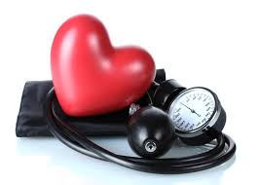
13) Hypertension

Slide 42
Hypertension
Elevated blood pressure…blood pressure the pressure the blood applies to the walls of the arteries.
Although hypertension is a common health problem with occasionally devastating outcomes, it typically remains asymptomatic until late in its course
Common symptoms are occipital headache dizziness visual difficulty

Slide 43
Blood pressure: 4 Categories, in mmHG
Normal | Pre-hypertension | Stage 1 HTN | Stage 2 HTN
<=120/80 | Systolic 120-139 | Systolic 140-159 | =>160/100
 | Diastolic 80-89 | Diastolic 90-99
∗Has to be a sustained one

Slide 44
Complication of HTN
Heart disease and stroke … variety of disorders
Treating HTN usually stars with life style changes which include reduce amount of salt in diet, lose weight, avoid drinking too much alcohol, stop smoking.
Medications are also available.

Slide 45
Read about food poisoning, alcohol intoxication( alcohol abuse ,dependence) marijuana addiction and smoking.
How they are treated
These are most likely to appear on the interview and written exam.

Slide 46
14) Cholera
Diarrehal illness caused by gram negative bacteria V.cholera.
Cholera is characterized by severe, watery diarrhea which can rapidly lead to dehydration an death in un treated patients.
Complication is through massive fluid and electrolyte loss.
Treatment is correction of hypovolemic dehydration.
Oral or intravenous volume repletion.
Antimicrobial therapy…antibiotics
Prevention…contaminated food and water is the main root of transsmition

Slide 47
Oral rehydration solution
Composed od odium chloride, trisodium citrate or bicarbonate, potassium chloride, and glucose.
Effective in all types of diarrhea.
cheap and easy to administer.

Slide 48
15) Oral hygiene care
Brushing thoroughly after every meal of twice daily
Use dental floss.
Replace toothbrush once you have a=had cold to prevent re infection.
Fluoride containing toothpaste good or bad?

Slide 49
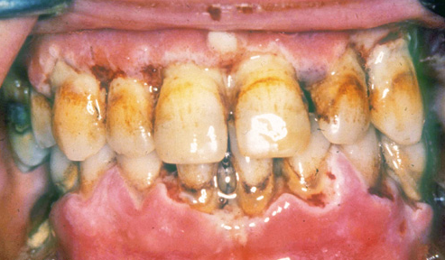

Slide 50
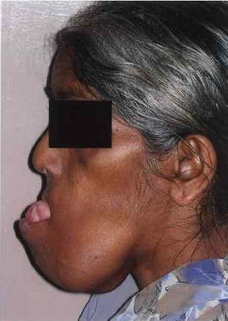
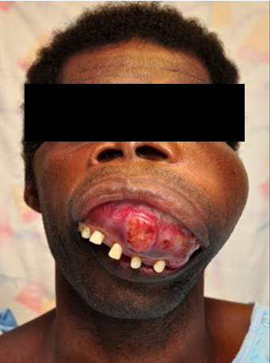

Slide 51
16) Nutrition
Nutritional problems in Eth. Include
1.macronutrient deficiency…protein energy malnutrition
2.miicronurient deficiency iron deficiency disorders, VitD deficiency (rickets) etc.

Slide 52
Two types of nutritional deficiency
Primary …inadequate protein calorie and nutrient intake.
Secondary…malnutrition following infections, injury, chronic disease, excessive nutrient loss due t diarrhoea, HIV, Malnutrition syndromes.
Marasmus and kwashiorkor
Malnutrition diseases characterized by wasting of muscle mass and depletion of body fa stores.
Treatment for severely affected children REMOSAL
Consists of modified ORS, glucose, Na, K, Mg, Z, and Cu
Commercially available
Notes:
Ravenously hungry

Slide 53
Millennium development goals
1.Eradicate extreme poverty and hunger
2.Promote gender equality
3.Achive universal primary education
4.Reduce child mortality
5.Improve maternal survival
6.Combat HIV, malaria and other diseases
7.Ensure environmental susceptibility
Develop a goal partnership for development

Slide 54
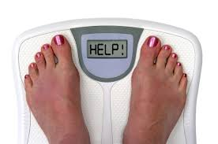
17) Obesity

Slide 55
obesity
Obesity is a chronic disease that is increasing in incidence.
It is called a disease because it is a causative factor for a whole lot of diseases including hypertension, diabetes mellitus, heart disease, dyslipidaemia, stroke, sleep apnoea...
The distinction between overweight and obesity is made on the basis of body mass index
Body weight ÷ (height in meters)2

Slide 56
Classification
Underweight BMI<18.5
Normal weight ,, 18.5-24.9
Overweight ,, 25.0-29.9
Obesity class I ,, 30.0-34.9
Obesity class II ,, 35.0-39.99
Obesity class III ,, >40
Notes:
Weight circumfrance also considered in women > 88cm and in men > 102cm

Slide 57
Etiology…sedentary life style, increased calorie intake, some medication like insulin, smoking cessation, although uncommon some obese patents have endocrine disorders such as Cushing syndromes.

Slide 58

Read…

Slide 59


