Slide 1
CHAPTER SEVEN
PSYCHOLOGICAL DISORDERS AND TREATMENT TECHNIQUES

Slide 2
Nature of Psychological Disorders
There are three main criteria for determining whether a person has a psychological disorder: abnormality, maladaptiveness, and personal distress.
1. Abnormality (What Is Normal? )
Abnormal behavior is a behavior that deviates from the behavior of the “typical” person or the norm.
A society’s norm can be qualitative and quantitative.
When someone’s behavior violates the norm, standards, rules & regulations of the society, it is more likely to be a psychological disorder.
The context in which “abnormal” behavior occurs must also be considered before deciding that it is symptomatic of psychological disorders.

Slide 3
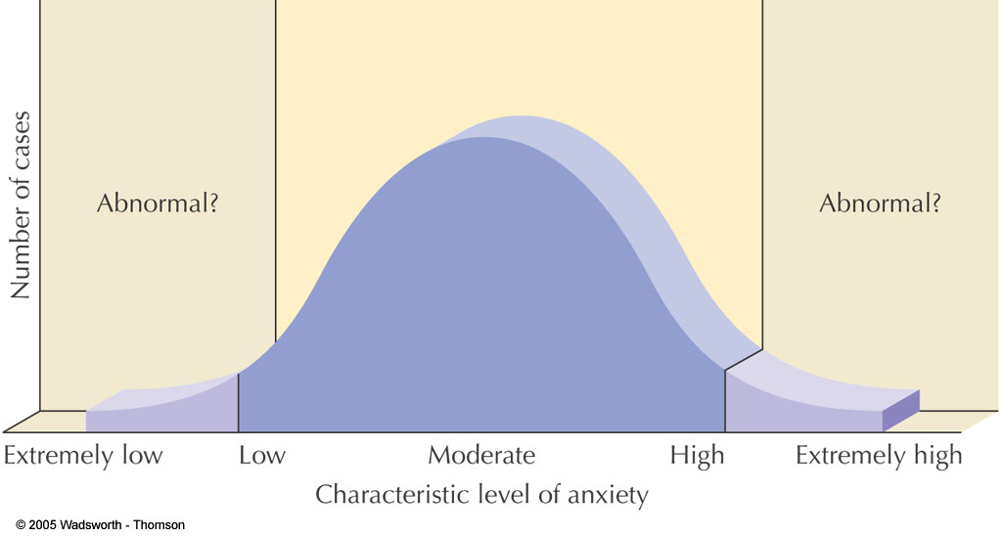
Statistical Abnormality: Having extreme scores on some dimension, such as intelligence, anxiety, or depression

Slide 4
2. Maladaptiveness
Maladaptive behavior creates a social, personal and occupational problem.
These behaviors seriously disrupt the day-to-day activities of individuals.
3. Personal Distress
Our subjective feelings of anxiety, stress, tension and other unpleasant emotions determine whether we have a psychological disorder.
But, the criterion of personal distress, is not sufficient for the presence of psychological disorder. Because some people’s feeling looks like distressed by its own.
Hence, behavior that is abnormal, maladaptive, and personally distressing might indicate that a person has a psychological disorder.

Slide 5
Psychological Disorders are also called mental illness, or mental health disorders, refers to a wide range of mental health disorders that affect your mood, thinking and behavior.
According to DSM-IV, a mental disorder is a clinically significant behavioral or psychological syndrome or pattern that occurs in an individual and that is associated with present distress or disability or with a significantly increased risk of suffering death, pain, disability or loss of freedom.
Diagnostic and Statistical Manual (DSM): is the primary set of rules used for diagnosing (labeling) psychological disorders.
DSM—Diagnostic & Statistical Manual of Mental Disorders -Published by American Psychiatric Association used by clinicians and researchers to diagnose and classify mental disorders

Slide 6
7.2. Causes of Psychological Disorders
Prehistoric times:
Abnormal behavior as demonic possession
Early societies viewed the human body and mind as a battleground between external forces of good and evil.
Abnormal behavior was typically interpreted as a victory by evil spirits and the cure for such behavior was to force the demons from a victim’s body. Example:
Trephination: is a kind of traditional surgery system where the persons digging out the skull of the victims so as to relies out the evil spirit from the head.

Slide 7
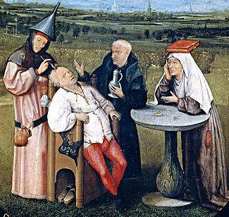
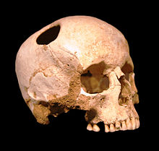
Trephination

Slide 8


Exorcism: this is a kind of praying by persons standing in front of the victim.

Slide 9
The emergence of the scientific model
Ancient Greece and Roma
Even though their theories now may seems strange, early Greek philosophers established the foundation for the systematic approach to psychological disorders.
Hippocrates (460-377 B.C) believed that, there were four important bodily fluids that influences physical and mental health. These are, black bile, yellow bile, phlegm, and blood.
An excess of any of these fluids could account for changes in an individual’s personality and behavior.

Slide 10
7.2. Causes of Psychological Disorders
(Based on Perspectives)
7.2.1 The Biological Perspective
Abnormalities in the work of neurotransmitter chemicals in the brain is found to contribute to many psychological disorders. E.g., over activity of the dopamine has been linked to the bizarre symptoms of schizophrenia
Biological causes also include genetic inheritance, medical conditions, brain damage, exposure to environmental stimuli, and hormonal imbalances etc.

Slide 11
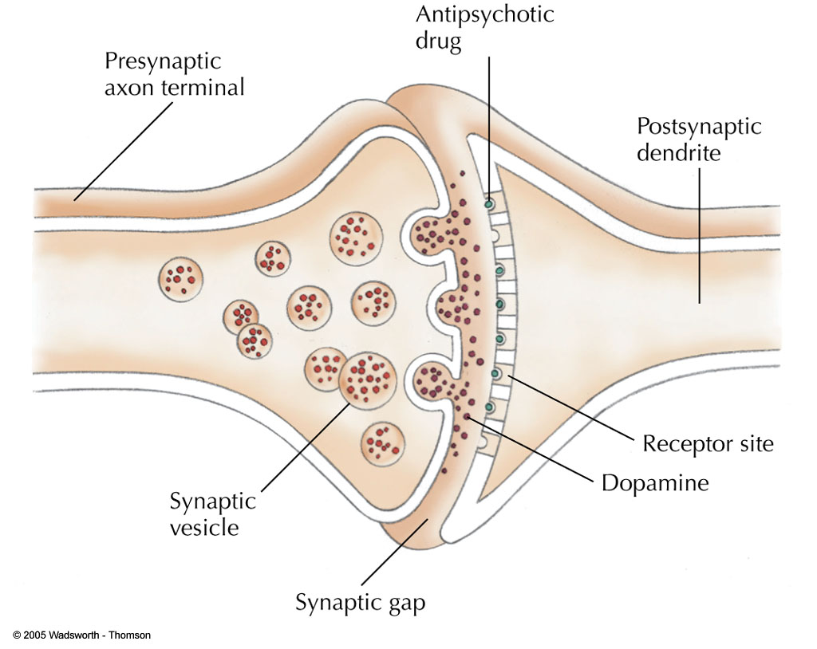
Figure 12.8
FIGURE 12.8 Dopamine normally crosses the synapse between two neurons, activating the second cell. Antipsychotic drugs bind to the same receptor sites as dopamine does, blocking its action. In people suffering from schizophrenia, a reduction in dopamine activity can quiet a person’s agitation and psychotic symptoms.

Slide 12
7.2.2 Psychological Perspectives
A. Psychodynamic theory of abnormality
All behavior, thoughts, and emotions, whether normal or abnormal are influenced to a large extent by unconscious process.
Behavior is affected by childhood experiences and particularly within the family
Abnormal behavior happens when the intra psychic conflicts are beyond the ego defense mechanism strategies. Behavior is the result of early fixations
B. Behavioral theory of abnormality
Abnormal behavior as the product of learning and association. Example: depression may in part due to extinction.

Slide 13
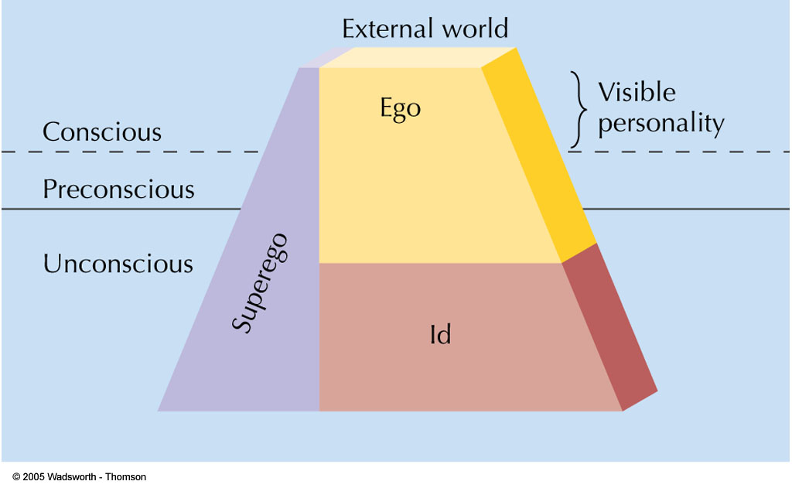
Figure 10.6
FIGURE 10.6 The approximate relationship between the id, ego, and superego, and the levels of awareness.

Slide 14
.
C. Humanistic theory of abnormality
Failure or challenges while some one strives to fulfill his/her potential
Incongruence between the real or actual and ideal self.
D. Cognitive theory of abnormality:
Traumatic life experiences and stressful life events
Distorted perceptions
Faulty way of thinking (irrational thinking)
Faulty way of information processing

Slide 15
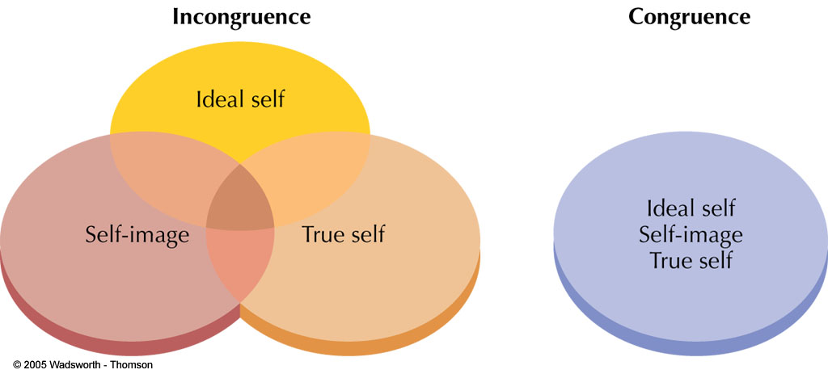
Other Theoretical Causes of Anxiety Disorders
Humanistic-Existential: Unrealistic self-image conflicts with true self

Slide 16
7.2.3 Socio-cultural perspective
Disturbance in intimate relationships or marital problems
Social Conditions: Poverty, homelessness, overcrowding, stressful living conditions
Family Factors: Parents who are immature, mentally ill, abusive, or criminal; poor child discipline
Problems in extended relationships
Political or social unrest
Discrimination towards one’s social group
Social labeling

Slide 17
7.3. Types of Psychological Disorders
A psychological disorder is a condition characterized by abnormal thoughts, feelings, and behaviors.
Psychopathology is the study of psychological disorders, including their symptoms, etiology (i.e., their causes), and treatment. The term psychopathology can also refer to the manifestation of a psychological disorder.

Slide 18
DSM-IV Classification of Major Types of Psychological Disorders
1. Anxiety disorders: Feelings of fear, apprehension, anxiety, and distorted behavior
2. Somatoform disorders: Complaints about physical symptoms, affecting different areas of the body with no physical cause
3. Mood(affective) disorders: Being dominated by emotional extremes
4. Dissociative disorders: Disturbances or changes in memory, consciousness, or identity
5. Personality disorders: When normal traits become extreme
6. Schizophrenia (the Most Severe Mental Illness): a group of psychological disorders characterized by hallucination and delusion, grossly impaired social, emotional, cognitive, perceptual functioning.
7. Sexual Dysfunctions and Deviations (paraphilia): trouble in engaging and enjoying sexual relationships
8. Eating disorders – Wrong eating pattern or behaviour
9. Substance use disorders – abuse and dependence

Slide 19
In this section we will try to see only mood disorder, anxiety disorder and personality disorder.
Mood Disorders
Mood disorders are characterized by a serious change in mood from depressed to elevated feelings causing disruption of life.
Depressive disorder is characterized by overall feelings of desperation and inactivity. Elevated moods are characterized by mania or hypomania. The cycling between both depressed and manic moods is characteristic of bipolar mood disorders.
If you have a mood disorder, your general emotional state or mood is distorted or inconsistent with your circumstances and interferes with your ability to function. You may be extremely sad, empty or irritable (depressed), or you may have periods of depression alternating with being excessively happy (mania)

Slide 20
.
The type of mood disorder include Major Depression, Dysthymic Disorder, Bipolar Disorder, and Cyclothymia.
1) Major Depression (also known as depression or clinical depression) is characterized by depressed mood, diminished interest in previously enjoyed activities, weight & sleep disturbance, loss of energy, difficulty concentrating, and often includes hopelessness and thoughts of suicide.
2) Dysthymia is often considered a lesser, but more persistent form of depression. Many of the symptoms are similar except to a lesser degree. Dysthymia is steadier rather than periods of normal feelings and extreme lows.
3) Bipolar Disorder (previously known as Manic-Depression) is characterized by periods of extreme highs (called mania) and extreme lows as in Major Depression.
4) Cyclothymia: Like Dysthymia and Major Depression, Cyclothymia is considered a lesser form of Bipolar Disorder.

Slide 21
2) Anxiety Disorders
Anxiety is a feelings of apprehension, dread, or uneasiness normal in reaction to stress and can be beneficial in some situations. It can alert us to dangers and help us prepare and pay attention.
Anxiety disorders differ from normal feelings of nervousness or anxiousness, and involve excessive fear or anxiety. Anxiety disorders are the most common of mental disorders and affect nearly 30 percent of adults at some point in their lives.
However, anxiety disorders are treatable and a number of effective
treatments are available. Treatment helps most people lead normal productive lives.
Anxiety disorders can cause people into trying to avoid situations that trigger or worsen their symptoms. Job performance, school work and personal relationships can be affected.
In general, for a person to be diagnosed with an anxiety disorder, the fear or anxiety must:
  Be out of proportion to the situation or age inappropriate
  Hinder your ability to function normally

Slide 22
.
Anxiety Disorders categorize a large number of disorders where the primary feature is abnormal or inappropriate anxiety. The disorders in this category include Panic Disorder, Agoraphobia, Specific Phobias, Social Phobia, Obsessive-Compulsive Disorder, Posttraumatic Stress Disorder, and Generalized Anxiety Disorder.
a) Panic Disorder ( may be with or without Agoraphobia): is a sudden state of anxiety for brief moments, intense, unexpected panic (panic attack) occur in the absence of actual danger. Panic attack includes feelings like one is having a heart attack, going to die, or is going insane.
b) Agoraphobia (fear of public places). It refers to a series of symptoms where the person fears, and often avoids, situations where escape or help might not be available, such as shopping centers, grocery stores, or other public place. Agoraphobia is often a part of panic disorder if the panic attacks are severe enough to result in an avoidance of these types of places.
c) Specific or Simple Phobia and Social Phobia represent an intense fear and often an avoidance of a specific situation, person, place, or thing. To be diagnosed with a phobia, the person must have suffered significant negative consequences because of this fear and it must be disruptive to their everyday life.

Slide 23
.
d) Obsessive-Compulsive Disorder (OCD) is characterized by obsessions (thoughts which seem uncontrollable) and compulsions (behaviors which act to reduce the obsession). Most people think of compulsive hand washers or people with an intense fear of dirt or of being infected. These obsessions and compulsions are disruptive to the person's everyday life, with sometimes hours being spent each day repeating things, which were already completed such as checking, counting, cleaning, or bathing.
e) Posttraumatic Stress Disorder (PTSD) occurs only after a person is exposed to a traumatic event such as war, natural disasters, major accidents, and severe child abuse. Once exposed to such incidents, the disorder develops into an intense fear of related situations, avoidance of these situations, reoccurring nightmares, flashbacks, and heightened anxiety to the point that it significantly disrupts their everyday life.
f) Generalized Anxiety Disorder is diagnosed when a person has extreme anxiety in nearly every part of their life. It is not associated with just open places (as in agoraphobia), specific situations (as in specific phobia), or a traumatic event (as in PTSD). The anxiety must be significant enough to disrupt the person's everyday life for a diagnosis to be made.

Slide 24
3) Personality Disorders
A personality disorder is a type of mental disorder in which you have a rigid and unhealthy pattern of thinking, functioning and behaving. A person with a personality disorder has trouble perceiving and relating to situations and people.
Personality Disorders are characterized by an enduring pattern of thinking, feeling, and behaving which is significantly different from the person's culture and results in negative consequences. This pattern must be longstanding and inflexible for a diagnosis to be made.
There are around nine types of personality disorders, all of which result in significant distress and/or negative consequences within the individual:
1) Paranoid (includes a pattern of distrust and suspiciousness).
2) Schizoid (pattern of detachment from social norms and a restriction
of emotions).
3) Schizotypal (pattern of discomfort in close relationships and
eccentric thoughts and behaviors).

Slide 25
4) Antisocial (pattern of disregard for the rights of others, lacks a conscience (superego) including violation of these rights and the failure to feel empathy), selfish, many are delinquents or criminals.
5) Borderline (pattern of instability in personal relationships, including frequent bouts of clinginess and affection and anger and resentment, often cycling between these two extremes rapidly).
6) Histrionic (pattern of excessive emotional behavior and attention seeking).
7) Narcissistic (pattern of grandiosity, exaggerated self-worth, and need for admiration).
8) Avoidant (pattern of feelings of social inadequacies, low self-esteem, and hypersensitivity to criticism).
9) Obsessive-Compulsive (pattern of obsessive cleanliness, perfection, and control).

Slide 26
7.4 Treatment Techniques
Treatment of mental illnesses can take various forms. They can include medication, talktherapy, a combination of both, and can last only one session or take many years to complete.
Many different types of treatment are available, but most agree that the core components of psychotherapy remain the same.
Psychotherapy consists of the following:
  A positive, healthy relationship between a client or patient and a trained psychotherapist
  Recognizable mental health issues, whether diagnosable or not
  Agreement on the basic goals of treatment
  Working together as a team to achieve these goals

Slide 27
Psychotherapy (treatments for disorders)
Providing psychological treatment to individuals with some kind of psychological problems is psychotherapy. When providing psychotherapy, there are several issues to be considered.
First and foremost is empathy. It is a requirement for a successful practitioner to be able to understand his or her client's feelings, thoughts, and behaviors.
Second, being nonjudgmental is vital if the relationship and treatment are going to work. Everybody makes mistakes, everybody does stuff they aren't proud of. If your therapist judges you, then you don't feel safe talking about similar issues again.
Therapists approach clients from slightly different angles, although the ultimate goal remains the same: to help the client reduce negative symptoms, gain insight into why these symptoms occurred and work through those issues, and reduce the emergence of the symptoms in the future.

Slide 28
Treatment (Psychotherapy) Approaches
Although, treatments for disorders vary according to the type, severity and nature of the disorder and clients’ condition generally treatments can be grouped in to two broad categories - biomedical and psychological treatments
Biomedical therapies
Refers Somatotherapy includes pharmacotherapy; biology-based treatments)
  Psychiatric medications (psychoactive drugs)
    Antianxiety drugs
    Antidepressant drugs
    Antipsychotic drugs
    Mood stabilizers
  Shock therapies such as Electroconvulsive therapy
  Psychosurgery such as Deep brain stimulation

Slide 29
B. Psychological approaches
    Include Cognitive, Behavioral, Psychodynamic, and Humanistic therapies.
Therapists who lean toward the cognitive branch will look at dysfunctions and difficulties as arising from irrational or faulty thinking. In other words, we perceive the world in a certain way (which may or may not be accurate) and this result in acting and feeling a certain way.
Those who follow more behavioral models look at problems as arising from our behaviors which we have learned to perform over years.
The dynamic or psychodynamic camp stem more from the teaching of Sigmund Freud and look more at issues beginning in early childhood which then motivate us as adults at an unconscious level.
Humanistic therapy: reject psychoanalytic and behavioral approaches; focus on the development of human potential, responsibility for oneself, unconditional positive regards, and trust in natural processes.
Cognitive approaches appear to work better with most types of depression, and behavioral treatments tend to work better with phobias.
Most mental health professionals nowadays follow biopsycho-social or eclectic approach in how to treat people using different approaches.
These professionals are sometimes referred to as integrationists.

Slide 30
Treatment Modalities
Therapy is most often thought of as a one-on-one relationship between a client or patient and a therapist. This is probably the most common example, but therapy can also take different forms.
Often time‘s group therapy is utilized, where individuals suffering from similar illnesses or having similar issues meet together with one or two therapists. Group sizes differ, ranging from three or four to upwards of 15 or 20, but the goals remain the same.
The power of group is due to the need in all of us to belong, feel understood, and know that there is hope. All of these things make group as powerful as it is. Imagine feeling alone, scared, misunderstood, unsupported, and unsure of the future; then imagine entering a group of people with similar issues who have demonstrated success, who can understand the feelings you have, who support and encourage you, and who accept you as an important part of the group.
It can be overwhelming in a very positive way and continues to be the second most utilized treatment after individual therapy.

Slide 31
Therapy can also take place in smaller groups consisting of a couple or a family. In this type of treatment, the issues to be worked on are centered around the relationship.
There is often an educational component, like other forms of therapy, such as communication training, and
couples and families are encouraged to work together as a team rather than against each other.
The therapist's job is to facilitate healthy interaction, encourage the couple or family to gain insight into their own behaviors, and to teach the members to listen to and respect each other.
Sometimes therapy can include more than one treatment modality.

Slide 32
.
For the individual who suffers from depression, social anxiety, and low self-esteem, individual therapy may be used to reduce depressive symptoms, work some on selfesteem and therefore reduce fears about social situations.
Once successfully completed, this person may be transferred to a group therapy setting where he or she can practice social
skills, feel a part of a supportive group, therefore improving self-esteem and further reducing depression.
The treatment approach and modality are always considered, along with many other factors, in order to provide the best possible treatment for any particular person.
Sometimes more than one is used, sometimes a combination of many of them, but together the goal remains to improve the life of the client.

