Slide 1
COURSE TITLE:- INCLUSIVENESS
COURSE CODE:- SNIE1012
INSTRUCTOR:- Temesgen M.

Slide 2
Chapter 1: Understanding Disabilities and Vulnerabilities
Definitions of Basic Terms (Impairment, Disability and Handicap)
Impairment:- Impairment means a lack/abnormality of an anatomic, physiological or psychological structure or function or deviation on a person.
It refers to any loss or abnormality of physiological, psychological or anatomical structure or function.
It is the absence of particular body part or organ.
AKAL-GUDATENGA

Slide 3
Disability:- The term disability is ambiguous as there is no single agreement on the concept (Mitra, 2006). It is not synonymous with AKAL-GUDATENGA
The full inclusion of people with impairments in society can be inhibited by:
  Attitudinal (societal barriers, such as stigma)
  Physical barriers (environmental barriers, such as absence of stairs), and
  Policy barriers (systemic barriers)
Where all together can create a disabling effect and inhibit disability inclusive development. Societal, environmental, and systemic barriers are the most popular disabling factors

Slide 4
What is disability?
Models of disability
Traditional model
Medical model
Social model
Bio psychosocial Model

Slide 5
1.TRADITIONAL MODEL OF DISABILITY
Traditionally, in many cultures around the world people with physical, sensory or mental impairments were being punished by God for wrong doing by themselves or their parents.
Disabilities as:
  - Will of God/test from God
  - Divine punishment
  Based on culturally and religiously-determined fixed knowledge, views, and practices.

Slide 6
1. Traditional Model
PWD were considered as
Dependent
Subject to charity
Unable to work & to learn
Based on Religion & Culture in a Society
Remain Hidden Behind the Homes
Sign of Shame

Slide 7

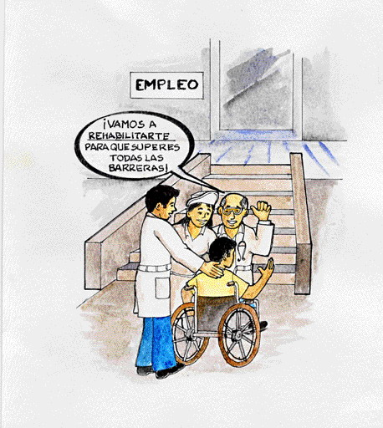
Problem belongs to individual: Disability results directly from
impairment of the person.
We will rehabilitate
you so you can overcome all barriers
Disability considered only a health problem, medical issue
Solutions decided by "experts”, based on diagnosis
Focus in elimination or cure of disability, “normalization”
(includes pre-natal genetic testing & selective abortion)
EMPLOYMENT
Notes:
7

Slide 8
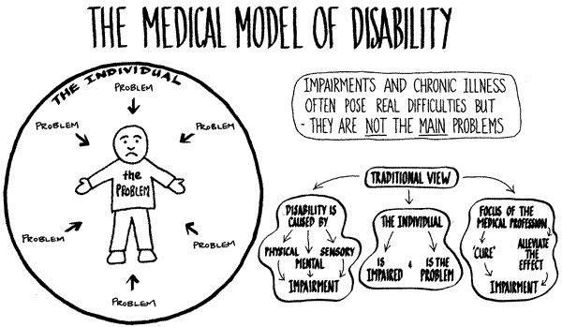
Brought the emergence of SPECIAL EDUCATION

Slide 9
3. THE SOCIAL MODEL
The social model of disability says that disability is caused by the way society is organised, rather than by someone's impairment.
The Social Model views disability as a consequence of environmental, social and attitudinal barriers that prevent people with impairments from maximum participation in society.
“the loss or limitation of opportunities to take part in the normal life of the community on an equal level with others, due to physical or social barriers’’
The social model of disability focuses on changes required in society.

Slide 10
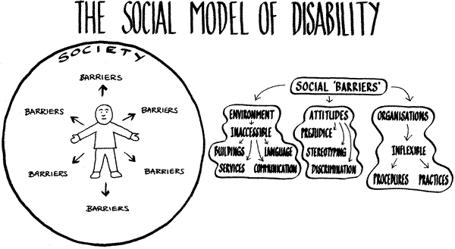
The social model

Slide 11
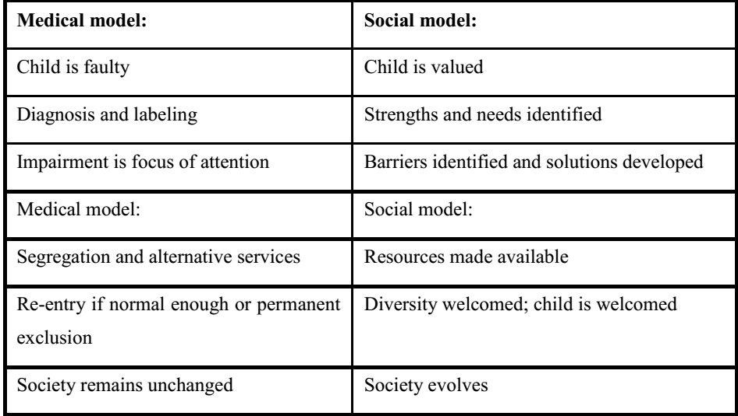

Slide 12
Handicap
It is a disadvantage for a given individual, resulting from an impairment or disability that limits/ prevents the fulfillment of a role that is considered as normal depending on age, sex, and social and cultural factors.
It is a limitation of opportunities to take part in life of the community.

Slide 13
... Contn’d
Handicap Refers to social abilities or relation between the individual and the society
It describes the encounter between the person with disability and the environment.
Handicapism is a social and environmental construct
Here we have to understand that disability/impairment /is the necessary but not sufficient condition to result handicapism
E.g. from Education, employment, participation in community activities…

Slide 14
The Relationship Among The Three
The interrelationship among the three terms are illustrated in the following figure.
When someone is:
Short sighted Difficulty in seeing is
Inability to read due
to Lack of eye glasses
Impairment
Disability
Handicap

Slide 15
Practical example
Example: TT is a 9 year old who has a cerbral palsy (CP) called Spastic diplegia. His CP causes his leg to be stiff and difficult to move he can not stand or walk.
Impairment: joint problems, muscle contraction, poor brain and muscle coordination, inability to bear weight on the feet
Disability :inability to walk
Handicap : his role in school, community, sport
However, with appropriate services and support he can reduce the extent CP affect his life

Slide 16
Causes of disability
What are the wrong perception regarding the causes of disability in your community?
Some people, especially in the past times, wrongly believe that disability is a punishment from God.
There are some who still believe that disability is a form of personal punishment for individual with disability, a kind of karma for their past mistakes, which is totally unacceptable now days.

Slide 17
Causes of disability
Biological Causes
Abnormalities in genes and genetic inheritance can cause intellectual disability in children.
In some countries, Down syndrome is the most common genetic condition.
Sometimes, diseases, illnesses, and over-exposure to x-rays can cause a genetic disorder.
chemical imbalances, bacteria, viruses and genetic predisposition

Slide 18
Causes of disability... Contn’d
Environmental factors
Poverty and malnutrition in pregnant mothers can cause a deficiency in vital minerals and result in deformation issues in the unborn child.
The use of drugs, alcohol, tobacco, the exposure to certain toxic chemicals and illnesses, toxoplasmosis, cytomegalovirus, rubella and syphilis by a pregnant mother can cause intellectual disability to the child.
Childhood diseases such as a whooping cough, measles, and chicken pox may lead to meningitis and encephalitis.

Slide 19
Modern approaches
Biopsychosocial model of health and illness
Move away from a simple linear model of health and claims that illness can be caused by a combination of biological, psychological and social factors.
The Biological factors are stated before.
the psycho aspects of health and illness include:
cognitions (e.g. expectations of health),
emotions (e.g. fear of treatment) and
behaviors (e.g. smoking, diet, exercise or alcohol consumption);

Slide 20
the social aspects of health includes:
social norms of behaviour (e.g. the social norm of being physically impaired
pressures to change behaviour (e.g. peer group expectations, parental pressure),
social class and ethnicity.

Slide 21
Inaccessible environments
Sometimes society makes it difficult for people with some impairment to function freely.
When society develops infrastructure such as houses, roads, parks and other public places without consideration to people with impairment, the basically make it impossible for them to take care of themselves.
For example, if a school is built with a ramp in addition to stairs, it makes it easy for people with wheelchairs to move about freely. This way, their impairment is not made worse.
Lack of education, support services, health and opportunities for people with impairment can cause additional disability to people with disabilities and even people with no disability.
Societal, environmental, and systemic barriers are the most popular disabling factors:
  A disabled persons,
  Persons with disability

Slide 22
Type Of Disabilities
1. Visual impairment:- in general designates two sub- classifications. These are blindness and low vision.
Blindness:- total or partial inability to see because of disease or disorder of the eye, optic nerve, or brain
not correctable with eyeglasses or contact lenses.
Low vision:- The term low vision is used for moderately impaired vision. People with low vision may have a visual impairment that affects only central vision-the area directly in front of the eyes-or peripheral vision-the area to either side of and slightly behind the eyes.

Slide 23
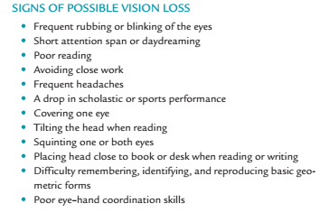

Slide 24
2. Hearing Impairment
Hearing impairment is a generic term indicating a continuum of hearing loss from mild to profound, which includes the sub-classifications of the hard of hearing and deaf.
Hard of Hearing: This term is used to describe persons with enough (usually with hearing aids) as a primary modality of acquisition of language and in communication with others.
Deaf: Those who have difficulty understanding speech, even with hearing aids but can successfully communicate in sign language.

Slide 25

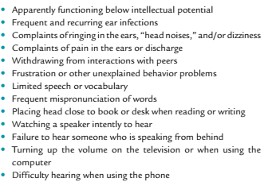

Slide 26
3. Specific learning disability
Specific Learning Disability means a disorder in one or more of the basic psychological processes involved in understanding or in using language, spoken or written, that may manifest itself in the imperfect ability to listen, think, speak, read, write, spell, or to do mathematical calculations.
The term does not include learning problems that are primarily the result of visual, hearing, or motor disabilities; of intellectual disability; of emotional disturbance; or of environmental, cultural, or economic disadvantage.
Learning disabilities should not be confused with learning problems which are primarily the result of visual, hearing, or motor handicaps; of intellectual disability; of emotional disturbance; or of environmental, cultural or economic disadvantages

Slide 27
Types of Specific Learning Disabilities
Auditory Processing Disorder (APD)
Also known as Central Auditory Processing Disorder, this is a condition that adversely affects how sound that travels unimpeded through the ear is processed or interpreted by the brain.
Individuals with APD do not recognize subtle differences between sounds in words, even when the sounds are loud and clear enough to be heard.
They can also find it difficult to tell where sounds are coming from, to make sense of the order of sounds, or to block out competing background noises.

Slide 28
Types of Specific Learning Disabilities
A. Dyscalculia
Dyscalculia is a specific learning disability that affects a person‘s ability to understand numbers and learn math.
Individuals with this type of LD may also have poor comprehension of math symbols, may struggle with memorizing and organizing numbers, have difficulty telling time, or have trouble with counting
B. Dysgraphia:- is a specific learning disability that affect person's handwriting ability and fine motor skills. Problems may include illegible handwriting, inconsistent spacing, poor partial planning on paper, poor spelling, and difficulty composing writing as well as thinking and writing at the same time.

Slide 29
Types of SLD ... Contn’d
C. Dyslexia:- is a specific learning disability that affects reading and related language-based processing skills.
The severity can differ in each individual but can affect
  reading fluency;
  decoding,
  reading comprehension,
  recall, writing, spelling, and
  sometimes speech and can exist along with other related disorders.
Dyslexia is sometimes referred to as a Language-Based Learning Disability.

Slide 30
Types of SLD ... Contn’d
D. Language Processing Disorder:- is a specific type of Auditory Processing Disorder (APD) in which there is difficulty attaching meaning to sound groups that form words, sentences and stories.
While an APD affects the interpretation of all sounds coming into the brain, a Language Processing Disorder (LPD) relates only to the processing of language. LPD can affect expressive language and/or receptive language
E. Non-Verbal Learning Disabilities:-is a disorder which is usually characterized by a significant discrepancy between higher verbal skills and weaker motor, visual-spatial and social skills.

Slide 31
Types of SLD ... Contn’d
F. Visual Perceptual/Visual Motor Deficit:-
It is a disorder that affects the understanding of information that a person sees, or the ability to draw or copy.
A characteristic seen in people with learning disabilities such as Dysgraphia or Non-verbal LD, it can result in missing subtle differences in shapes or printed letters, losing place frequently, struggles with cutting, holding pencil too tightly, or poor eye/hand coordination.

Slide 32
4. Speech and Language Impairments
Speech and language impairment means a communication disorder such as stuttering, impaired articulation, language impairment, or a voice impairment that adversely affects a child‘s educational performance.
It is disorder that adversely affects the child's ability to talk, understand, read, and write.
This disability category can be divided into two groups:
    speech impairments and
    language impairments.

Slide 33
Speech Impairments
Speech Impairments:- There are three basic types of speech impairments: articulation disorders, fluency disorders, and voice disorders
Articulation disorders are errors in the production of speech sounds that may be related to anatomical or physiological limitations in the skeletal, muscular, or neuromuscular support for speech production. These disorders include:
  Omissions: (bo for boat)
  Substitutions: (wabbit for rabbit)
  Distortions: (shlip for sip)
Fluency disorders are difficulties with the rhythm and timing of speech characterized by hesitations, repetitions, or prolongations of sounds, syllables, words, or phrases. Common fluency disorders include:
  Stuttering: rapid-fire repetitions of consonant or vowel sounds especially at the beginning of words, prolongations, hesitations, interjections, and complete verbal blocks
  Cluttering: excessively fast and jerky speech

Slide 34
Speech Impairments... Contn’d
Voice disorders are problems with the quality or use of one's voice resulting from disorders in the larynx.
Voice disorders are characterized by abnormal production and/or absences of ;
          vocal quality,
          pitch,
          loudness,
          resonance, and/or duration.

Slide 35
Language Impairments
There are five basic areas of language impairments: phonological disorders, morphological disorders, semantic disorders, syntactical deficits, and pragmatic difficulties.
phonological disorders:- abnormal organization of the phonological system, or a significant deficit in speech production or perception
Morphological disorders are defined as difficulties with morphological(pluraliztion) inflections (inflections on nouns, verbs, and adjectives that signal different kinds of meanings).
Semantic disorders are characterized by poor vocabulary development, inappropriate use of word meanings, and/or inability to comprehend word meanings.
Syntactic deficits are characterized by difficulty in acquiring the rules that govern word order and others aspects of grammar such as subject-verb agreement.
Pragmatic difficulties are characterized as problems in understanding and using language in different social contexts. These students may lack an understanding of the rules for making eye contact, respecting personal space, requesting information, and introducing topics.

Slide 36
5.Autism
Autism is a developmental disability significantly affecting verbal and nonverbal communication and social interaction, generally evident before age three that adversely affects a child‘s educational performance
Other characteristics often associated with autism are engaging in repetitive activities and stereotyped movements, resistance to environmental change or change in daily routines, and unusual responses to sensory experiences
Autism is a neurodevelopment disorder defined by impairments in social and communication development, accompanied by stereotyped patterns of behavior and interest.
impairments in the production of speech (i) personal pronouns the use of ―I instead of ―you and vice-versa,
(ii) the misuse of such prepositions as ―in, ―on, ―under, ―next to
(iii) repetition of others speech echolalia formal repetition of other‘s utterances

Slide 37
6. Emotional and Behavioral Disorders
According to Individuals with Disabilities Education Act (IDEA), the term Emotional and Behavioural Disorders means a condition exhibiting one or more of the following characteristics over a long period of time and to a marked degree that adversely affects educational performance.
An inability to learn that cannot be explained by intellectual, sensory, or health factors;
An inability to build or maintain satisfactory interpersonal relationships with peers and teachers;
Inappropriate types of behaviour or feelings under normal circumstances;
A general pervasive mood of unhappiness or depression; or
A tendency to develop physical symptoms or fears associated with personal or school problems.

Slide 38
Classification of behavioral and emotional disorders
An individual having behavioural or emotional disorders can exhibit widely varied types of behaviour. These include:
Conduct disorder: individuals may seek attention, are disruptive and act out. The disorder is classified by type: overt (with violence or tantrums) versus covert (with lying, stealing, and/or drug use).
Socialized aggression: individuals join subculture group of peers who are openly disrespectful to their peers, teachers, and parents. Common are delinquency and dropping out of school.
  Early symptoms include stealing, running away from home, habitual lying, cruelty to animals, and fire setting.

Slide 39
Classification of EBD ... Contn’d
Attention problems- These individuals may have attention deficit, are easily destructible and have poor concentration. They are frequently impulsive and may not think the consequence of their actions.
Anxiety/Withdrawn- These individuals are self-conscious, reserved, and unsure of themselves. They typically have low self-esteem and withdraw from immediate activities. They are also anxious and frequently depressed.
Psychotic behaviour: These individuals show more bizarre behaviour. They may hallucinate, deal in a fantasy world and may even talk in gibberish.
Motor excess: These students are hyperactive. They cannot sit nor listen to others nor keep their attention focused.

Slide 40
Classification of EBD ... Contn’d
Kauffman (1993) conclude that emotion or behavioural disorders fall into two broad classifications:
Externalizing Behaviour: also called under controlled disorder, include such problems disobedience, disruptiveness, fighting, tempers tantrums, irresponsibility, jealous, anger, attention seeking etc…
Internalizing Behaviour: also known as over controlled disorders, include such problems anxiety, immaturity, shyness, social withdrawal, feeling of inadequacy (inferiority), guilt, depression and worries a great deal

Slide 41
Causes of behavioral and emotional disorders
Behavioral and emotion disorders result from many causes, these includes the following.
Biological- includes genetic disorders, brain damage, and malnutrition, allergies, temperament and damage to the central nervous system.
Family factors- include family interactions, family influence, child abuse, neglect, and poor disciplinary practices at home.
Cultural factors- include some traditional and cultural negative practices, for example watching violence and sexually oriented movies and TV programs.
Environmental factors- include peer pressure, living in impoverished areas, and schooling practices that are unresponsive to individual needs.

Slide 42
7. Intellectual Disability
It is a disability characterized by significant limitations in both intellectual functioning and in adaptive behavior, which covers many everyday social and practical skills. This disability originates before the age of 18. An individual is considered to have an intellectual disability based on the following three criteria:
1. Sub average intellectual functioning: It refers to general mental capacity, such as learning, reasoning, problem solving, and so on. One way to measure intellectual functioning is an IQ test. Generally, an IQ test score of around 70 or as high as 75 indicates a limitation in intellectual functioning.
2. Significant limitations exist in two or more adaptive skill areas: It is the collection of conceptual, social, and practical skills that are learned and performed by people in their everyday lives.
  Conceptual skills—language and literacy; money, time, and number concepts; and self-direction.

Slide 43
Intellectual Disability ...contn’d
Social skills—interpersonal skills, social responsibility, self-esteem, gullibility, innocence (i.e., suspicion), social problem solving, and the ability to follow rules/obey laws and to avoid being victimized.
Practical skills—activities of daily living (personal care), occupational skills, healthcare, travel/transportation, schedules/routines, safety, use of money, use of the telephone.
3. People with intellectual disabilities academic learning can be affected, as well as their ability to adapt to home, school, and community environments are presented under the following sub-headings:
General Cognition: People with intellectual disabilities vary physically and emotionally, as well as by personality, disposition, and beliefs.
Learning and Memory: The learning and memory capabilities of people with intellectual disabilities are significantly below average in comparison to peers without disabilities.

Slide 44
Intellectual Disability ...contn’d
Attention: To acquire information, children must attend to the learning task for the required length of time and control distractions. Children with intellectual disabilities may have difficulty distinguishing and attending to relevant questions in both learning and social situations
Adaptive Skills :- The adaptive skills of people with intellectual disabilities are often not comparable to those of their peers without disabilities. A child with intellectual disabilities may have difficulty in both learning and applying skills for a number of reasons, including a higher level of distractibility, inattentiveness, failure to read social cues, and impulsive behavior
Speech and Language: People with intellectual disabilities may have delayed speech, language comprehension and formulation difficulties.

Slide 45
Intellectual Disability ...contn’d
Motivation: People with intellectual disabilities are often described as lacking motivation, or outer-directed behavior. Past experiences of failure and the anxiety generated by those failures may make them appear to be fewer goals directed and lacking in motivation.
Academic Achievement: The cognitive difficulties of children with mild to moderate intellectual disabilities lead to persistent problems in academic achievement unless intensive and extensive supports are provided.
Physical characteristics: Children with intellectual disabilities with differing biological etiologies, may exhibit coexisting problems, such as physical, motor, orthopedic, visual and auditory impairments, and health problems.

Slide 46
Levels of support for individuals with intellectual disabilities
IQ= MA/CA*100
Level of Mental Retardation |  | Level of IQ | Level of support
SNE professionals | Types
1. Educable | 1. Mild mental retardation | 50 to 75 | Intermittent
2. Trainable | 2. Moderate | 35 to 49 | Limited
 | 3. Severe | 20 to 34 | Extensive
3. Custodial | 4. Profound | Below 20 | Pervasive

Slide 47
8.Physical disability/Orthopedic Impairment and Health impairment
is a condition that interferes body.
Physically disabling conditions that affect locomotion or motor functions
Many but not all, physical disabilities are orthopedic impairments. (The term orthopedic impairment generally refers to conditions of muscular or skeletal system and sometimes to physical disabling conditions of the nervous system).
It is a condition that requires ongoing medical attention. It includes asthma, heart defects, cancer, diabetes, hemophilia. HIV/AIDS, etc

Slide 48
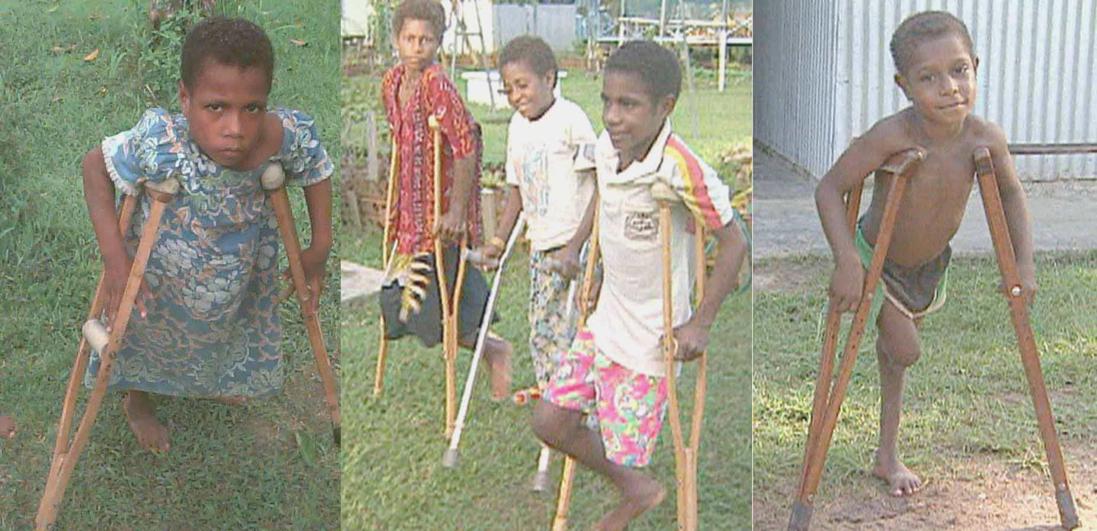
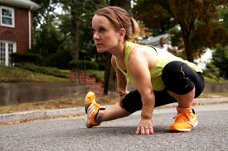
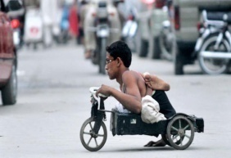
8. Physical disability/Orthopedic Impairment and Health impairment

Slide 49
Classification and Characteristics
based on the impact of physical disability, on mobility and motor skills, it is divided into three.
Mild physical disability:- these individuals are able to walk without aids and may make normal developmental progress.
Moderate physical disability:- individuals can walk with braces and crutches and may have difficulty with fine-motor skills and speech production.
Severe physical disability:-these are individuals who are wheel-chair dependent and may need special help to achieve regular development.
The physical disability could be broadly classified in to two
The neurological system (the brain ,spinal cord & nerve) related problems.
Musculo skeletal system ( the muscles, bones and joints) are deficient due to
various causes.

Slide 50
… contn’d
Neurological system:-with a neurological condition like cerebral palsy or a traumatic brain injury, the brain either sends the wrong instructions or interprets feedback incorrectly. In both cases, the result is poorly coordinated movement.
problems that can be associated with cerebral palsy include learning disabilities, mental retardation. Seizures, speech impairments, eating problems, sensory impairments, and joint and bone deformities such as spinal curvatures and contractures (permanently fixed, tight muscles and joints).
Epilepsy:-is disorder that occurs when the brain cells are not working properly and is often called a seizure disorder
It is characterized by recurring seizures, which are spontaneous abnormal discharge of electrical impulses of the brain.

Slide 51
… contn’d
Spinal bifida and spinal cord injury:- damage to the spinal cord leads to paralysis and loss of sensation in the affected areas of the body.
The spinal bifida is a birth defect of the backbone (spinal column). The cause is unknown but it usually occurs in the first twenty-six days of pregnancy

Slide 52
… contn’d
II. Musculoskeletal system
it includes the muscles and their supporting framework and the skeleton. It includes:-
Progressive muscle weakness (muscular dystrophy); Inflammation of the joints (arthritis), or Loss of various parts of the body (amputation
The list of the impairment and associated with musculoskeletal malformation are the following:
Muscular dystrophy:- is an inherited condition accruing mainly in males, in which the muscles weaken and deteriorate.
Arthritis:-is an inflammation of the joints. Symptoms include swollen and stiff joints, fever, and pain in the joints during acute periods

Slide 53
… contn’d
Amputation:- a small number of children have missing limbs because of congenital abnormalities or injury or disease (malignant bone tumors in the limbs).
Other muscle-skeletal disorders are:-
Marfan syndrome is a genetic disorder in which the muscles are poorly developed and the spine is curved. Individuals with marfan syndrome may have either long, thin limbs, prominent shoulder blades, spinal curvature, flat feet, or long fingers & thumbs. The heart and blood vessels are usually affected. The greatest danger is damage to aorta, which can lead to heart failure. Need to avoid heavy exercise and lifting heavy objects
Achondroplasis:- is a genetic disorder that affects 1 in 10,000 births. Children with this disorder usually develop a normal torso but have a straight upper back and a curved lower back (sway back). The disability may be lessened through the use of the back braces or by surgery.
Polio:- is viral disease that invade the brain and cause severe paralysis of the total body system

Slide 54
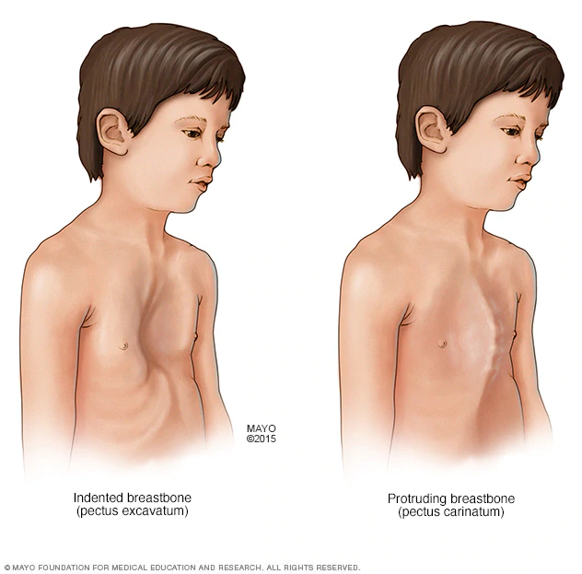
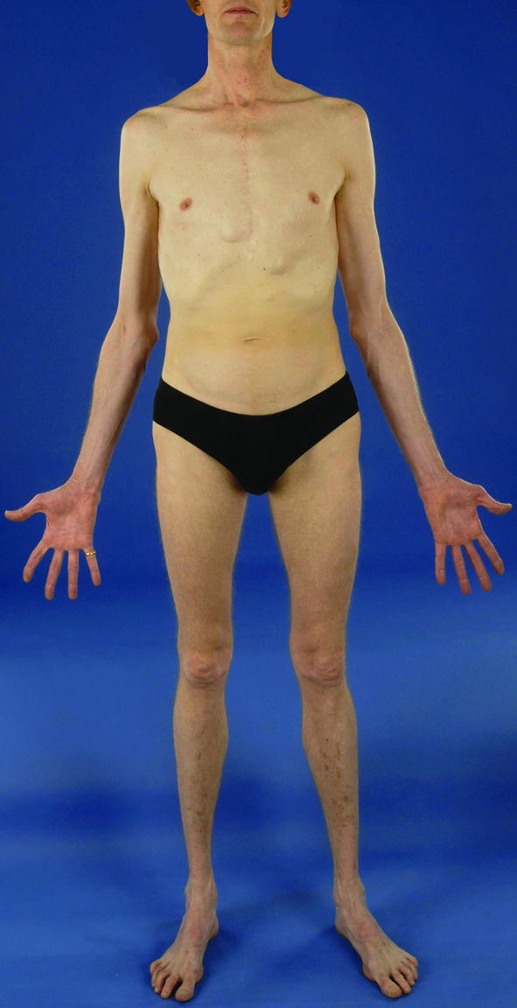
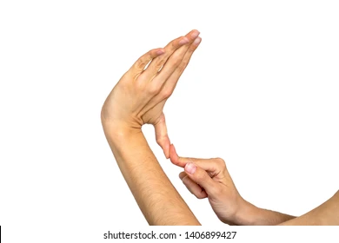
Marfan syndrome

Slide 55
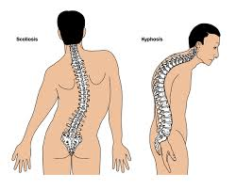
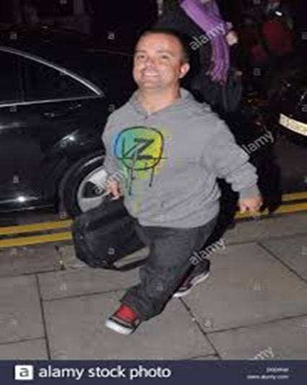
Achondroplasis:

Slide 56
… contn’d
Club foot:- is a major orthopedic problem affecting about 9,000 infants each year. This term is used to describe various ankle or foot deformities.
Twisting inward (equino varus), the most severe form
Sharply angled at the heel (calcanel vaigus), most common
The front part of the foot turned inward.
Cleft lip and cleft palate:- are openings in the lip or roof of the mouth, respectively, that fail to close before birth, the cause is unknown. Most cleft problems can be repaired through surgery

Slide 57
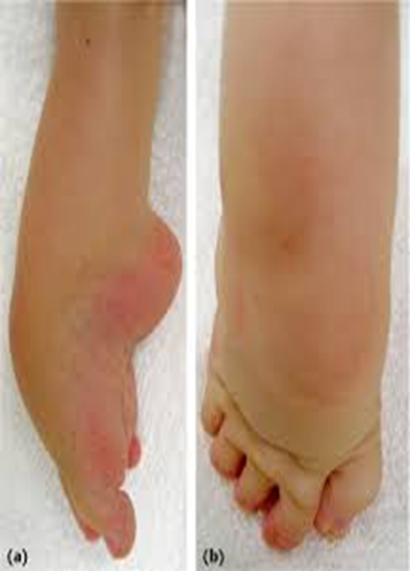
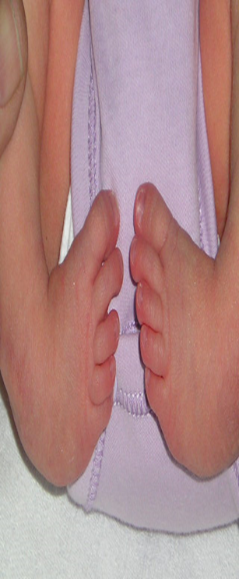
Club foot

Slide 58
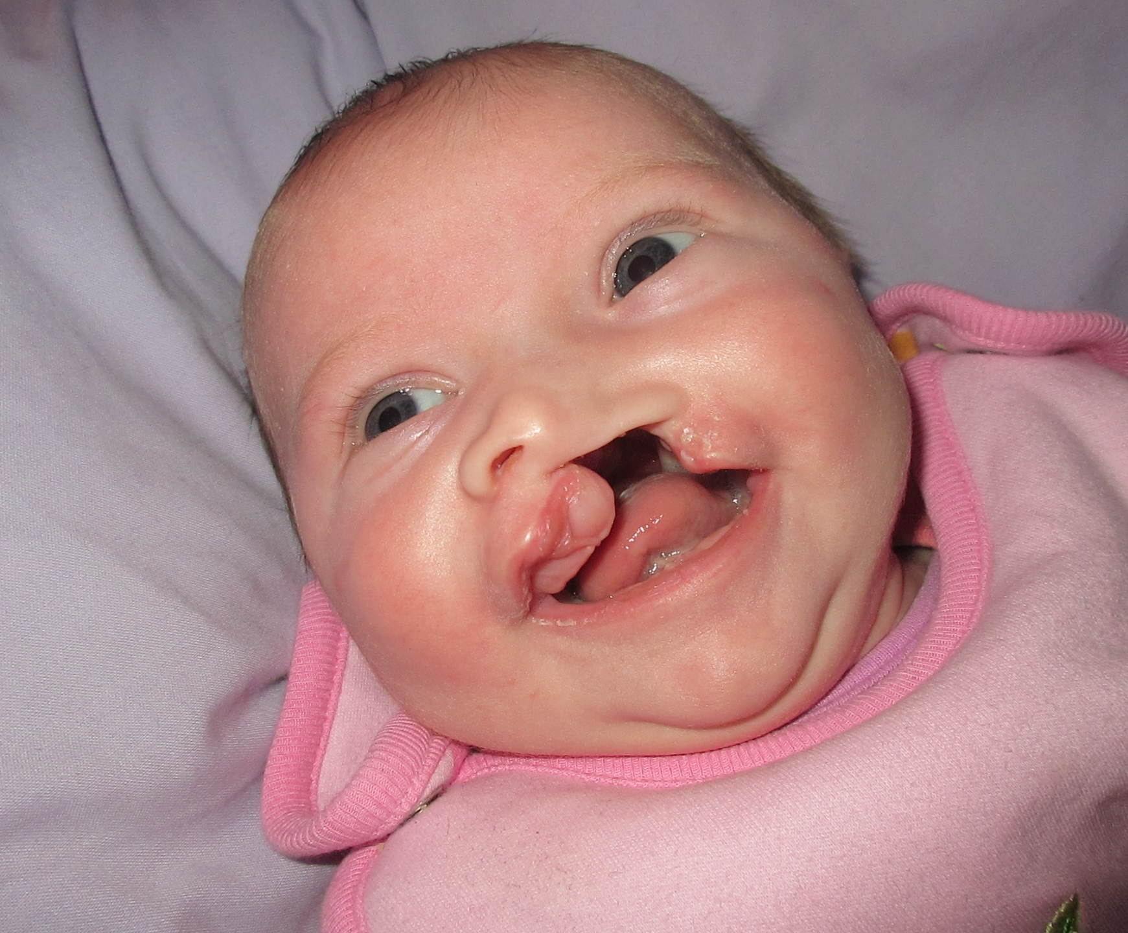
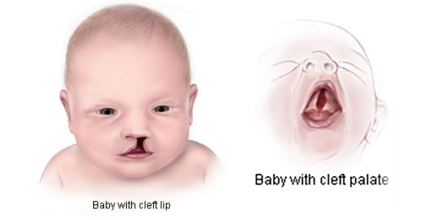
Cleft lip and cleft palate

Slide 59
Health Impairments
Heart disease:- It is caused by improper circulation of blood by the heart some of the disorders are congenital
Cystic fibrosis:- is a hereditary disease that affects the lungs and pancreas. It leads to recurrent respiratory and digestive problems including abnormal amounts of thick mucus, sweet and saliv
Acquired immune deficiency syndrome (AIDS):- is a very severe disease caused by human immunodeficiency virus (HIV) infection
  Hemophilia:- is a hereditary disease in which the blood clots very slowly or not all. The disorder is transmitted by sex-linked recessive gene and nearly always occurs in males.

Slide 60
Health Impairments … contn’d
  Asthma: is a chronic respiratory condition characterized by repeated eplosde of breathing difficulties especially while exhaling.
  Diabetes: Developmental or hereditary disorder characterized by inadequate secretion or use of insulin
Nephrosis & Nephritis Kidney disorders or diseases caused by infections, poisoning, burns, accidents or other diseases
Sickle-cell anemia Hereditary and chronic blood disease (occurring primarily in African Americans) characterized by red blood cells that are distorted and that do not circulate properly
Leukemia: Disease characterized by excessive production of white blood Cells

Slide 61
Health Impairments … contn’d
Lead poisoning Disorder caused by ingesting lead-based paint chips or other substances containing lead
Rheumatic fever Disease characterized by painful swelling and inflammation of the joints that can spread to the hear and central nervous system
Tuberculosis Infectious disease that commonly affects the lungs and may affect other tissues of the body.
Cancer Abnormal growth of cells that can affect any organ system

Slide 62
9. Vulnerability
Vulnerable means being at risk of being harmed. Characterized as;
Economic difficulties/lack of financial resources: poverty, low living standards, housing problems (e.g. too damp, too expensive, too cold or difficult to heat)
Social exclusion: limited access to facilities such as transportation, schools, libraries or medical services
Lack of social support from social networks: no assistance from family members, friends, neighbors or colleagues
Stigmatization: being a victim of stereotypes, being devalued, confronted with disgraceful behavior because of belonging to a particular social or ethnic group
Health difficulties: disadvantages resulting from poor mental health, physical health or disabilities

Slide 63
Causes of Vulnerability
may be causes by rapid population growth, poverty and hunger, poor health, low levels of education, gender inequality, fragile and hazardous location, and lack of access to resources and services, including knowledge and technological means, disintegration of social patterns (social vulnerability).
political vulnerability
economic vulnerability
Environmental vulnerability

Slide 64
Characteristics of Vulnerable People
Less physically or mentally capable (infants, older adults, people with disabilities)
Fewer material and/or financial resources (low-income households, homeless)
Less knowledge or experience (children, illiterate, foreigners, tourists)
Restricted by society to grow and develop according to their needs and potentials

Slide 65
CHAPTER 2: CONCEPT OF INCLUSION
Inclusion in education/service refers to an ongoing process education/services for all while respecting diversity and the different needs and abilities, characteristics and learning expectations of the students and communities and eliminating all forms of discrimination.
This definition has the following components:
Concepts about learners
Concepts about the education system and schools
Concepts about processes to promote inclusion
Concepts about resources

Slide 66
2.1. Definition of Inclusion
an ongoing process aimed at offering quality education/services for all.
process of addressing and responding to the diversity of needs of all
changes and modifications in content, approaches, structures and strategies covers all
wide range of strategies, activities and processes that seek to make a reality of the universal right to quality, relevant and appropriate education and services to all
acknowledges that learning begins at birth and continues throughout life
enable communities, systems and structures in all cultures and contexts to combat discrimination, and celebrate diversity
It is part of a wider strategy promoting inclusive development
Its goal is to creating a world where there is peace, tolerance, and sustainable use of resources, social justice, and where the basic needs and rights of all are met

Slide 67
… contn’d
The above definition of inclusion has following components:
Concepts about learners
    Education is a fundamental human right for all people
    Learning begins at birth and continues throughout life
    All children have a right to education within their own community
    Everyone can learn, and any child can experience difficulties in learning
    All learners need their learning supported child-focused teaching benefits all children.
Concepts about the education system and schools
    It is broader than formal schooling
    It is flexible, responsive educational systems
    It creates enabling and welcoming educational environments
    It promotes school improvement – makes effective schools
    It involves whole school approach and collaboration between partners.

Slide 68
… contn’d
Concepts about diversity and discrimination
    It promotes combating discrimination and exclusionary pressures at any social sectors
    It enables responding to/embracing diversity as a resource not as a problem
    It prepares learners for an inclusive society that respects and values difference.
Concepts about processes to promote inclusion
    It helps to identifying and overcoming barriers to participation and exclusionary pressures
    It increases real participation of all collaboration, partnership between all stakeholders
    It promotes participatory methodology, action research, collaborative enquiry and other related activities

Slide 69
… contn’d
Concepts about resources
    Promotes unlocking and fully using local resources redistributing existing resources
    It helps to perceive people (children, parents, teachers, members of marginalized groups, etc) as key resources
    It helps to use appropriate resources and support within schools and at local levels for the needs of different children, e.g. mother tongue tuition, Braille, assistive devices.

Slide 70
Inclusion is About : Inclusion IS NOT about:
Welcoming diversity
Benefiting all learners, not only targeting the excluded
Children in school who may not feel excluded
Providing equal access to education by provision of support
Reforms of special education alone;
Responding only to diversity;
Meeting the needs of children with disabilities only; and
Meeting one child’s needs at the expense of another child.

Slide 71
Needs special equipment
Needs special environment
Needs special teacher
Shafting from exclusion to inclusion
Child as a problem
Education system as a problem
Is different from other children
Not equipped to hold diversity
Has special problem
Rigid method
Rigid curriculum
Parents not involved
Many drop out
Many repeater
Has Special Needs
Lack of teaching aids; and training equipment
Doesn’t respond; Can't learn
Doesn’t respond; can’t teach
Child is excluded from school
In accessible environment; excluding children from school

Slide 72
2.2 Principles of Inclusion
UNESCO has identified four important elements of inclusive education
Inclusion is a process: Inclusion has to be seen as a never ending search to find better ways of responding to diversity.
It is about learning how to appreciate differences and learn from diversity. In this way, differences come to be seen more positively, as a stimulus for fostering learning among both children and adults.
Inclusion is concerned with the identification and removal of barriers:
It involves collecting, collating and evaluating information from a wide variety of sources in order to plan for improvements in policy and practice.
It is about using evidence of various kinds to stimulate creativity and problem solving.

Slide 73
Principles…
Inclusion is about presence, participation and achievement
Presence- concerned with where children are educated, and how reliably they attend;
Participation- the quality of their experiences while they are present and must incorporate the views of the learners them­selves;
Achievement- is about outcomes of learning across the curriculum, not merely tests or examination results.
Inclusion involves a particular emphasis on those groups of learners who may be at risk of marginalization, exclusion or under-achievement.
Refers that there is a moral responsibility to ensure that those groups that are statistically most ‘at risk’ are carefully monitored and that where necessary steps are taken to ensure their presence, participation and achievement in the education system.

Slide 74
2.3. Factors that Influenced Development of Inclusion
Inclusiveness originated from three major ideas
  inclusive education is a basic human right;
  quality education results from inclusion of students with diverse needs and ability differences
  there is no clear demarcation between the characteristics of students with and without disabilities and vulnerabilities
Barriers Development of Inclusion
    Existing attitudes and values
    Lack of understanding
    Lack of necessary skills,
    Limited resources
    Inappropriate organization

Slide 75
2.4 Influences on the Development of Inclusive Education
Activities & advocates:
Gender, disability, ethnicity
Experience in d/t
Cultures and contexts
Community initiative &
Community based
programs
Promoting quality &
School improvement
Inclusive
education
Special educational
needs
International government
agencies: UN, donors
NGOs, networks,
Movements &
campaign
World situations &
Global issue
Education for All
Movement

Slide 76
2.6 Benefits of Inclusion
Benefits for Students with Special Needs Education
In inclusive settings people will develop:
    Learn socialization through social interaction
    Promote friendship and gain peer role models
    improved academic achievement
    Increase school attending and participation
    Increased parental participation
    Allows Target students to be grouped
2. Benefits for persons without Special Needs Education
    Have increased appreciation, acceptance and respect
    Create opportunity to understand diversity
    Gain knowledge how to deal with individual difference, and human exceptionality.

Slide 77
3. Benefits for Teachers Benefits for Parents/Family
Benefits …
Learn more about how their children are being educated in schools with their peers in an inclusive environment
Become personally involved and feel a greater sense of accomplishment in helping their children to learn.
Feel valued and consider themselves as equal partners in providing quality learning opportunities for children.
Find out ways to interact with others in the community, as well as to understand and help solve each other‘s problems.
Know that their children and ALL children are receiving a quality education.
Experience positive attitude about themselves and their children by seeing their children accepted by others, successful in the inclusive setting, and belonging to the community where they live
They have more opportunities to learn new ways to teach different kinds of students.
They gain new knowledge, such as the different ways children learn and can be taught.
They develop more positive attitudes and approaches
They have greater opportunities to explore new ideas with communicating other school clusters and or with parents.
They can encourage their students to be more interested, more creative and more attentive
They get opportunities to exchange information about instructional activities and teaching
They benefit from developing teamwork and collaborative problem-solving skills to creatively address SWD

Slide 78
Benefits …
2.4. Benefits for Society
helps break down barriers & prejudice that prevail in the society towards PWD
Bring values and appreciates differences in human beings
cost effective
Ultimate Goal of Inclusion
to create homes, schools and societies where everyone belongs
welcoming all in all environmental and developmental arenas.
Create opportunity to understanding of difference and diversity
To create Inclusive society
To promote inclusive circle:
inclusive schools Inclusive education inclusive society inclusive development

Slide 79
2.7 Features of Inclusive Environment
  Is about belongingness
  welcomes all people, regardless of their disability and other vulnerabilities
  Is about respectful, supportive, and equalizing
  reaches out to and includes PWD and vulnerabilities in all levels
  adjusted to individuals’ needs and not vice versa
  Differences are a source of richness and diversity, but not as a problem
  developing culture, policy and practice which meet pupils’ diversified needs
Major characteristics of Inclusive Environment
  it ensures the respect and dignity PWD
  provides accommodations willingly and proactively
  promote inclusiveness and quality provisions and practice
  It involves mobilizing resources within the community
  It strives to create strong links with, clinicians, caregivers, and staff
  It develops social relationships as an equal member of the class
  It involves restructuring environment, culture, policy, and practice
  It recognizes and responds to the diverse needs

Slide 80
2.8 Barriers to Inclusion
Attitudinal barriers;
Problems related with societal values and beliefs
Economic factors (poverty)
lack of implementation of inclusive policies
Lack of cooperation, collaboration and taking responsibility among stakeholders
Conservative traditions among the community members about inclusion
Lack of knowledge and skills among teachers regarding inclusive education
Rigid curricula, teaching method and examination systems
Fragile democratic institutions that could not promote inclusion
Large class sizes that make teachers and stakeholders meet students’ diverse needs
Globalization and free market policy

Slide 81
Chapter 3: Identification and Differentiated services
Impact of Disability and Vulnerability on daily life
Factors related to the person
The Nature of the Disability
The Individual’s Personality
The Meaning of the Disability to the Individual
The Individual’s Current life Circumstance
The Individual's Support System

Slide 82
The Nature of the Disability
Disability can be acquired (a result of an accident, or
acquired disease) or congenital (present at birth).
Acquired disability is more likely to cause a negative reaction than a congenital disability.
Congenital disabilities are disabilities that have always been present, thus requiring less of an
adjustment than an acquired disability

Slide 83
The Individual’s Personality
The individual personality can be typically positive or negative, dependent or independent, goal-oriented or laissez-faire.
Someone with a positive outlook is more likely to embrace a disability then someone with a negative outlook.

Slide 84
The Meaning of the Disability to the Individual
The definition of disability for individual
Is it viewing positively or negatively? If it is positive the impact of disability will less than negative understanding.

Slide 85
The Individual’s Current Life Circumstances
The individual‘s independence or dependence on others (parents).
The economic status of the individual or the individual's caregivers, the individual's education level.
If the individual is happy with their current life
circumstance, they are more likely to embrace their disability, whereas if they are not happy
with their circumstances, they often blame their disability.

Slide 86
The Individual's Support System
The individual‘s support from family, significant other, friends, or social groups.
If so, he/she will have an easier time coping with a disability and thus will not be affected negatively by their disability.

Slide 87
Common effects of a disability may include but not limited to health conditions of the person; mental health issues including anxiety and depression; loss of freedom and independence; frustration and anger at having to rely on other people; practical problems including transport, choice of activities, accessing buildings; unemployment; problems with learning and academic study; loss of self-esteem and confidence, especially in social situations

Slide 88
Economic Factors and Disability
The economic status of the community may have a more profound impact than the status of the individual on the probability that disability will result from impairment or other disabling conditions.
Community can be defined in terms of the microsystem (the local area of the person with the disabling conditions), the meso system (the area beyond the immediate neighborhood, perhaps encompassing the town), and the macro system (a region or nation

Slide 89
Political Factors and Disability
The political system, through its role in designing public policy, can and does have a profound impact on the extent to which impairments and other potentially disabling conditions will result in disability
Factors Psychological of Disability
Several constructs can be used to describe one's psychological environment, including personal resources, personality traits, and cognition. These constructs affect both the expression of disability and an individual's ability to adapt to and react to it’
Social Cognitive Processes
Self-Efficacy Beliefs
Psychological Control
Coping Patterns
Personality Disposition

Slide 90
Four Psychological constructs:
Cognition consists of thoughts, feelings, beliefs and ways of viewing the world, others and ourselves. Three interrelated cognitive processes are socially constructed.
Self-Efficacy Beliefs
concerned with whether or not a person believes that he or she can accomplish a desired outcome (Bandura,1977,1986).
Beliefs about one’s abilities affect what a person chooses to do.
Self –efficacy beliefs also affect the person’s affective and emotional responses.
Under conditions of high self- efficacy, a person’s outlook and mental health status will remain positive even under stressful & aversive situations.
Social cognitive processes
With conditions of low self –efficacy, mental health may suffer even when env’l conditions are favorable.
Psychological Control
The onset of the disabling condition is often followed by a loss or potential loss of control.
The Individuals control over themselves depends on the provision of the environments: accessibility or inaccessibility.

Slide 91
Coping Patterns
Several coping strategies may be used when a person confronts a stressful situation.
Among people with disabling conditions, there is evidence that passive, avoidant, emotion-focused cognitive strategies(catastrophizing and wishful thinking) are associated with poorer outcomes, whereas active, problem-focused attempts to redefine thought to become more positive are associated with favorable outcomes.
Personality Disposition
Optimism the general tendency to view the world ,others, and oneself favorably.
People with an optimistic orientation rather than pessimistic orientation are far better across several dimensions.
Optimists tend to have better self- esteem and less hostility toward others and tend to use more adaptive coping strategies than pessimists.

Slide 92
The Family and Disability
The family can be either an enabling or a disabling factor for a person with a disabling condition
. Even among people with disabilities who maintain a large network of friends, family relationships often are most central and families often provide the main sources of support. This support may be instrumental (errand-running), informational (providing advice or referrals), or emotional (giving love and support).

Slide 93
NEEDS OF PERSONS WITH DISABILITIES AND VULNERABILITIES
PWD and vulnerabilities do not share a single experience, even of the same impairment.
They have socio-emotional, psychological, physical,& social environmental and economic needs.
To ensure equality for all in our society the following lists: but not last basic needs:
full access to transport system
Accessible (adapted housing)
Personal assistance& support
Inclusive education & training.etc.
Abraham Maslow has identified 5 categories of needs with different priority levels:
Survival(physiological),safety, social needs, esteem and self- actualization(fulfillment). Maslow’s model is valid for PWD and vulnerabilities, whose needs are similar to those ordinary persons.
Nevertheless, many of these needs are not fulfilled, so disabilities and vulnerabilities seek to fill these needs and reach a state of wellbeing.

Slide 94
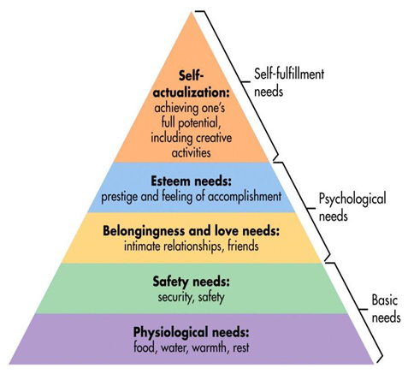
Needs of Persons with Disabilities and Vulnerabilities. hgb

Slide 95
The Health Care Needs of Persons with Disabilities and Vulnerabilities
People with disabilities report seeking more health care than people without disabilities and have greater unmet needs
PWD are particularly vulnerable to deficiencies in health care services.They may experience PWD greater vulnerability to:
Secondary conditions:- occur with primary health condition
Co-morbid conditions: occur with PHC related with disability
Age-related conditions
Engaging in health risk behaviors
Barriers to Health Care for Persons with Disabilities and Vulnerable Groups
Prohibitive costs
Limited availability of services
Physical barriers
Inadequate skills and knowledge of health workers

Slide 96
Addressing for Inclusive Barriers to Health Care
Policy and legislation
Financing
Service delivery
Human resources

Slide 97
Disability, vulnerability and the Environment
Disability is not inherent in an individual but is, rather, a relational concept—a function of the interaction of the person with the social and physical environments
The physical and social environments comprise factors external to the individual, including family, institutions, community, geography, and the political climate
environmental factors must be seen to include the natural environment, the human made environment, culture, the economic system, the political system, and psychological factors.

Slide 98
Creating Welcoming (Inclusive) Environment
External environmental modifications can take many forms. These can include assistive devices, alterations of a physical structure, object modification, and task modification
Examples of Environmental Modification
Mobility aids
Communication aids
Accessible structural elements
Accessible features
Job accommodations
Differential use of personnel

Slide 99
Impact of the Social and Psychological Environments on the Enabling-Disabling Process
The social environment is conceptualized to include cultural, political, and economic factors. The psychological environment is the intrapersonal environment

Slide 100
Strategies to Disability inclusive intervention and rehabilitation
Prevention is action aimed at preventing the occurrence of physical,intellectual,psychiatric or sensory impairment.
E.g vaccination.
Primary prevention –actions to avoid or remove the cause of a health problem in an individual or a population before it arises
Secondary prevention (early intervention) –actions to detect a health and disabling conditions at an early stage in an individual or a population, facilitating cure, or reducing or preventing spread, or reducing or preventing its long-term effects
Tertiary prevention (rehabilitation) –actions to reduce the impact of an already established disease by restoring function and reducing disease related complications

Slide 101
Implementing the Twin-track Approach
Track 1: Mainstreaming disability as a cross-cutting issue
Track 2: Supporting the specific needs of vulnerable groups with disabilities
Implement Disability Inclusive Project/ Program

Slide 102
Implement effective Intervention and Rehabilitation
Rehabilitation interventions promote a comprehensive process to facilitate attainment of the optimal physical, psychological, cognitive, behavioral, social, vocational, a vocational, and educational status
Rehabilitation requires goal-based activities and, more recently, measurement of outcomes.
Consumers/patients, families, and professionals work together as a team to identify realistic goals and develop strategies to achieve the highest possible functional outcome, in some cases in the face of a permanent disability, impairment, or pathologic process

Slide 103
Components of Rehabilitation Interventions
Multiple Disciplines
Physicians
Occupational Therapists
Physical Therapists
Speech and Language Therapist
Audiologists
Rehabilitation Nurses
Social Workers
Case Managers
Rehabilitation Psychologists
Neuropsychologists
Therapeutic Recreation Specialists
Rehabilitation Counselors
Orthotists and Prosthetists
Additional Rehabilitation Professionals
Person with the Disability and His or Her Family

Slide 104
Community-Based Rehabilitation
It promotes collaboration among community leaders, peoples with disabilities and their families and other concerned citizens to provide equal opportunities for all peoples with disabilities in the community and to strengthen the role of their organization
Community-consists of people living together in some form of social organization sharing political, economic, social and cultural characteristics in varying degrees.
Rehabilitation-includes all measures aimed at reducing the impact of disability
CBRis a strategy that can address the needs of peoples with disabilities with in their communities
It is a common sense strategy for enhancing the quality of life of peoples with disabilities by improving services delivery

Slide 105
Major Objectives of Community Based Rehabilitation
The major objective of community based rehabilitation is to ensure that people with disabilities are empowered to maximize their physical and mental abilities
promotes the human rights of people with disabilities through attitude changes within the community

Slide 106
Reading assignment
Inclusiveness and AT

Slide 107
Barriers of employment
Attitudes and Discrimination
Accessibility
Education and Training
Social Networks
Women Disabilities
Legal Barriers
Inflexible Work Arrangements
Dismissal on the Basis of Disability
The Benefit Trap

Slide 108
Strategies to Improve Employment for Persons with Disabilities and Vulnerabilities
Anti-Discrimination Legislation
Vocational Education And Training
Wage Subsidies( DEGOMA)
Supported Employment
Workplace Accommodation Schemes
Workers’ Compensation
Quota Systems
Sheltered Workshops
Private Sector Initiatives
Employer Networks
Support Disability-Inclusive Business
Social Enterprises
Support Persons with Disabilities in the Workplace
Building a More Inclusive Society
Boost Education and Training Opportunities
Break Down Attitudinal Barriers and Challenge Discrimination
Improve Data Collection on Disability and Employment

Slide 109
CHAPTER 4
PROMOTING INCLUSIVE CULTURE
4.1 Definition of Inclusive Culture
    Inclusive means is a sense of belonging, welcoming all, and give value to all
    Inclusive organization let the people fell free and compromise diversity
  Culture is “the ideas, customs, and social behavior of a particular people or society”
  An organization’s culture is the culmination of the priorities, values and behaviors, which support their employees in how they work singularly, in teams and with clients.
Therefore, an inclusive culture involves the full and successful integration of diverse people into a workplace
It is also about representation, Receptivity and Fairness
4.1.1 Dimensions/ elements of an inclusive culture
There are three dimensions of an inclusive culture
    Universal Design
    Recruitment, Training and Advancement Opportunities
    Workplace Accommodations and Accessibility: Policy & Practice

Slide 110
Dimensions/ elements of an inclusive culture
1) Universal Design
    Is refers to the construction of structures, spaces, services, communications and resources are accessible to all
    About adapting manuals, materials and forms to all employees to be accessible to all
    Making the work place safety, accessible and health to wheelchairs users and to all employees
    Providing employees with a variety of flexible schedule and work options
2) Recruitment, Training, & Advancement Opportunities
    A) Recruitment of PWD has two components
      Accessible outreach and hiring practices: is about creating barriers free environment for PWD to participate
      Targeted recruitment of workers with disabilities: involves specific outreach to people with disabilities

Slide 111
Dimensions…
B) Training
  Is twofold role for creation of inclusive workplace culture
  the degree to which people with disabilities have equitable access to training sites, events, and materials.
  the training of managers, particularly middle management, and human resources staff, to work effectively with all people
  However, inadequate training result in reducing job satisfaction low productivity and retention.
C) Advancement
  Is about accumulation of Recruitment and adequate training
  The existing mentoring programs are advertised, implemented and maintained with attention to inclusion of workers with disabilities
  Targeted mentoring and coaching programs specifically assist employees with disabilities

Slide 112
Dimensions…
3) Workplace accommodations and accessibility: Policy & Practice
  Policy plays a critical role in generating meaningful inclusion of PWD
  policies need to carefully plan for the provision of reasonable accommodations
  accommodations policies are be “procedural justice” meaning policy should be fair, accessible and functional to employees with disability and “interactional justice” meaning the managers or colleagues with whom one is interacting are behaving fairly, reasonably and respectfully
4.2 Benefits of Inclusive cultures
  Increased worker commitment to and identification with organizational success
  Improved employee health and well-being
  Reduced expenses corresponding to reduced employee turnover
  Improved productivity
  Increased employee investment in work performance
  Reduced perception of discrimination and inequity
  Improved cooperation and collaboration

Slide 113
Inclusive culture…
Means of establish inclusive culture (stages in establishing IC)
By considering the four key inclusive leadership behaviors: Empowerment each, Enable team members to grow and excel by encouraging
accountability, Show confidence in team members
Courage, Stand up for what you believe is right, even when it means taking a risk
Humility (overcome your limitations)
2) Consider what you want to achieve and what the benefits will be
3) Undertake an inclusion review of your workplace by:
    The demographics of your organization and customer base
    Your formal policies and procedures
4) Decide where work is needed and create an action plan through:
    Actively involve all employees
    Build a culture of inclusion and respect
    Take an inclusive approach to recruitment, promotion and development
    Encourage engagement with the local community

Slide 114
Inclusive culture
5) Communicate the plan with staff and put the plan into action through:
    Actively involve all groups of employees
    Participation and consultation through: (Staff surveys, Focus groups and Engagement with employee networks)
6) Review, monitor and evaluate the plan’s impact and use what you find to plan future action

Slide 115
Inclusive organization
Inclusive culture inclusive organization
inclusive organization are:
    fairness and respectful
    value and belonging to all
    safe and open and
    empowerment and growth for all
benefits of an Inclusive organization
    Higher Job Satisfaction
    Lower Turnover
    Higher Productivity
    Higher Employee Morale
    Improved Creativity and Innovation
    Improved Problem-Solving
    Increased Organizational Flexibility

Slide 116
Inclusive Org..
Ten Characteristics of an Inclusive Organization
It accepts diversity and inclusion as a way of life
It evaluates individual and group performance on the basis of observable and measurable behaviors and competencies
It operates under transparent policies and procedures
it is consistent in its interactions with everyone
It creates and maintains a learning culture
It has a comprehensive and easily accessible system of conflict resolution at all levels
It recognizes that it is part of the community that it serves
It lives its mission and core values
It values earned privilege over unearned privilege
It accepts and embraces change

Slide 117
4.3 Building inclusive community
Inclusive community is
The community where everyone is respected as a citizen, get access to resource, get equal treatment and opportunity
A community that is free from any form of discrimination, values diversity
All are part of decision-making processes
Aims at empowering and promoting the social, economic, and political inclusion of all regardless of age, sex, disability, race, ethnicity, origin, religion, economic, or other status
A community where also no one lift behind, open and inclusive to all
Importance of inclusive community
  Block exclusion and injustice that bases few group
  promote chance of all to participate in all activities
  Promote diversity as richness

Slide 118
Building inclusive…
To build inclusive community the following consideration of motivation is impotent behind the community:
  Types and sequence of strategies selected
  Resources available
  Amount of support and obstruction (obstacles)
  Rate of progress
  Expected outcomes
Characteristics of an Inclusive Community
Integrative and cooperative
Interactive
invested (empower)
welcome and incorporate diverse
Equitable, accessible and Sensitive
Participatory and safe

Slide 119
4.4 Inclusive values
Inclusion is most importantly seen as putting inclusive values into action
Inclusive values wish to overcome exclusion and promote participation
inclusive values are appreciating diversity, equality and equity, cooperativeness, participation, community, and sustainability
To develop inclusive values there are seven Pillars of Inclusion
  Access
  Attitude (willing people are to embrace inclusion and diversity)
  Choice (options)
  Partnership
  Communication
  policy and
  opportunity

Slide 120
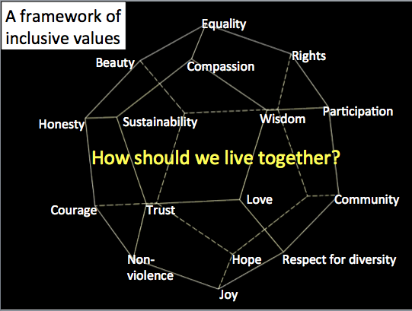
4.4.1 Framework of inclusive values

Slide 121
4.5 Indigenous inclusive values and practices
“Indigenous” refers to a better understanding of, and respect for, indigenous cultures develops an enriched appreciation of the existing cultural heritage
Indigenous inclusion defined as an organizational state that is embraced as a cultural norm, with enterprise-wide workplace strategies as well as a culture which invites the full participation of indigenous people into all aspects of business operations
4.5.1 Features of an indigenous inclusion
  1) Inclusion has been embraced as a core competency
  2) Share experience and achievements among organization
  3) Human rights and responsibilities are promoted and respected
  4) Comprehensive Indigenous procurement, recruitment and corporate social responsibility strategies
  5) Indigenous people are employed and retained in all areas of the organization

Slide 122
4.5.1 Features…
6) There are significant revenues and jobs gained by Indigenous people and businesses through the organization‘s supply chain;
7) Indigenes community sustainable gains have been realized as a result of the relationships built between the company and the community
8) High levels of Indigenous employee engagement are seen and experienced in the organization
9) Leadership has put into place the resources needed to sustain its Indigenous inclusion
10) Indigenous inclusion is integral to the mission and vision of the organization

Slide 123
4.6 Inclusive practice
Inclusive practice is:
an approach to recognizes the diversity of students
aim to embrace all people irrespective of race, gender, disability, medical or other need.
about giving equal access and opportunities and getting rid of discrimination and intolerance (removal of barriers)
about the attitudes, approaches strategies talent to ensure that people are not excluded or isolated
having an understanding of the impact that discrimination, inequality, social exclusion can have on an individual
gives an individual more confidence in the care that they were receiving

Slide 124
4.6.1 principle of Inclusive practices
1) All have his/her unique style ability and achievement which to be equally valued, respected and celebrated by society
2) Diversity enriches and strengthens all communities
3) All are enabled to fulfill their potential by taking into account individual requirements and needs
4) Support is guaranteed and fully resourced across the whole activities experience
6) All learners need friendship and support from people of their own age
7) All children and young people are educated together as equals in their local communities

Slide 125
4.6.2 Benefits of Inclusive practices
    Friendships
    Increased social initiations, relationships and networks
    Peer role models for academic, social and behavior skills
    Increased achievement of Individual Educational Plan goals
    Greater access to general curriculum
    Enhanced skill acquisition and generalization
    Increased inclusion in future environments
    Greater opportunities for interactions
    Higher expectations
    Increased school staff collaboration
    Increased parent participation
    Families are more integrated into community

Slide 126
CHAPTER 5
INCLUSION FOR PEACE, DEMOCRACY AND DEVELOPMENT
5.1 introduction
Inclusive education is:-
heart of any strategy for peace-building, democracy and development
It is through inclusive educational that values, skills and knowledge which form the basis of respect for human rights and democratic principles can be developed
It is through Inclusive education that the rejection of violence, and a spirit of tolerance, understanding and mutual appreciation among individuals, groups and nations can be enhanced.
As a result, inclusiveness should be the first phase towards increasing participation and fight for social justice for people with disabilities, vulnerable and general populations

Slide 127
5.2 Definition of Peace, Democracy and Development
5.2.1 Inclusion for Peace
peace is defined as creating mutual understanding, positive relationship between individuals and groups.
developed interpersonal peace through deep respect for other persons, justice, tolerance and cooperation
Peace has a notion of societies’ completeness, fulfillment, wholeness, harmony, feeling of security and well being of an individual, a community or a society.

Slide 128
5.2.1 Inclusion…
Human being is interconnected and should be free from negative force, fear, hatred, anger, tension, violence stress, anxiety and any kind of destructions
Peace make the mind quiet and calm prevents anxieties, worries, stress and fears, and awakens inner strength and confidence, develop freedom, happiness, love, joy, justice and gratitude
Peace can be achieved through formal and informal IE.
Peace issues are core to the discussion of resilience (flexibility).
Resilient societies are those where the social fabric (structure) is strong.

Slide 129
5.2.1 Inclusion…
Inclusive education is a foundation for inclusiveness in all aspects of life
Inclusiveness:
It creates equality and equity among divers population.
  Equal (sameness and nondiscrimination)
  equitable (social justice and fairness ) distribution of resources within the system
  Diversity refers to in terms of language, religion, socio-economic status, culture and psychology, disability…
to create a society that is peaceful, democratize and developed.
Inclusive education crucial for:
Fostering education that promotes the values, attitudes and behavior inherent in a culture of peace

Slide 130
5.2.1 Inclusion…
Inclusive education crucial for
Promoting sustainable economic and social development
Promoting gender equality in economic, social and political decision-making;
Fostering democratic participation and citizenship
Advancing understanding, respect for cultural diversity, and human solidarity by promoting a dialogue among societies
Promoting international peace and security
Promoting respect for the UDHR at all levels
Inclusive education is the basis for harmony
create citizens those are unselfishness and living for the wellbeing of others
develop self-control, give genuine service, be fair, generous, attitude of forgiveness, humility and honesty

Slide 131
5.2.2 consequence of absence of inclusive education
cut people off from full involvement in the economic and social life of their countries
social exclusion this result in horizontal inequalities (underpin grievances) this leads to mobilize groups for conflict
Reduce disparities in wealth and income
Educational inequalities reflect social inequalities more broadly
Dominant ethnic groups control state resources and minority groups were discriminated.
conflict could be happen due to discrimination on the basis of: gender. Age, class, religion, disability, poverty, geographical location..etc.

Slide 132
5.2.3 Sources of Conflict
Conflict begins within the Individual
Spiritual sources of conflict
Result of original ancestor’s separation from God and negative influence from evil spiritual forces
Disunity within the individual and confusion of values
Family sources of conflict
Family dysfunctions affect succeeding generations.
National/international sources of conflict
National policies affect future generations and can lead to conflict within or between nations

Slide 133
5.2.3.1 Historical Sources of Conflict
National crimes burden future generations
Ethnic/religious resentments accumulate
Individual Choice: To resolve or repeat past conflicts- rethinking the past and the future
5.2.3.2 Absence of inclusiveness
selfishness (living only for oneself)
lust- envy (desire to covert)
Exploitation (taking advantage over others)
prejudice (partiality) or narrow-mindedness
reed- Self-indulgence (self- pity)
vengeance- retaliation (revenge or un-acceptance)
Arrogance (over superiority)
self-importance those are the basis of conflicts are in the minds of human being

Slide 134
5.2.4 Sustaining Peace
expand formal and informal IE creating inclusive society create competencies in young and adult populations that:
    Have skills of sifting the truth from propaganda
    Respect for different points of view of other
    resolve conflict in non-violent ways
    Have desire and ability to participate in shaping society
Building of peace requires taking the following steps:
  Fostering (promoting) inclusion, ensuring access to justice, strengthening the social fabric and delivering good governance
  Reaffirm a commitment to human rights, the foundation for human dignity and just societies
  Foster social resilience by strengthening inclusion and addressing inequality

Slide 135
5.3 Inclusion for Democracy
5.3.1 Definition of democracy
Democracy is “the rule of the people, by the people, for the people”
“people” is to mean all human being, regardless of the diversities.
Democratic schools are an educational ideal in which democracy is both a goal and a method of instruction.
5.3.2 Inclusion Education for Democracy
Schools are the ideal place to promote democracy
Schools task should be helping students to realize the democratic values.

Slide 136
5.3 Inclusion for Demo…
5.3.2.1 DEMOCRATIC VALUES
  Protected right
  Independent quality life for all
  Freedom
  Pursuit of happiness
  Justice
  The common good
  Truth
  Respect and tolerance for diversity and partisanship.

Slide 137
5.3 Inclusion for Dem…
5.3.2.2 INCLUSIVE EDUCATION
sees young people not as passive recipients of knowledge, but rather as active co-creators of their own learning that help to exercise democracy
aims to develop real democracy through active participation by all divers learners involved in classrooms and educational institutions
Develops values of cooperation, fairness and justice into the hearts of our students.
In democratic education students have the power to make decisions about their learning
All children are able to be part of their community and develop a sense of belonging
democracy is one of the principles of inclusiveness in the process of building inclusive society that begun in schools.

Slide 138
5.3.3 Democratic principles for inclusive practices
Diversity enriches and strengthens all communities.
All PWD different in their needs, potentials, learning and working styles;
PWDs’ achievements according to their potentials are equally valued, respected and celebrated by society
All learners are enabled to fulfill their potential by taking into account individual requirements and needs.

Slide 139
5.4 Inclusion for Development
5.4.1 Definition of development
refer to a specified state of advancement or growth a new and advanced idea, profession, physical, mental, product;
or an event that constitutes a new stage under changing circumstances.
is a positive growth or change in economical, social and political aspects of a country.
Any kind of development should be inclusive
Therefore, inclusive development as a “process that occurs when social and material benefits are equitably distributed across divides in society” (Hickey, 2015)
Inclusive development also has an “integral focus on the achievement of equity and the rights of citizenship” (Hickey, 2013).

Slide 140
5.4.2 Inclusive education for Development
inclusive development
consists of ensuring that all marginalized and excluded groups are stakeholders in development processes
Inclusive and sustainable development is crucial to reduce poverty in all its dimensions so all member are benefited.
goal of inclusiveness is to prevent social exclusion and creating more social inclusion
  Social inclusion is an integral part of inclusive development
  Social inclusion enhances capabilities, broadens social ties of respect and recognition, and at the collective level, enhances social bonds, cohesion, integration and solidarity among human race (UNDP, 2015).

Slide 141
… contn’d
Social inclusion ought to be based on the recognition of rights and responsibilities, accountability and judgment and of the fundamental equality of all
Social inclusion is thus also inherently political, and it is crucial for inclusive development to address social inclusion
It is obvious that people with disabilities and marginalized population are large and most disadvantaged minority in the world therefore, they should benefited and include in any developmental organization
Without creating inclusiveness for these populations we cannot realize peace, democracy and development.

Slide 142
5.4.3 Importance of Inclusion
to support people to learn, productive, successful and live independently without helping them too much
All people are able to be part of their community and develop a sense of belonging
values diversity and the unique contributions, where everybody brings to the milieu.
Create opportunity to participate in the typical experiences in life
it prepares individuals today and in the future

Slide 143
5.5 Respecting divers needs, culture, values, demands and ideas
These include race, ethnicity, age, ability, language, nationality, socioeconomic status, gender, religion, or sexual orientation.
The group is diverse if a wide variety of groups are represented.
Cultural diversity has become a hot-button issue when applied to the workplace.
We have created a list of the biggest diversity issues in the workplace:
    Acceptance and respect
    Accommodation of beliefs
    Ethnic and cultural differences
    Gender equality
    Physical and mental disabilities
    Generation gaps
    Language and communication

Slide 144
5.5.1 Diversity may happen in the Workplace
Ethnicity (language and cultural differences)
Age and generation differences
Gender and gender identity
Religious and spiritual beliefs
Disability and ability
Socioeconomic status and background
      Poor and rich
      Educated and uneducated
      Highly educated and less educated
      Rural vs. urban history
      Married and unmarried
      Hard worker and non hard worker
      Mental health problems…etc

Slide 145
5.5.2 Valuing diversity
Recognizes differences between people and acknowledges that these differences are a valued asset
Multicultural education is an important component of valuing diversity
great reputation for the company, leading to increased profitability and opportunities for workers quality services
Make people to build a stronger sense of identity and wellbeing
It helps dispel negative stereotypes and personal biases about different groups
helps us recognize and respect ways of being‖ that are not necessarily our own

Slide 146
5.5.3 Cultural Diversity
Our culture is what shapes us; it shapes our behavior and our identity
Culture is our way of living, it refers to the shared language, beliefs, values, norms, behaviors, and material objects that are passed down from one generation to the next.
Cultural diversity in the world is divers and a blessing gift for development; but become sources of conflict. Why?
The term culturally diverse is often used interchangeably with the concept of multiculturalism
The multicultural person, therefore, is not simply the one who is sensitive to many different cultures. Rather, this person is always in the process of becoming a part of and apart from a given cultural context.

Slide 147
5.5.3 Cultural Diversity
Cultural diversity is when population differences are well represented within a community.
These include
        race,
        ethnicity,
        age,
        ability,
        language,
        nationality,
        socioeconomic status,
        gender, religion and
        geographical area.

Slide 148
5.5.4 Ethnic diversity
The terms "race" and "ethnicity" used interchangeably, but, generally speaking, the meanings are distinct.
Race is usually seen as biological, referring to the physical characteristics of a person. An example of race is brown, white, or black skin (all from various parts of the world)
while ethnicity is viewed as a social science construct that describes a person's cultural identity.
It is including nationality, regional culture, ancestry, and language. Example of ethnicity is German or Spanish ancestry (regardless of race) or Han Chinese

Slide 149
5.5.5Benefits of Cultural Diversity
Increased productivity, profits
Improved creativity, employee engagement and cultural insights
build bridges to trust, respect, and understanding across cultures; inclusiveness.
Respect the religious diversity, however, disrespect and unfair treatment, bullying and harassment other religions can cause of conflict in workplace
How to Resolve Conflict
    Agree on a mutually acceptable
    Focus on the current conflict
    Listen to others view
    Seek for win-win approaches
    Seek common ground

Slide 150
Gender differences
"sex" refers to the biological differences between males and females
"Gender" can refer to the role of a male or female in society, known as a gender role
Women are generally better at language tasks but men little bit better at organizing things in space.
Aristotle saw women as subject to men.

Slide 151
CHAPTER 6: LEGAL FRAME WORK
6.1 introduction
legal frameworks that may incorporate: legislations, conventions, policies and related legal frameworks
This legal frameworks were developed on the behave of discrimination, exclusion, segregation and isolation against persons with disabilities in denied their human rights, participation in the society and in the sphere of economic, social and cultural rights, in the fields of, for instance, housing, employment, transport, cultural life and access to public services.

Slide 152
6.2 Key International Instruments and other Documents that Promote Inclusion
1948 Universal Declaration of Human Rights – Article 26
1960 UNESCO Convention against Discrimination in Education – Articles 1, 3 and 4
1965 International Convention on the Elimination of All Forms of Racial Discrimination – Article 5
1966 International Covenant on Economic, Social and Cultural Rights – Article 13
1966 International Covenant on Civil and Political Rights – Articles 18 and 19
1973 ILO Convention on the Minimum Age for Employment – Article 7

Slide 153
6.2 Key International…
1979 Convention on the Elimination of All Forms of Discrimination Against Women – Article 10
1982 World Program of Action Concerning Disabled Persons proposals for implementation, national action, part 2
1989 Convention on the Rights of the Child – Articles 23, 28 and 29
1989 ILO Convention Concerning Indigenous and Tribal Peoples – Articles 26, 27, 28, 29, 30 and 31
1990 The World Declaration on Education for All, Jomtien
1993 The Standard Rules on the Equalization of Opportunities for Persons with Disabilities

Slide 154
6.2 Key International…
1994 The Salamanca Statement and Framework for Action on Special Needs Education
1999 ILO Convention on the Worst Forms of Child Labor – Article 7
1999 Salamanca Five Years On Review
2000 World Education Forum Framework for Action, Dakar
2000 Millennium Development Goals focusing on Poverty Reduction and Development
2002 EFA Global Monitoring Report: EFA

Slide 155
6.2 Key International…
2004 EFA Global Monitoring Report: Gender and Education for All – the leap to quality
2005 EFA Global Monitoring Report: Education for All – the quality imperative
2006 EFA Global Monitoring Report: Literacy for Life
2006 Convention on the Rights of Persons with Disabilities
2007 EFA Global Monitoring Report: Strong Foundations – early childhood care and education
2008 EFA Global Monitoring Report: Education for All by 2015

Slide 156
6.1 International and National Legal Frameworks
6.1.1 International Legal Framework
    There have been international efforts to address equal opportunity of PWDs in employment
    aimed at protecting the rights of persons with disabilities through the principles of equality and non discrimination.
    1948 Universal Declaration of Human Rights – Article 26 Everyone has the right to education which is free and compulsory at elementary level.
    The UN Convention on the Rights of the Child, 1989 Extracts from Articles, 2, 23, 28 and 29 (Ensure the right for all children to receive education without discrimination on any ground)
    World Conference on Education for All, Jomtien, and 1990 World Declaration on Education for All: Meeting Basic Learning Needs (Known as Justice declaration). It is the move away from a rigid, prescriptive education system towards a flexible system that would be tailor-made, adapted to the needs, cultures and circumstances of learners.

Slide 157
6.2 Key International…
D) The World Programmed of Action, 1982 the International Year of Disabled Persons in 1981 education of PWD should be in general schools and services individualized, locally accessible and comprehensive
E) The Standard Rules on the Equalization of Opportunities for Persons with Disabilities - Rule 6 education of PWD is “an integral part of the educational system”
F) The Salamanca Statement and Framework for Action on Special Needs Education, 1994 – Accommodation (adjustment) regardless of physical, mental, emotional other factors. Salamanca the focus was on diversity of children‘s characteristics and educational needs

Slide 158
6.2 Key International…
G) Convention on the Rights of Persons with Disabilities, 2006 (Article 24 – Education)
States Parties recognize the right of persons with disabilities to education
H) World Education Forum, Dakar, 2000
Ensure that all children have access to and complete free and compulsory primary education by 2015 focus on marginalized and girls

Slide 159
6.1.2 National Laws and Policy Frameworks
It about our country laws and policies about disability and rights of PWD
Ethiopia has no disability related instrument until 1971of the imperial order to provide for the establishment the rehabilitation agency. But after introduction of a new constitutional order in the country.
Ethiopia has signed most of the international conventions and declarations protecting the rights of persons with disabilities

Slide 160
Major national legal frameworks that are related with protecting persons with disabilities rights
1. Constitution of the Federal Democratic Republic of Ethiopia-1995: Article 41(5) State’s responsibility for the provision of necessary rehabilitation and support services for people with disabilities
2. Labor Proclamation, No. 377/2003, amended by Labor Proclamation No. 494/2006: it is unlawful to discriminate employers in work place on their base of nationality, sex, religion, political outlook
3. The Federal Civil Servant Proclamation- No. 515/2007:
  It offers for special preference in the recruitment, promotion, and deployment, among others, of qualified candidates with disabilities. This provision is applicable to government offices only.

Slide 161
4. Proclamation concerning the Rights to Employment for Persons with Disabilities- No. 568/2008: The proclamation makes null and void any law, practice, custom, attitude and other discriminatory situations that limit equal opportunities for PWD
5. Framework Document- 2009: provides for Special Needs Education in Technical and Vocational Education and Training.
6. Building Proclamation- No. 624/2009: provides for accessibility in the design and construction of any building to ensure suitability for physically impaired persons.
7. Proclamation on Definition of Powers of Duties of the Executive Organs of the FDRE, No. 691/2010: This provides for conditions of equal opportunities and full participation of persons with disabilities and those living with HIV/AIDS.

Slide 162
8. Growth and Transformation Plan (GTP) 2010-2015: It focuses on establishing disability as a cross cutting sector of development
9. National Plan of Action of Persons with Disabilities -(2012-2021): aim at making Ethiopia an inclusive society
10. Proclamation concerning the Rights of Disabled Persons to Employment-No.101/1994: document was the only legislation in Ethiopia which specifically provides for the employment of disabled persons.

Slide 163
11. The Federal Civil Servant Proclamation (Proclamation -No 1064/2017: Article 13/2 of proclamation no 1064/2017 recognizes that: ‘There shall be no discrimination among job seekers or civil servants in filling vacancies because of their ethnic origin, sex, religion, political outlook, disability, HIV/AIDS or any other ground.’
12. Labor Proclamation-1156/2019: controls the private sector employment relationship. Article 15 of the proclamation outlaws discrimination on the basis of disablement
13. Organization of Civil Society Proclamation -No. 1113/2019: This proclamation is a newly enacted legislation replacing its predecessor proclamation 621/2009: Article 11 of this proclamation expressly provides that persons with disabilities should be included as a member to enhance and strengthen benefit and involvement of part of the society with disability.

Slide 164
14. The Revised higher institutions proclamation -No. 1152/2019: This proclamation has been enacted in replacement of its predecessor proclamation 650/2009:
art. 51 stated that institutions shall: make, to the extent possible, their facilities and programs amenable to use with relative ease for students with physical disabilities; shall, to the extent that situations and resources permit, relocate classes, develop alternative testing procedures, and provide different educational auxiliary aids in the interest of students with physical disabilities and learning disabilities; consider building designs, campus physical landscape, computers and other infrastructures of institutions shall take into account the interests of physically disabled students; shall ensure that students with physical challenges get academic assistance, including tutorial sessions, exam time and submission date deadline extensions

Slide 165
15. Avertissement Proclamation -No. 759/2012: article 7/4 of this proclamation, advertisement which undermines the dignity and emotional feeling of a physically disabled person is immoral
16. The Ethiopian Building proclamation -No 624/2009: all public building including toilets are accessible to person with physical disability who use wheelchairs and those who are able to walk
17. Definition of Powers and Duties of the Executive Organs of the Federal Democratic Republic of Ethiopia Proclamation -No. 1097/2018: focus on crating condition whereby everyone has equal opportunity and full participation through the responsible ministries specifically duty for ministry of labor and social affair

Slide 166
18. Developmental Social Welfare Policy 1997:
targets people with disabilities and sets out to safeguard their rights and to promote opportunities for vocational rehabilitation. full participation in education, health, political, economic and social activities and other activities
19. The FDRE Education and Training Policy of 1994: This document recognizes that special attention must be provided for those with special needs. However, it does not have any clear recognition for reasonable accommodation
20. The FDRE special needs/inclusive education strategy 2012: This document focuses on inclusive education policy, strategies and responsibilities of stakeholder

Slide 167
Chapter 7: Resources Management for Inclusion
Provisions of Resources
Resource should be considered for people with disabilities in workplaces, social gatherings, recreational and in schools that help them to feel comfortable, secure and work at their independent and team activities
Resources for school children
School based resource room
Human resources in schools
School based material resources like:-
Various magnifying lenses
Slate and styles
Perkins Braille writer
White Cane
Blind folder
Tuning fork
Audiometer
Hearing aids etc

Slide 168
Accommodations
Accommodations are adjustments that teachers and school personnel make to maximize learning and social well-being for individual students.
Instructional accommodation checklist
Use a multisensory approach.
Use a highly structured format for presentations.
Use graphic organizers.
Present material in small, sequential steps.
Teach specific strategies (e.g. taking notes, reading comprehension).
Review key points frequently.
Assign a buddy reader or note taker.
Provide students with outline of notes.
Use color coding to match materials and concepts.
Reduce visual distractions.
Seat student close to board, teacher, or student helper: away from door or window.
Provide a quiet work area.
Allow students to move if needed. Use visual reminders as memory aids.
Use teacher-initiated signals for redirecting attention.
Highlight sections of text.
Provide tape recording of lecture or required texts.
Give oral and written directions.
Speak slowly and clearly.
Allow for longer response time.

Slide 169
Organization and Task Completion
Keep work area clear.
Post assignments and work completed in a consistent spot.
Assist student with notebook organization.
Use assignment notebook.
Extend time to complete assignments.
Shorten or chunk assignments.
Give timeline for longer projects.
Give specific feedback.
Provide peer tutoring.
Use cooperative learning groups.
Provide structured daily activities

Slide 170
Evaluation
Explain grading and give rubric.
Give specific feedback.
Preview before test; give frequent quizzes; give sample questions.
Orient student to test format.
Use a clear, uncluttered copy; enlarge print.
Make test directions simple and clear.
Provide ample space for answers on test.
Allow alternate test response (oral, computer).
Read test aloud to student. Give open-note or take-home tests.
Use alternate forms of evaluation (oral report, group projects, and debate).
Reduce required assignments.
Provide proofreading checklist.
Accept print or cursive writing

Slide 171
Resources for work/social environment
Human resources
Special needs educator at every organization to create inclusive environment
Sign language interpreter
Sighted guide
Material resources
Various magnifying lenses
Slate and styles
Perkins Braille writer
White Cane
Hearing aids … etc

Slide 172
Chapter 8: Collaborative (Cooperative) Partnerships with stakeholders

