Slide 1
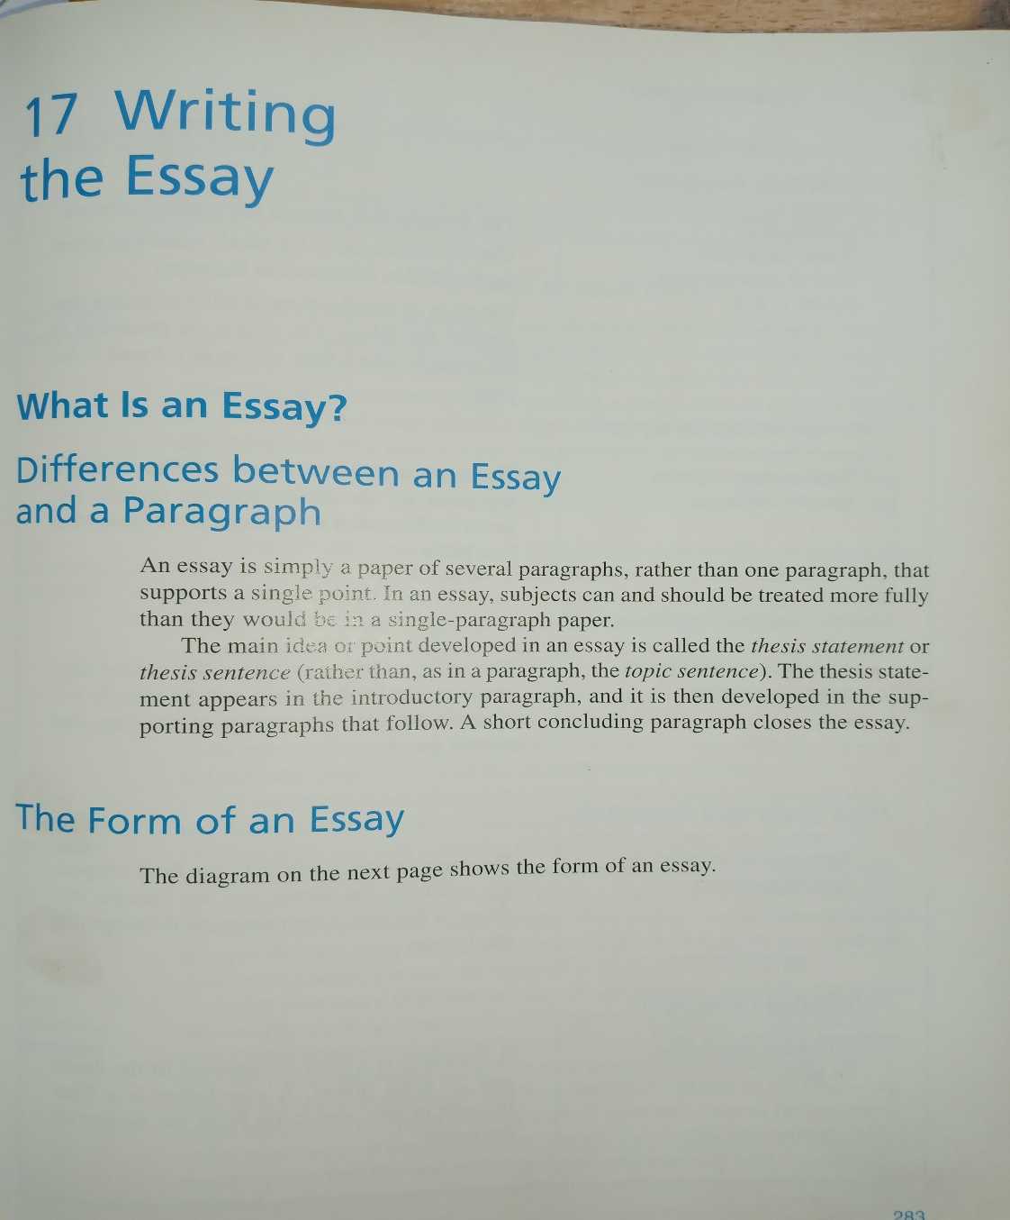
PART III WRITING EFFECTIVE ESSAY

Slide 2
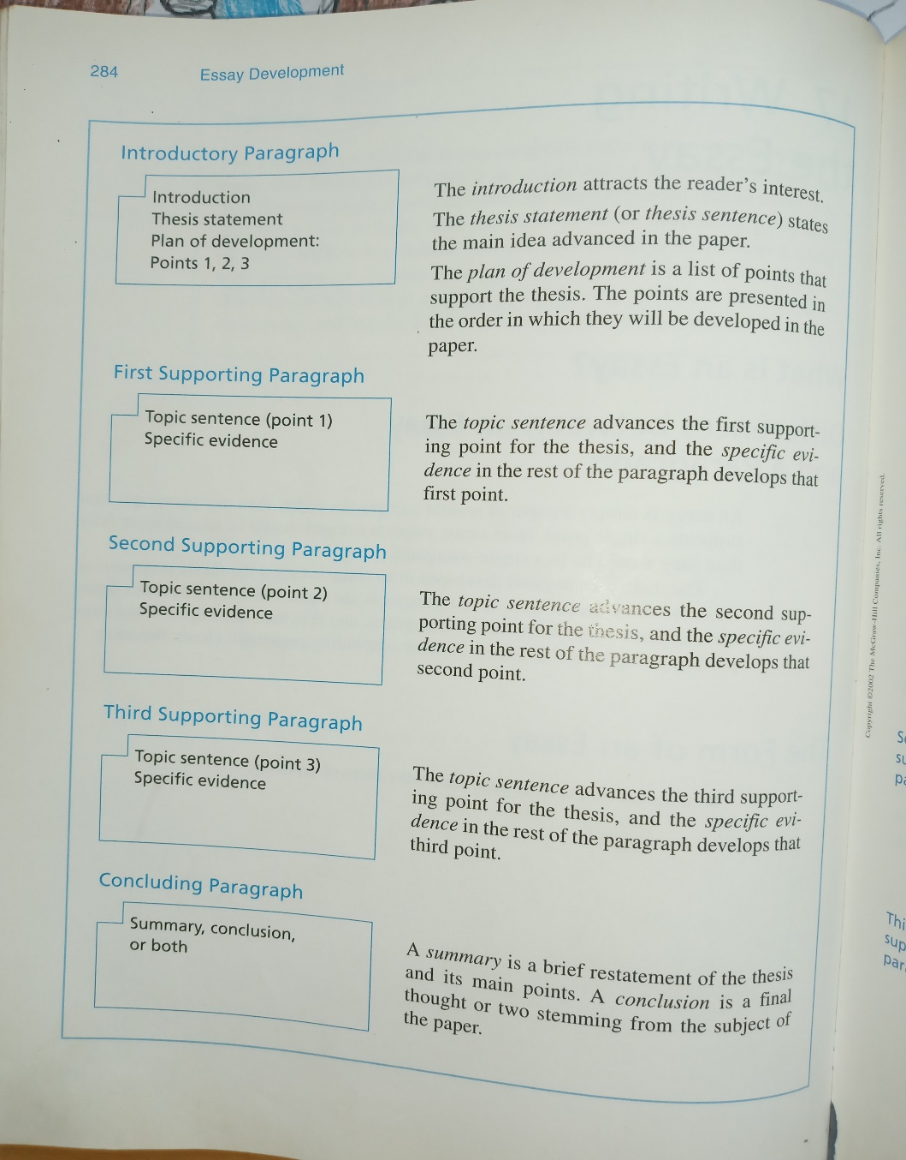
Structure

Slide 3
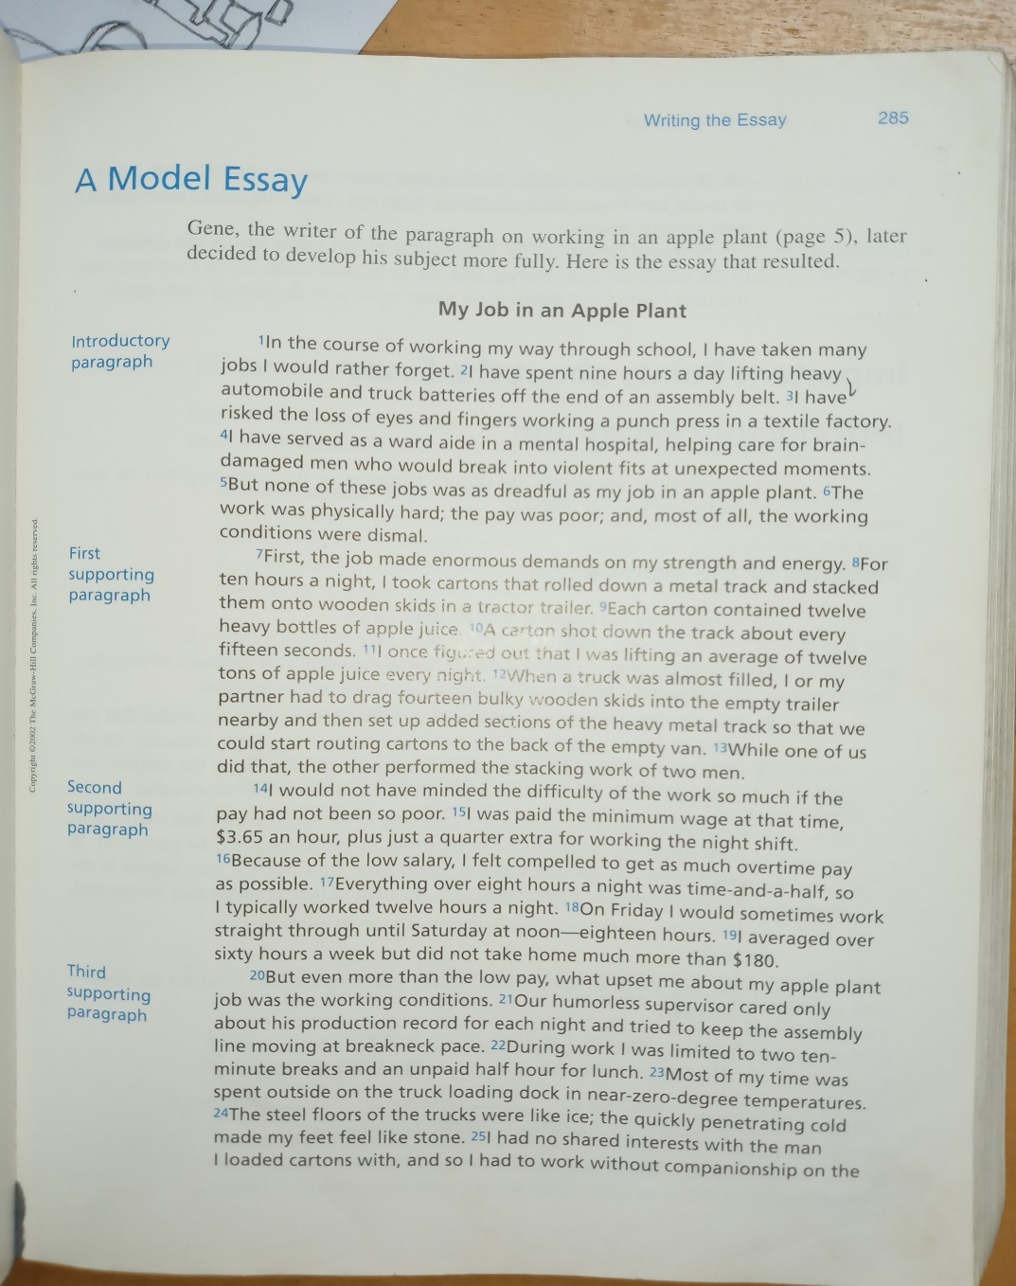
Model essay

Slide 4
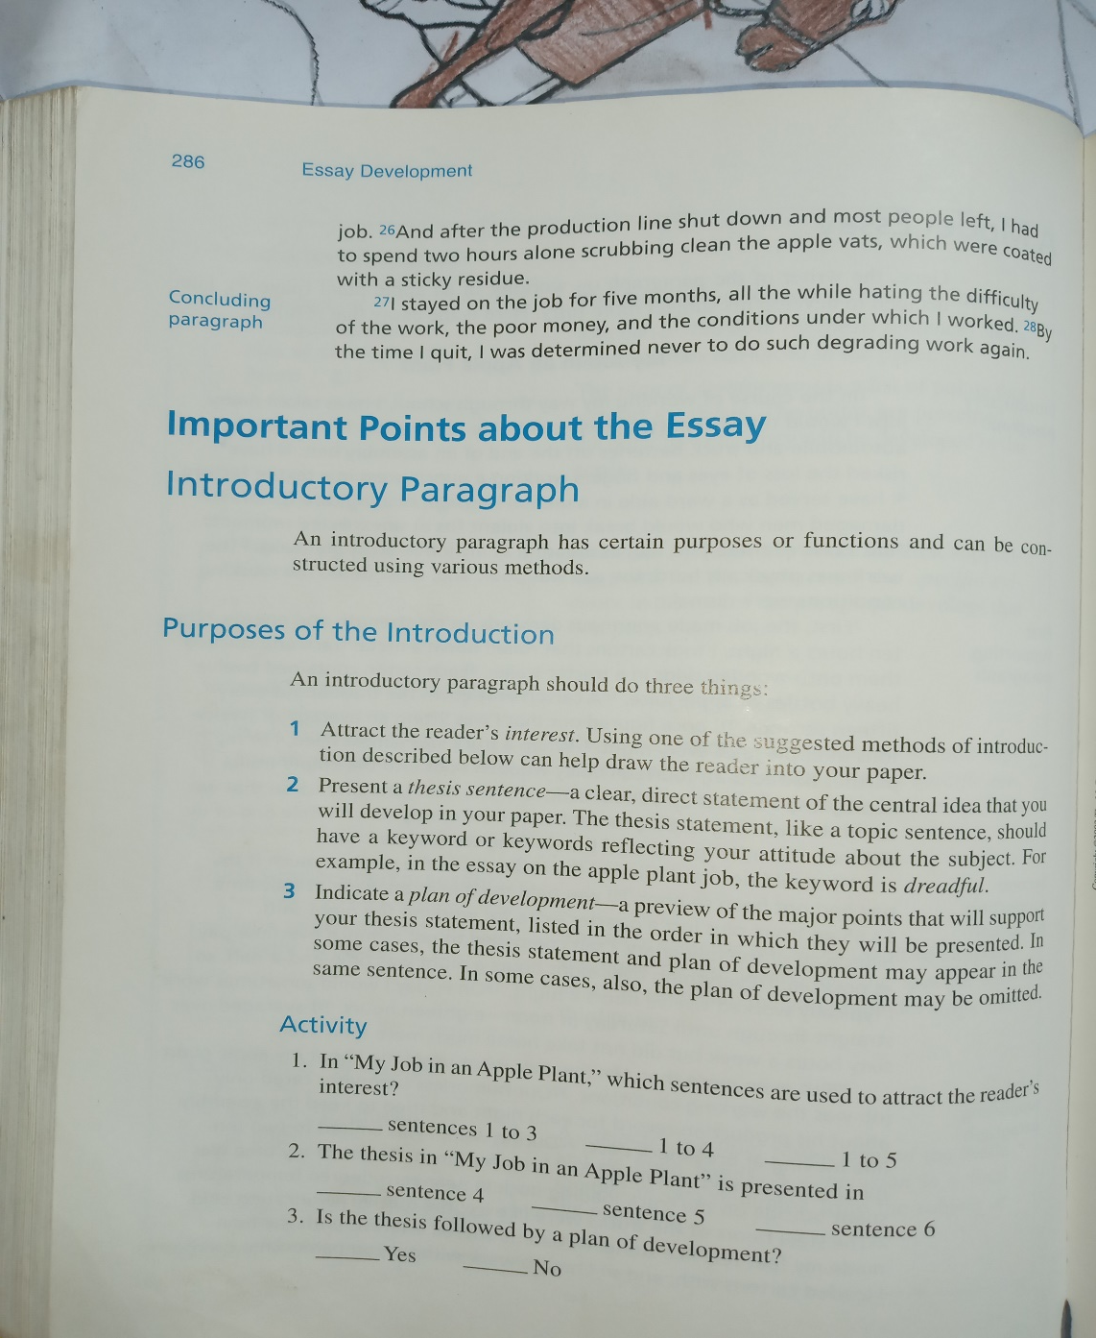
Important points

Slide 5
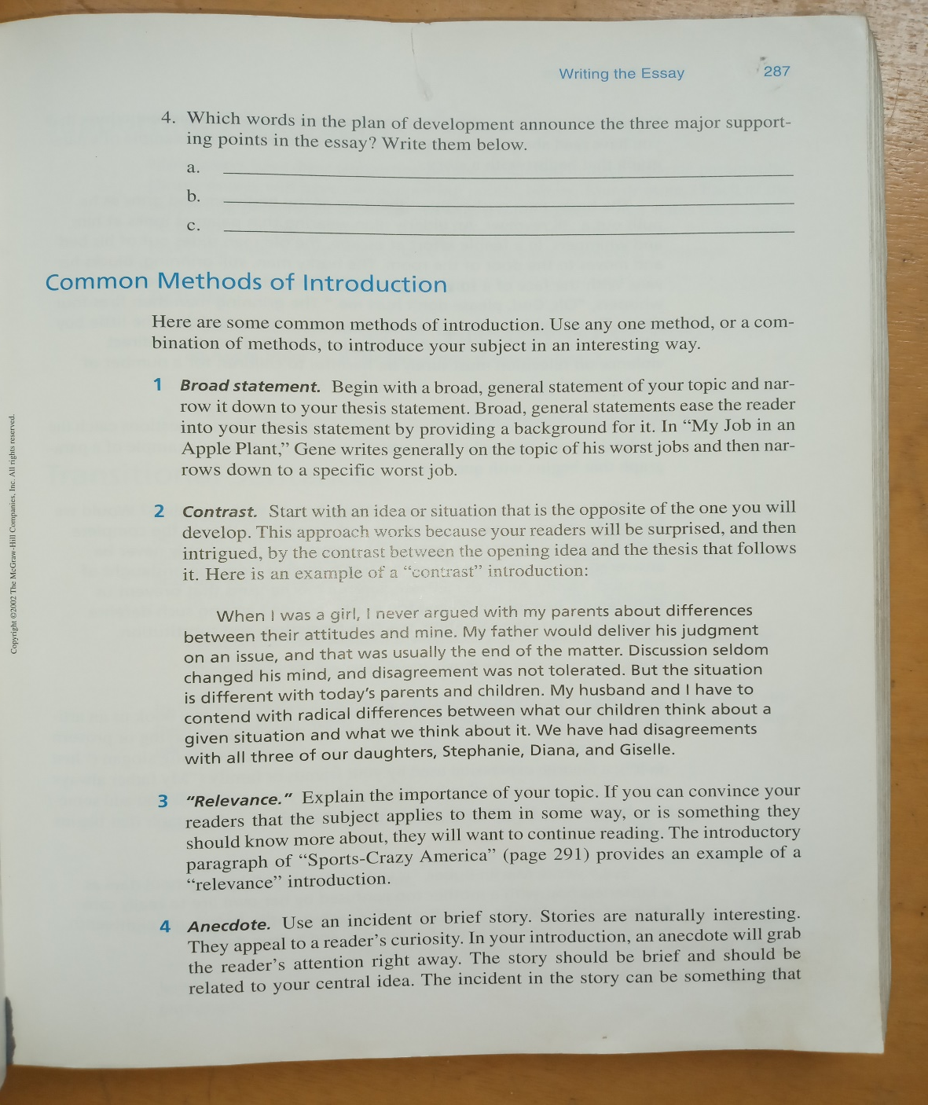
Writing attractive introduction

Slide 6
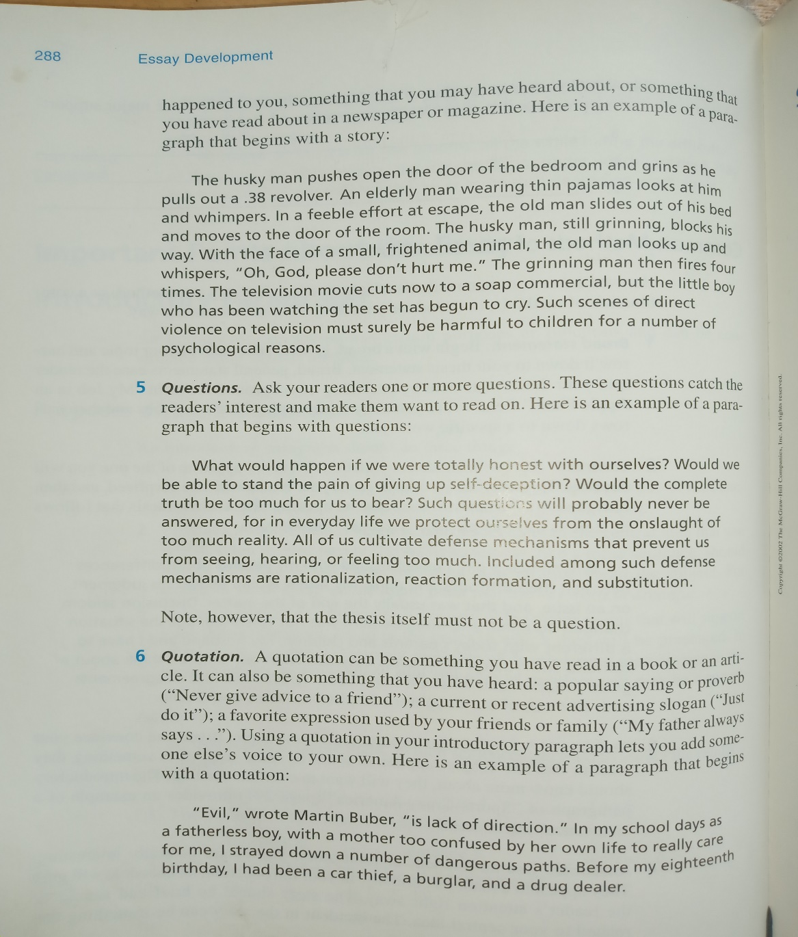
Cont.…

Slide 7
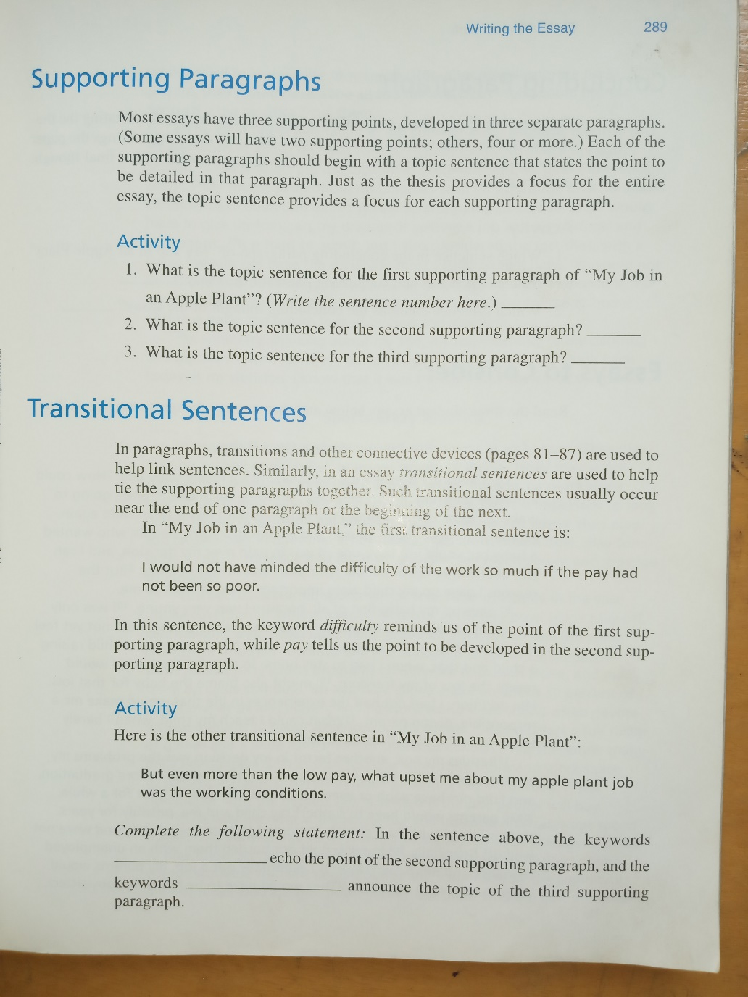
Supporting paragraphs

Slide 8
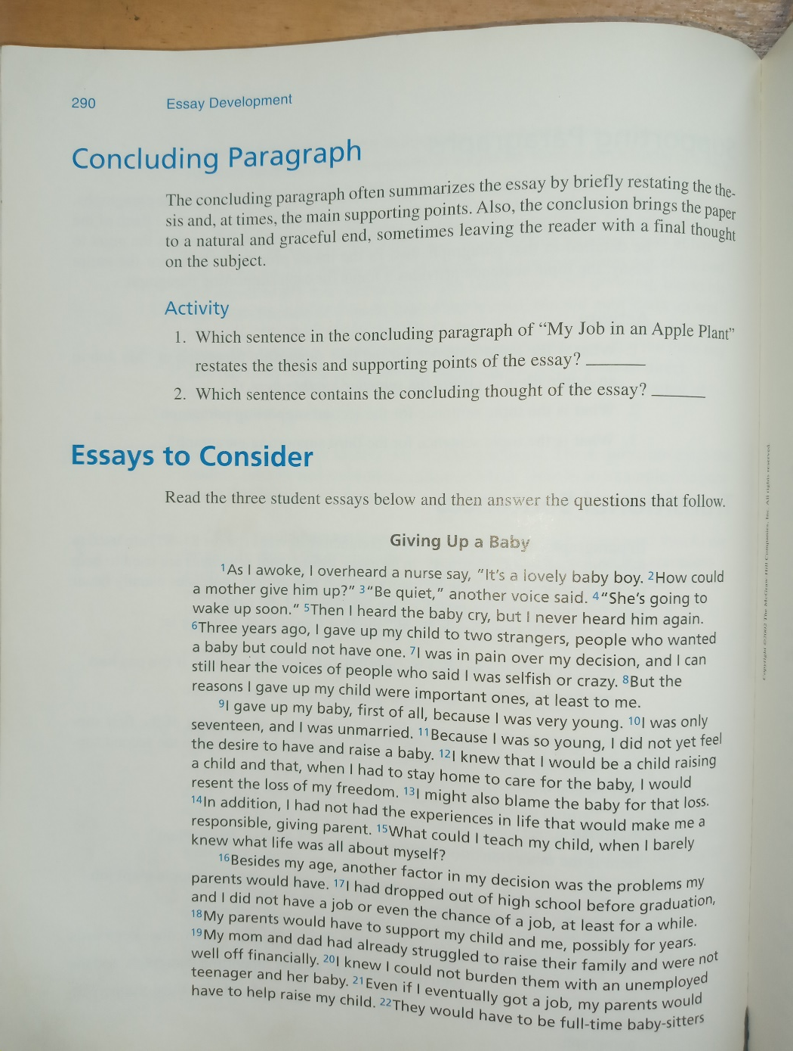
Concluding paragraph

