Slide 1
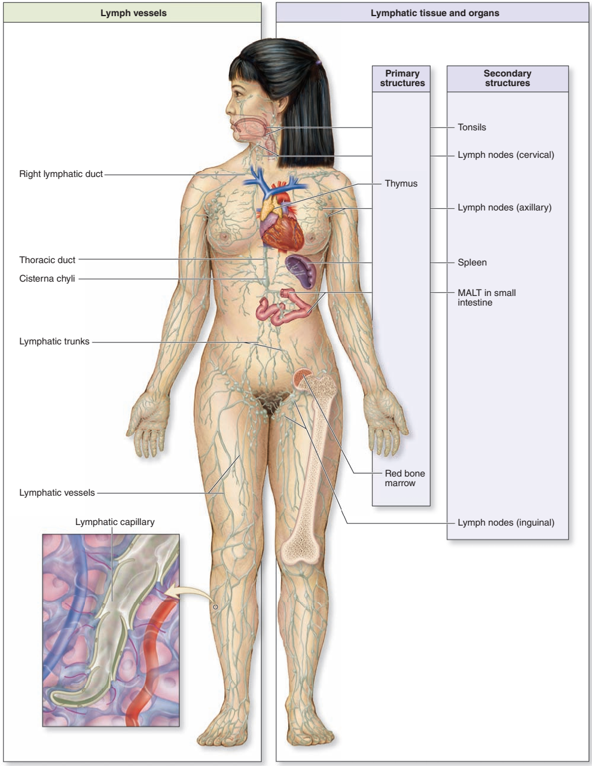
Lymphatic System
Getachew A.
(MSc in clinical Anatomy)

Slide 2
Outline of the presentations
Lymphatic System and its function
Components of the Lymphatic System
Lymphatic vessels
Lymphatic tissue and organs
  Thymus
  Lymph nodes
  Spleen
  MALT
  Bone marrow

Slide 3
Objectives
Describe the components of the lymphatic system.
Outline the organization of lymphatic vessels.
Compare the structure of the primary and secondary lymphatic organs and tissues

Slide 4
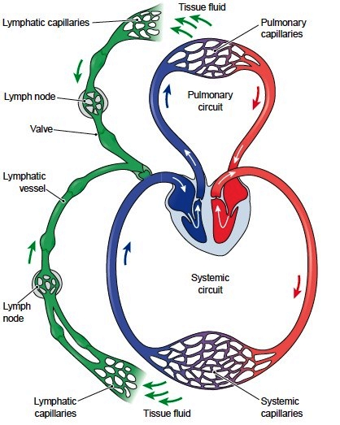
Assists the cardiovascular system by transporting excess interstitial fluid (lymph) through lymphatic vessels
Lymphatic vessels: withdraws excess tissue fluid (lymph) from the body’s interstitial fluid compartment

Slide 5
Most components of blood plasma filter freely through the capillary walls to form interstitial fluid.
More fluid filters out of blood capillaries, however, than returns to them by reabsorption.
The excess filtered fluid drains into lymphatic vessels and becomes lymph.
Because most blood plasma proteins are too large to leave blood vessels, interstitial fluid contains only a small amount of protein.

Slide 6
Proteins that do leave blood plasma cannot return to the blood directly by diffusion because the concentration gradient.
However, move readily through the more permeable lymphatic capillaries into lymph.
Lymph is filtered and checked for foreign or pathologic material, such as cancer cells and bacteria.
Initiate an immune response
Returns it to the bloodstream
Unidirectional flow (towards the heart)

Slide 7
Functions of the Lymphatic System
Reabsorbs excess interstitial fluid:
  Returns it to the venous circulation and maintain blood volume levels
  prevent interstitial fluid levels from rising out of control.
Transport dietary lipids:
  Transported through lacteals
  Drain into larger lymphatic vessels and bloodstream.
Immune Response: lymphocytes

Slide 8
IMMUNE SYSTEM
The ability to distinguish "self" (the organism's own molecules) from "nonself" (foreign substances) molecules.
Aimed to neutralize or inactivate foreign molecules
Destroys microorganisms or other cells (such as virus-infected cells, cells of transplanted organs, and cancer cells)
Rarely, reacts against once own normal body tissues or molecules, causing autoimmune diseases.

Slide 9
Cells of the Immune System include:
  Lymphocytes (T, B and NK cells),
  Plasma cells,
  Neutrophils,
  Eosinophils, and cells of the mononuclear phagocytic system (monocytes-macrophages system)
  Antigen-presenting cells (APCs)= a group of very diverse cell which assist other immune cells

Slide 10
Cells of the Immune System include:
      APCs include, among other cells
        Macrophages
        Langerhan’s cells
        lymphoid dendritic cells
        Microfold (M) cells
        follicular dendritic cells (FDC)
        B cells
        mast cells and granulocytes.

Slide 11
THE IMMUNE CELLS
are diffusely distributed throughout the body in the blood, lymph, epithelial and connective tissues; or
arranged in small spherical masses called lymphatic nodules(lymph follicles) in connective tissues and inside several organs; or
organized as discrete organs called lymphoid organs [lymphoid tissues]—the lymph nodes, the spleen, thymus, and the red bone marrow.

Slide 12
THE IMMUNE CELLS
Two types of immune responses:
  humoral immune responses: by producing antibodies against foreign substances (antigens)
  Cell-mediated immune responses:
  By direct action of cytotoxic cells against microorganisms, tumor cells, transplanted cells, and virus-infected cells.

Slide 13
LYMPHOCYTES
Constitute 20-30 of circulating leukocytes in blood.
distributed in the blood, lymph, loose CT & lymphoid organs
classified as T, B, and natural killer (NK) cells [null cells]
Exposure to antigen & one or more cytokines induces activation of resting T & B cells, leading to their proliferation and differentiation into effector cells.

Slide 14
T LYMPHOCYTES
Constitute 65–75% of blood lymphocytes
are responsible for cell-mediated immune responses and assist B cells in developing a humoral response
Recognize antigens that have been processed and displayed (presented) on the surface of APCs only.
Proliferation, Maturation and Differentiation of T Lymphocytes occurs in the thymus

Slide 15
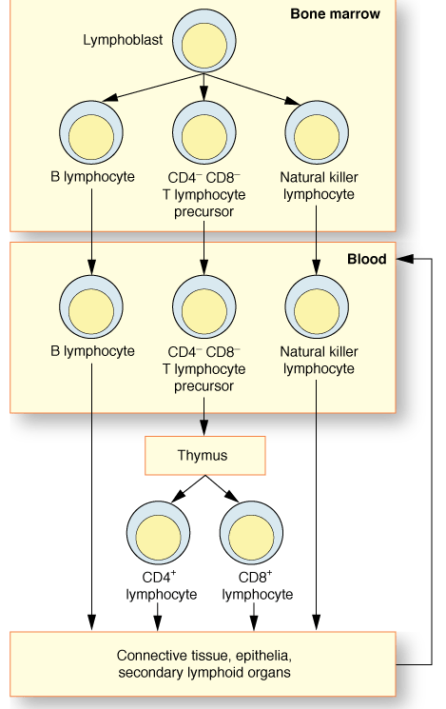

Slide 16
T Helper (TH ) Cells (CD4⁺ cells)
synthesize and release numerous growth factors, known as cytokines (lymphokines)
Induce B cells to respond to an antigenic stimulus.
Cytotoxic T (TC) Cells(CD8⁺ cells)
  Induced by IL-2 to proliferate and differentiate into effector cytotoxic T lymphocytes (CTLs)
  Modulate lysis of foreign cells and virus-infected self-cells

Slide 17
T Helper (TH ) Cells (CD4⁺ cells)
synthesize and release numerous growth factors, known as cytokines (lymphokines)
Induce B cells to respond to an antigenic stimulus.
Cytotoxic T (TC) Cells(CD8⁺ cells)
  Induced by IL-2 to proliferate and differentiate into effector cytotoxic T lymphocytes (CTLs)
  Modulate lysis of foreign cells and virus-infected self-cells

Slide 18
  T Suppressor (TS) (Regulatory) Cells
are CD8⁺ and CD25⁺ cells
Play crucial roles in switching off the immune response
can modulate the extent of the immune response by suppressing activity of TH cells, as well as TC cells.
T memory cells
Provide a faster and greater secondary response against a future challenge by the same antigen.

Slide 19
B LYMPHOCYTES
The encounter of a B lymphocyte with the epitope it recognizes leads to several cycles of cell proliferation, followed by a redifferentiation into plasma cells and B memory cells.
Plasma cells
are effector cells of immune system, which actively synthesize and secrete antibody

Slide 20
NATURAL KILLER (NK) CELLS
a small group of peripheral blood lymphocytes that lack the surface determinants characteristic of T and B lymphocytes
They attack virus-infected cells, transplanted cells, and cancer cells without previous stimulation

Slide 21
IMMUNOGEN (ANTIGEN)
a molecule that is recognized by cells of the immune system and may elicit a response from these cells.
molecule that has capability of inducing an immune response.
AN ANTIBODY
is a glycoprotein that interacts specifically with an antigen
Antibodies belong to the immunoglobulin protein family.
secreted by plasma cells and combines with the epitope that it specifically recognizes

Slide 22
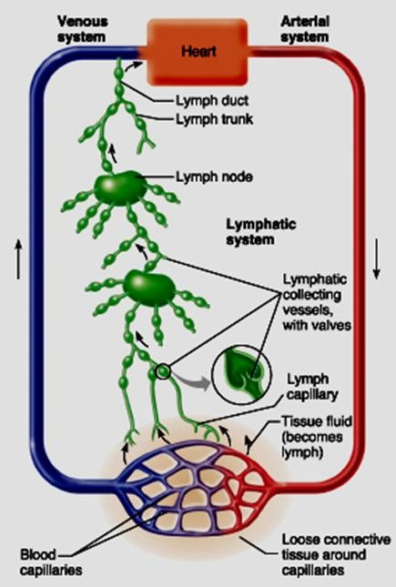
Components of the Lymphatic System
Lymph
Lymphatic Vessels
  Lymphatic Capillaries
  Lymphatic Vessels
  Lymphatic Trunks
  Lymphatic Ducts
Lymphatic organs
lymphoid tissue

Slide 23




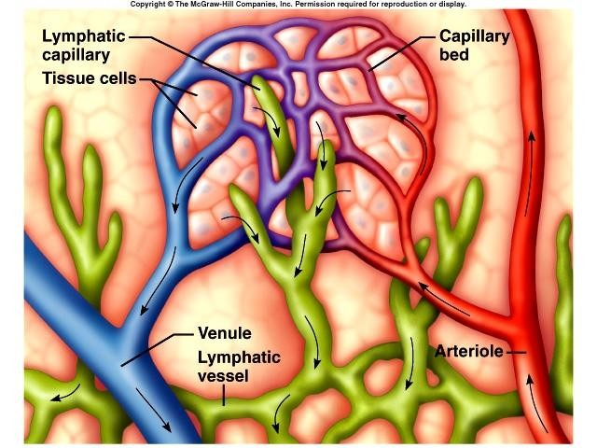
The Lymphatic System
Lymph
is a tissue fluid that enters lymph capillaries
Tissue fluid consists;
water, small molecules of blood plasma, various ions, microorganisms, nutrient molecules, and lymphocyte

Slide 24
The Lymphatic System
Lymph
Tissue fluid is continuously leaving and re-entering the blood capillaries
Usually clear, watery, and slightly yellow, lymph is similar in composition to blood plasma

Slide 25
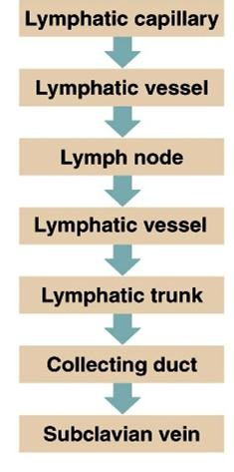
Lymphatic vessels
These vessels collect lymph from the loose connective tissue around blood capillaries and fat absorbed from the GIT carry this fluid to the great veins at the root of the neck
Lymph flow is unidirectional

Slide 26
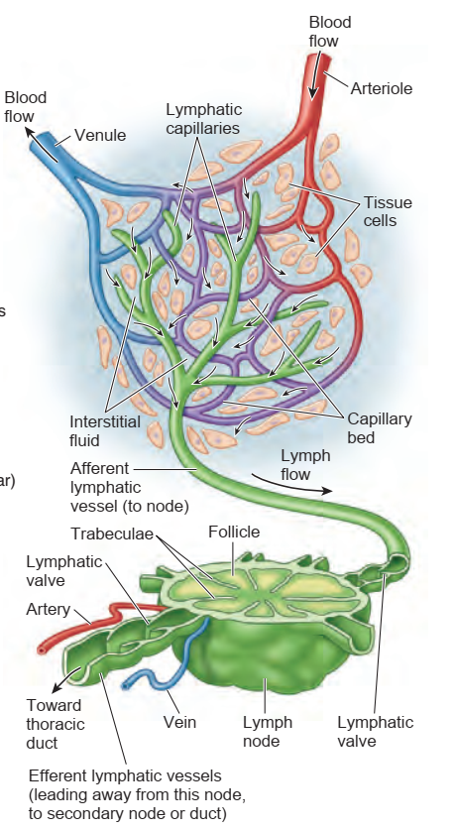

Slide 27

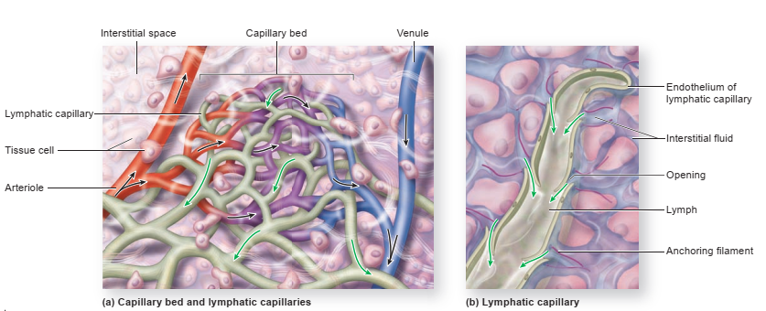
Lymph Capillaries
Lymph capillaries are permeable vessels that receive the tissue fluid
They are located near blood vessels in the loose connective tissue
Like blood capillaries their walls consists of a single layer of endothelial cells with porous junctions

Slide 28
Lymph Capillaries
  They typically have a flat or irregular outline
  They have collagenous anchoring filaments that extend from the incomplete basal lamina to the surrounding connective tissue;

Slide 29
  They have greater permeability
    Endothelial cells overlap instead of being tightly bound
  The region of endothelial cell overlap -acts as a one-way valve, permitting passage of interstitial fluid into the lymphatic capillary but preventing its escape
  The gaps between endothelial cells are large enough -that there is a little in the interstitial fluid that cannot find its way into a lymphatic capillary

Slide 30

Lymphatic capillaries
Lymphatic capillaries differ from vascular capillaries in several ways:
  Lymphatic capillaries are larger both in diameter and in sectional view
  They have thinner walls because their endothelial cells lack a continuous basal lamina

Slide 31
Lymph Capillaries….
Lymph capillaries occurs almost everywhere the blood capillaries occur
They are absent in the teeth and bone, bone marrow, the entire central nervous system, coats of the eye, internal ear, and fetal placenta.
In the CNS excess fluid drains into the cerebrospinal fluid and then returns it to the blood at the superior sagittal sinus

Slide 32
Lymph Capillaries….
lymph capillaries also allows entrance of bacteria, viruses, or cancer cells from the loose connective tissue
Cancer cells use lymph nodes as a site to metastasize further

Slide 33
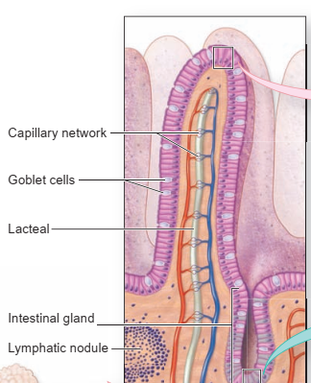
Lymph Capillaries….
In the small intestine, specialized lymphatic capillaries called lacteals carry dietary lipids into lymphatic vessels
The lymph draining from the small
intestine to appear creamy white; such
lymph is referred to as chyle

Slide 34
Lymph Collecting Vessels
The lymph enters lymphatic collecting vessels accompanying blood vessels
In general, the superficial lymphatic collecting vessels in the skin travel with superficial veins
Deep lymphatic collecting vessels of the trunk and digestive viscera travel with the deep arteries

Slide 35
The vessels have the same tunics as blood vessels but their walls are always thinner
The thinness reflects that lymph flows under very low pressure and there is no pumping organ

Slide 36

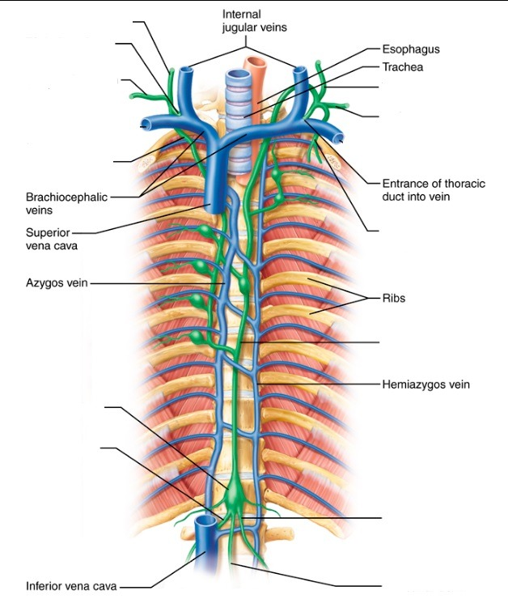
The Lymphatic trunk
After the lymph leave the lymph nodes, the largest lymphatic vessels converge to form lymph trunks
Resemble large vein and drain large areas of the body
The principal lymph trunks:
The lumbar trunk
The Intestinal trunk
The Bronchomediastinal trunk
The Subclavian trunk
The Jugular trunks trunk

Slide 37
The Lymphatic trunk
Lumbar Trunks
  These paired trunks lie along either side of the aorta in the inferior abdomen
  They receive lymph draining from the lower limbs, pelvic organs and the abdominal wall

Slide 38
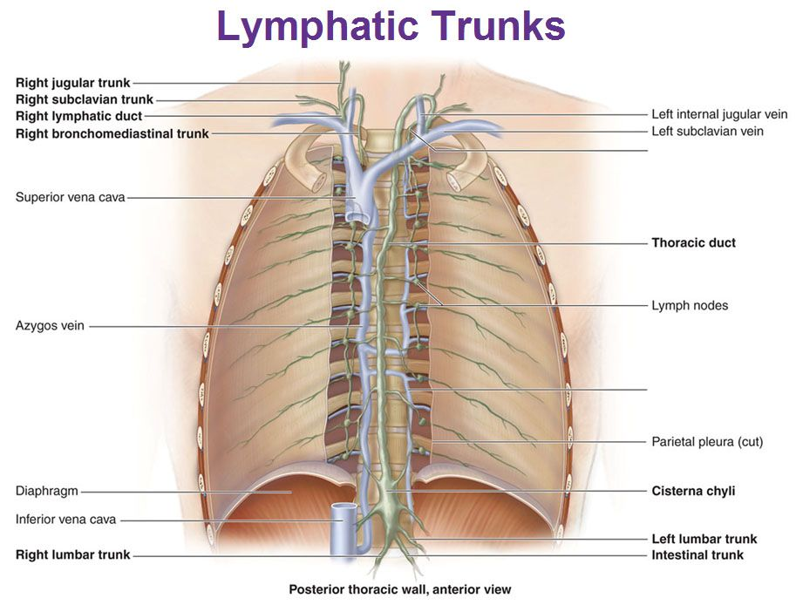

Slide 39
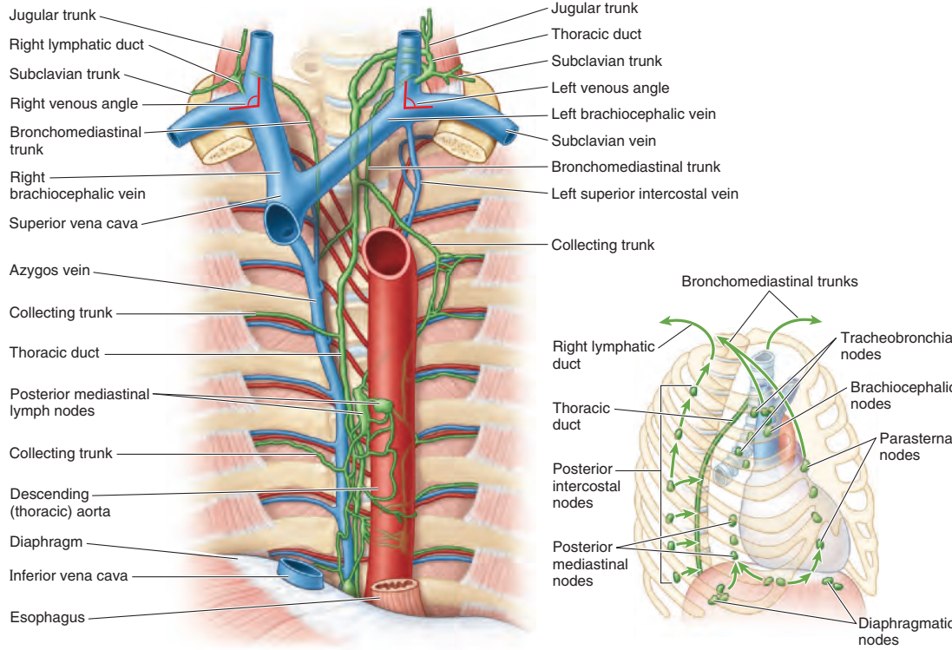


Slide 40
Intestinal Trunk
  This unpaired trunk lies near midline on the posterior abdominal wall
  It receives fatty lymph (chyme) from intestines, stomach and other digestive organs
Bronchomediastinal Trunks
  These paired trunks ascend near the sides of the trachea
  They collect lymph from the thoracic viscera and wall

Slide 41
The Lymphatic trunk …
Subclavian Trunks
  These are paired trunks located near the subclavian vein
  These trunks receive lymph from the upper limbs
  They also drain the inferior neck and the superior thoracic wall
Jugular Trunks
  located in the neck at the base of each internal jugular vein
    Drain lymph from the head and neck

Slide 42
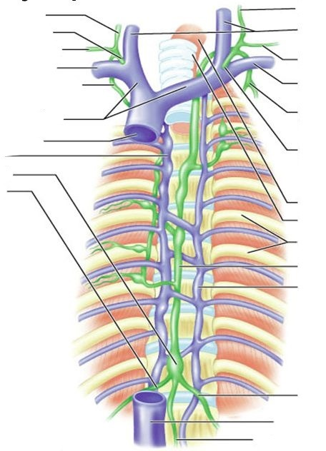
The Lymph Duct
The trunks drain into the largest vessels - the lymph ducts; which are;
Thoracic Duct:-
  Its inferior most part, located at the union of the lumbar and intestinal trucks (the cisterna chyli – at bodies of L1 & L2)

Slide 43
The Lymph Duct
  The thoracic duct ascends along the vertebral bodies
  In the superior thorax, it turns left and empties into the venous circulation at the junction of the left internal jugular and left subclavian veins
  It drains all the lymph of the body except for the right thorax, right upper limb and right side of the head and neck

Slide 44

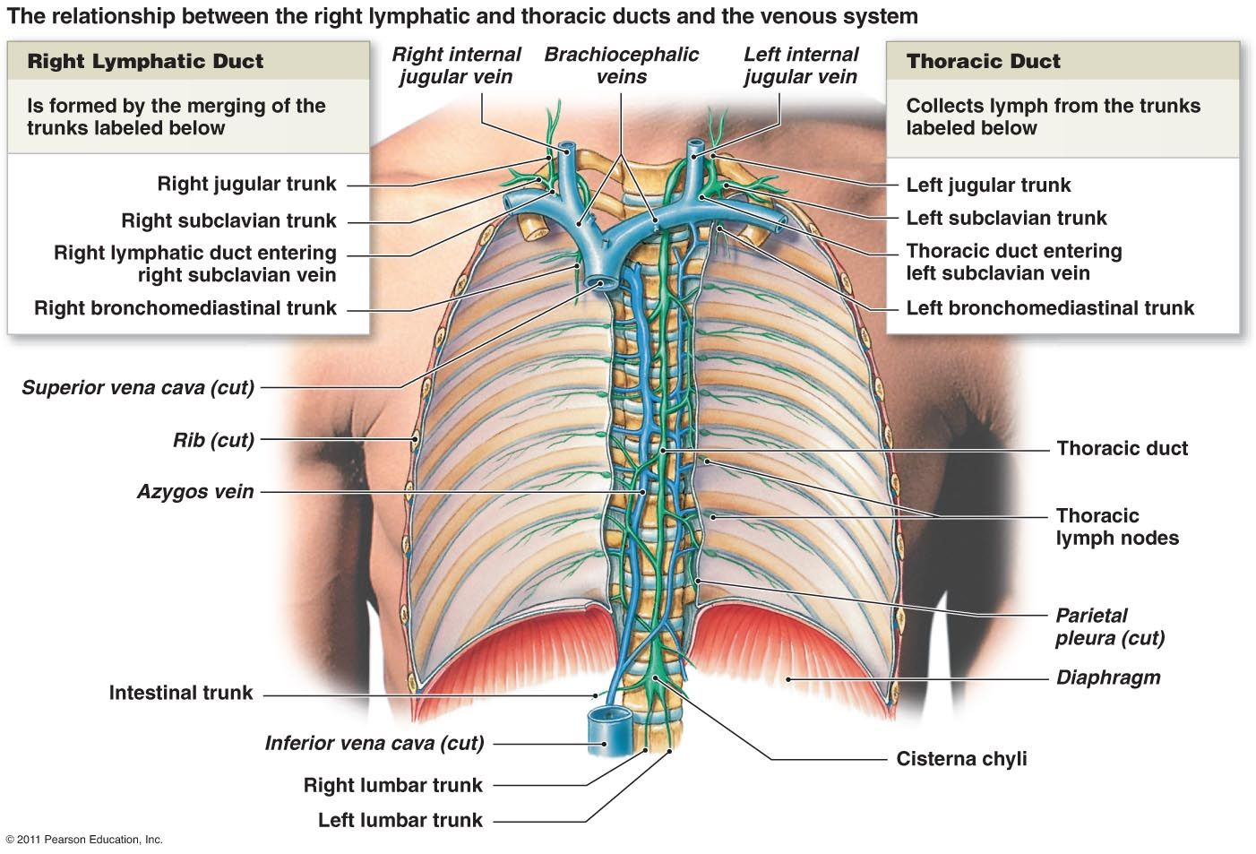
The Lymph Duct….

Slide 45

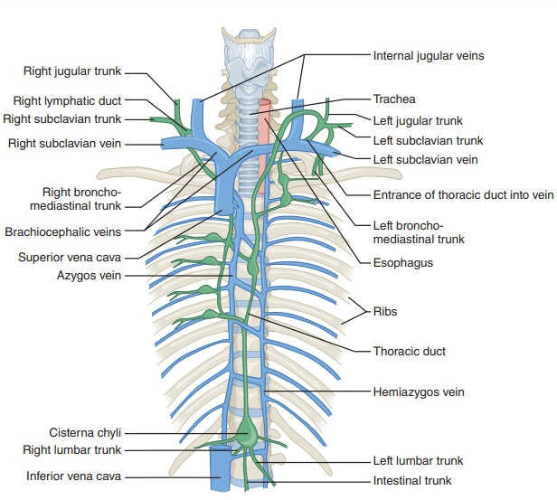
The Lymph Duct…
Right lymphatic Duct
a short right lymphatic duct formed by the union of the right jugular, subclavian, and bronchomediastinal trunks

Slide 46
The Lymph Duct…
Right lymphatic Duct
  When present, this duct empties into the neck veins at or near the junction of the right internal jugular and subclavian vein
  The right lymphatic duct drains the upper quarter of the body (right sides of upper limb,thorax, head and neck)
  In individuals without a right lymphatic duct, the three trunks empty separately into the neck veins

Slide 47
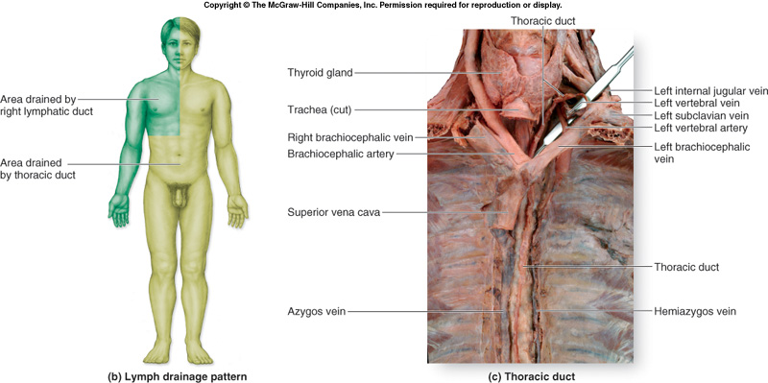

Slide 48
Lymph Transport
The mechanisms that promote lymph return
  Milking action of active skeletal muscles
  Pressure changes in the thorax during breathing
  Valves – prevent backflow
  Pulsations of nearby arteries
  Rhythmic contraction of smooth muscle in the walls of the lymphatic trunks and thoracic duct
Three L/24hrs of lymph enters the blood stream

Slide 49
Lymphoid Tissue
Houses lymphocytes and they are sites where most lymphocytes activation and most effector and memory lymphocytes are generated
Exists;
Freely within the regular connective tissue or
Surrounded by capsules, forming the lymphoid organs

Slide 50
Lymphoid Tissue
Are made up of free cells supported by a rich network of reticular fibrils (made principally of type III collagen)
Are the main battleground in the fight against infection

Slide 51
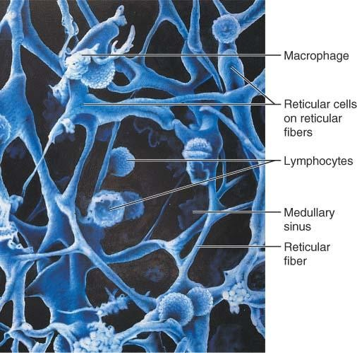
Reticular tissue in a human lymph node.

Slide 52
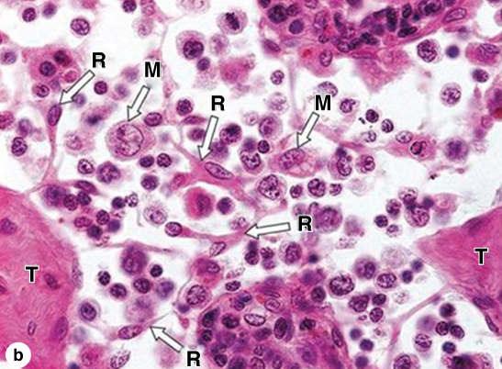
Cells of typical lymphoid tissue include the fibroblast-like reticular cells (R) which produce and maintain the trabeculae (T) and reticulin framework. Many cells are loosely attached to the reticulin fibers, including macrophages (M) and many lymphocytes. X240. H&E.

Slide 53
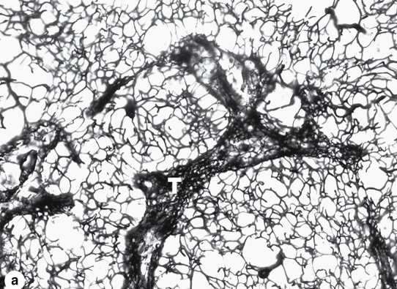
A three-dimensional framework of reticular fibers (collagen type III) supports the cells of most lymphoid tissues and organs (except the thymus). Areas with larger spaces between the fibers offer more mobility to cells than areas in which the fiber mesh is tight, such as in trabeculae (T) and the cells here are generally more stationary. X10. Silver impregnation

Slide 54
LYMPHOID TISSUES
Lymphoid tissues exist in two different forms:
  Diffuse lymphoid tissues
  Nodular types organized as lymphatic nodules
Diffuse lymphoid tissues or
  Scattered especially in any loose CT deep to the epithelia

Slide 55
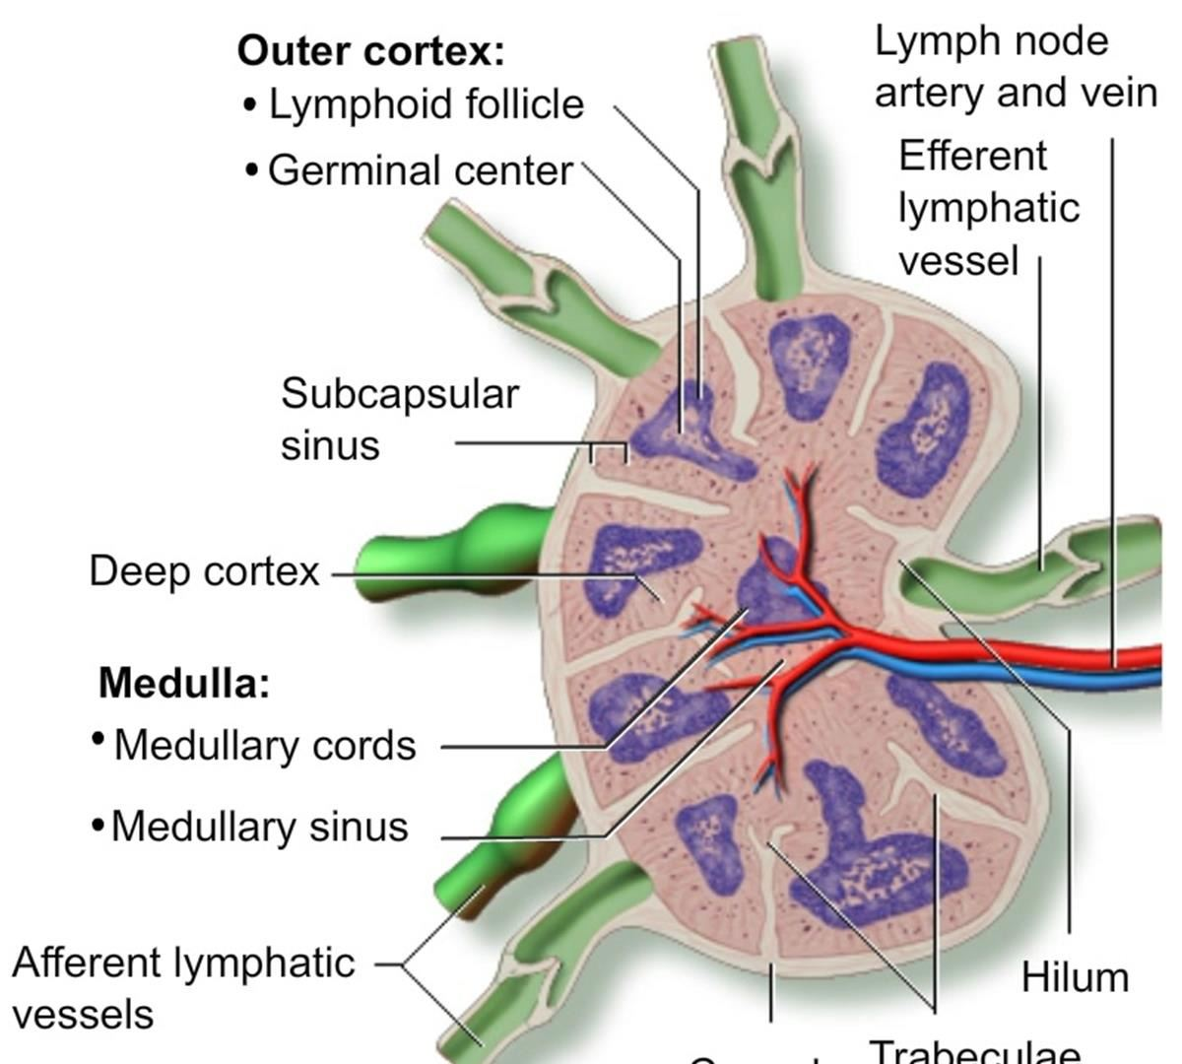
LYMPHOID TISSUES
2. Lymphoid nodules (lymph follicles)
Groups of lymphocytes are arranged as spherical masses called lymphoid nodules or lymphoid follicles, containing primarily B lymphocytes.

Slide 56
Lymphoid nodules (lymph follicles) in the outer cortex of a lymph node

Slide 57
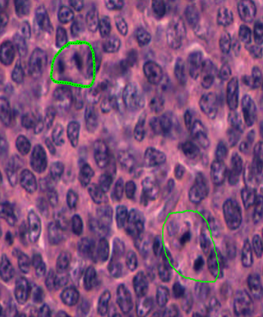
LYMPHOID TISSUES
When lymphoid nodules become activated, lymphocytes proliferate in the central portion of the nodule, which then stains lighter and is called a germinal center.

Slide 58
LYMPHOID TISSUES
After completion of the initial immune response, the germinal center may disappear.
Germinal centers contain a special cell, the follicular dendritic cell (FDC, distinct from the dendritic APCs), with surfaces that have many extremely fine processes.

Slide 59
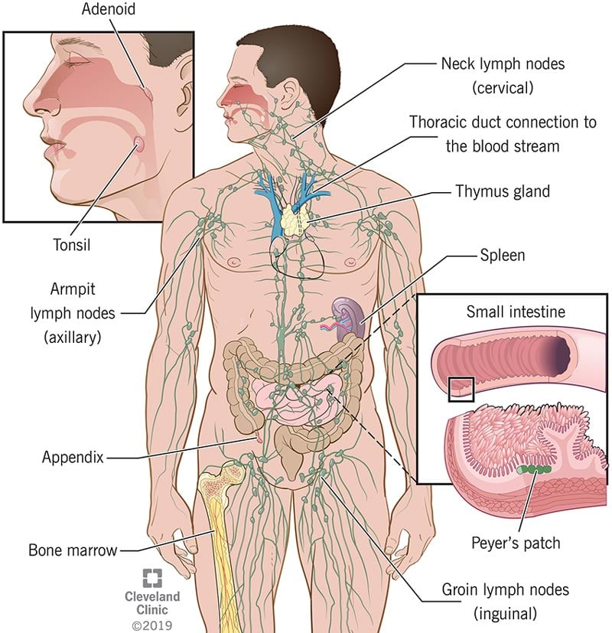
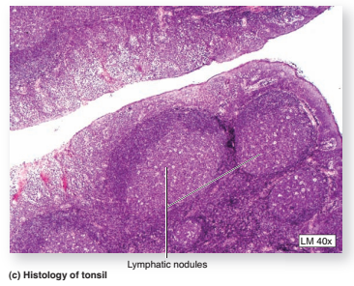
Lymphoid Tissue
Lymphoid nodules
  Measure up to 1 mm in diameter
  Found within lymphoid organs except in the thymus
  Are not covered by a capsule

Slide 60
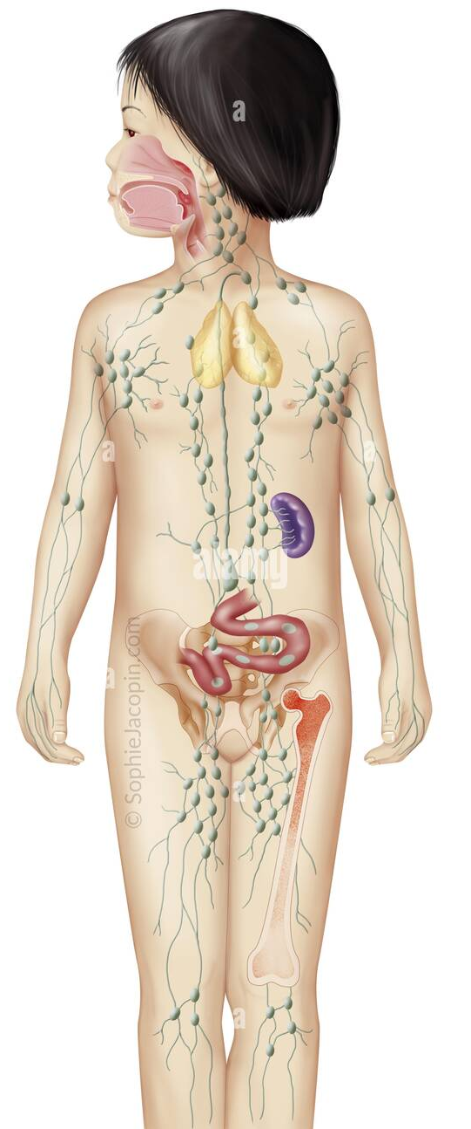
Lymphoid Organs
Primary or central organs :- Red bone marrow and thymus gland
  Sites where stem cells divide and become immunocompetent
Secondary organs:- Lymph node, Spleen, MALT
  Sites where most immune responses occur

Slide 61
Lymphoid Organs
B and T Lymphocytes are major component of
Lymphoid Organs
Other cells:- macrophages, dendritic cells , reticular cells
Lymphoid Organ | T Lymphocytes, (%) | B Lymphocytes, (%)
Thymus | 100 | 0
Bone marrow | 10 | 90
Spleen | 45 | 55
Lymph nodes | 60 | 40
Blood | 75 | 35
Table showing the proportion of lymphocyte in lymphoid organs

Slide 62
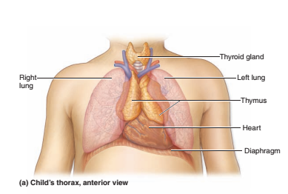
Thymus
Is a lymphoepithelial organ behind the sternum b/n inferior thyroid pole & the upper four costal cartilages,
Located in the superior and anterior part of inferior mediastinum

Slide 63
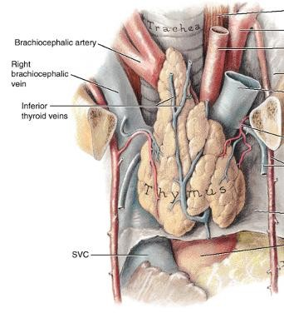
Thymus
After puberty, the thymus undergoes gradual involution and is largely replaced by fat
The thymus consists of right and left lobes joined by isthmus

Slide 64
Thymus has a dual embryonic origin from endoderm and mesoderm
Nonthymic lymphoid organs however, are derived exclusively from mesenchyme (mesoderm).

Slide 65

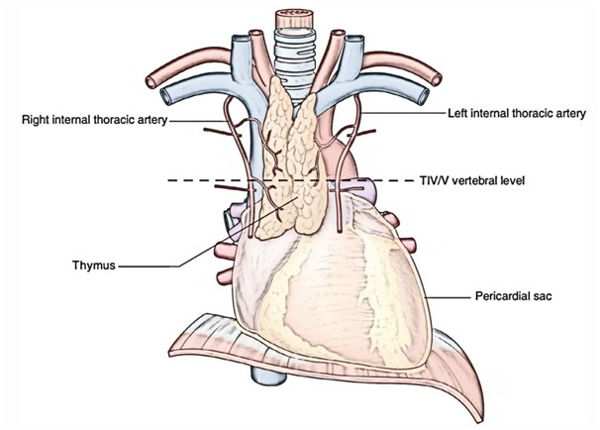
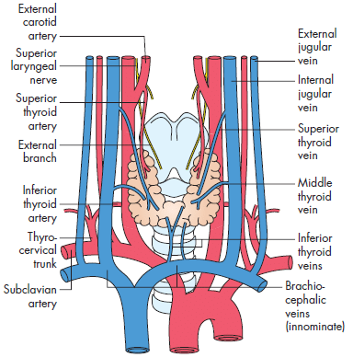
Thymus
The rich arterial supply - from the anterior intercostal and anterior mediastinal branches of the internal thoracic arteries
The veins -end in the left brachiocephalic, internal thoracic, and inferior thyroid veins
65

Slide 66
Thymus
The lymphatic vessels of the thymus end in the parasternal, brachiocephalic, and tracheobronchial lymph nodes
66

Slide 67
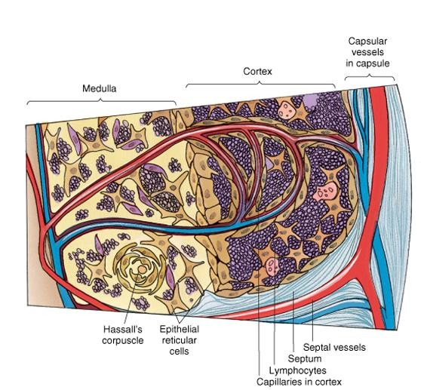
Thymus
Histology
  Is covered by connective tissue capsule that penetrates the parenchyma and divides it into incomplete lobules
  Each lobule has a
    Cortex - peripheral
dark zone
    Medulla - central light zone
67

Slide 68
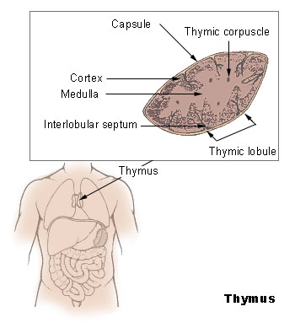
THYMUS

Slide 69
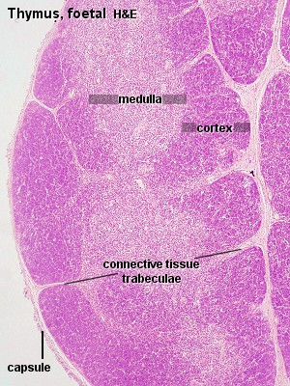

Slide 70
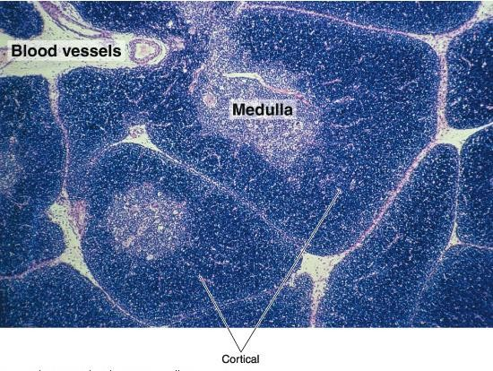
Thymus
Histology
70

Slide 71
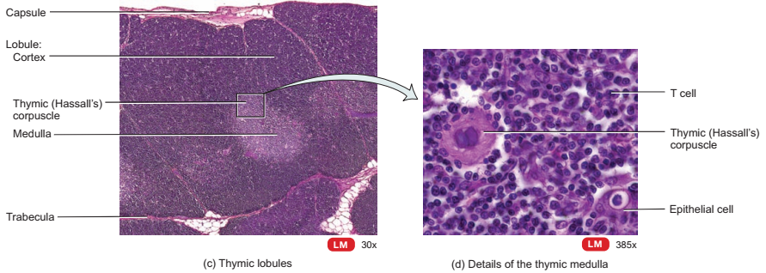
Thymus
The cortex
  composed of an extensive population of T cell precursors (thymocytes), dispersed epithelial reticular cells, and macrophages
  stains more darkly- large number of T lymphocytes

Slide 72
EPITHELIAL RETICULAR CELLS
are pale cells (derived from the third pharyngeal pouch), having a large ovoid, lightly staining nucleus, which often displays a nucleolus.
Possess long interdigitating cytoplasmic processes that surround the thymic cortex, isolating it both from the connective tissue septa and from the medulla.

Slide 73
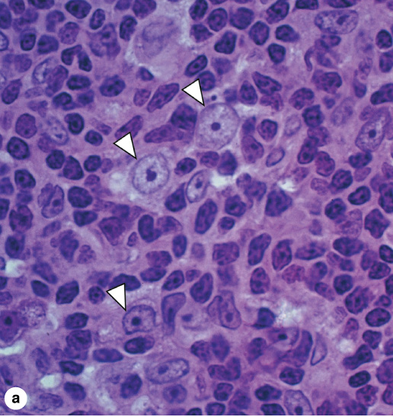
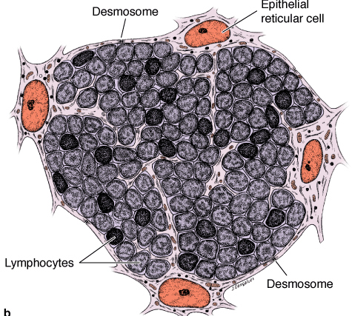
Cortex of Thymus
Notice absence lymph follicles in the thymus.
The cortical zone of an active thymus is packed with lymphoblasts that proliferate. The lymphoblasts are supported in a meshwork of epithelial reticular cells (arrowheads). X400. PT. (b): The epithelial reticular cells extend long processes bound together by desmosomes to make the framework for the lymphocytes. The epithelial reticular cells also secrete polypeptide factors that promote T cell maturation.

Slide 74
EPITHELIAL RETICULAR CELLS
These processes, form desmosomal contacts with each other, forming an unusual cytoreticulum.
secrete at least three different hormones (thymosin alpha-1, serum thymic factor, & thymopoietin) and a variety of other humoral factors which regulate T cell maturation and proliferation

Slide 75
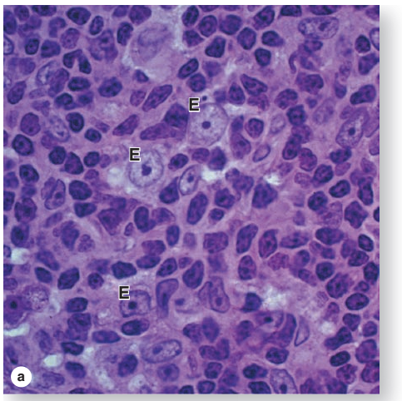

Slide 76
THYMOCYTES
are immature T lymphocytes present in large numbers within the thymic cortex in different stages of differentiation.
are surrounded by processes of epithelial reticular cells, which help to segregate thymocytes from circulating antigens during their maturation.
migrate toward the medulla as they mature

Slide 77
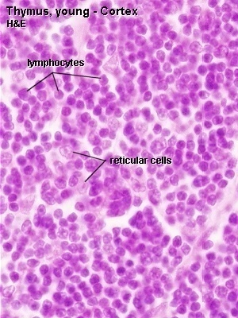
(Thymocytes)

Slide 78
      About 98% T lymphocyte die by apoptosis and removed by macrophages
    The remaining T cells survive and migrate to the medulla and to thymic dependant secondary lymphoid organs;
Paracortical zone of lymph nodes
Periarterial sheath of spleen
Some part of peyer’s patches of ileum

Slide 79

Thymus
  Macrophages -
    present in small numbers, scattered throughout the cortex
    They are difficult to distinguish from reticular cells by light microscopy
    lack of desmosomes

Slide 80
Blood-Thymus Barrier
Ensures that antigens escaping from the bloodstream do not reach developing T cells in the thymic cortex.
consists of the following layers:
  continuous endothelium of blood capillaries and its complete basal lamina
  perivascular connective tissue and cells (e.g. pericytes and macrophages), and
  epithelial reticular cells and their basal laminae.

Slide 81
THYMICMEDULLA
is continuous between adjacent lobules.
contains large numbers of epithelial reticular cells and mature T lymphocytes, which are loosely packed
is the region from which mature T cells exit the thymus

Slide 82
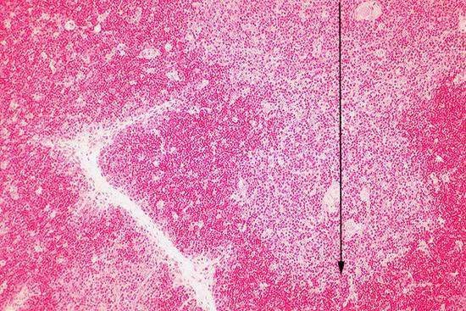
Thymus medulla

Slide 83
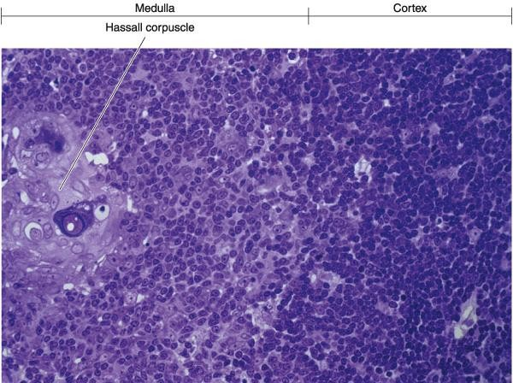
Thymus
  Thymic corpuscles
Circular
Function - unknown
Degenerate and filled with keratin filaments
They sometimes calcify
Size from 10 -
100μm or more in diameter, increase with age
Thymus

Slide 84

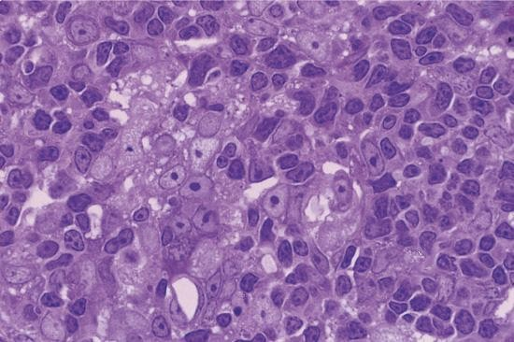
Thymus
Medullary zone of the thymus.
Large numbers of epithelial reticular cells with their large and light-stained nuclei are responsible for the light color of the thymus medulla.
This zone also contains mature T lymphocytes

Slide 85
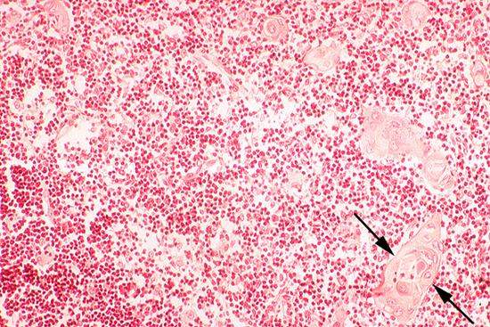
Hassall’s corpuscles (in the thymic medulla)

Slide 86
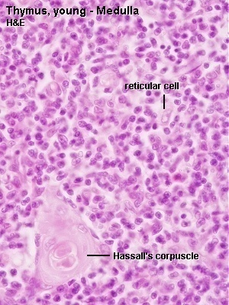

Slide 87
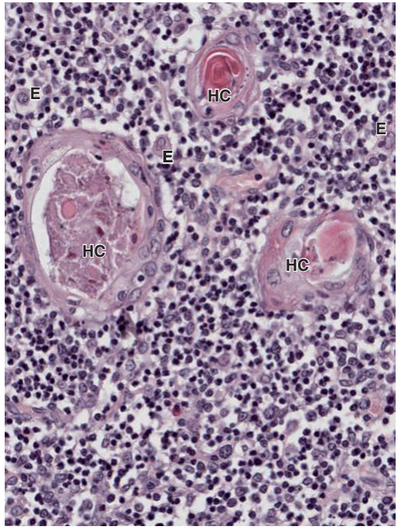

Slide 88
Involution of the Thymus
Involves two distinct processes, fatty infiltration and lymphocyte depletion, which occur independently on a different time scale.
Fatty infiltration and lymphocyte depletion results in disruption of cortico-medullary organization.

Slide 89
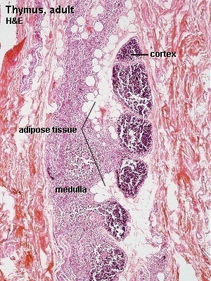

Slide 90

Thymus
Blood circulation
  The arteries to the thymus penetrate and follow the connective tissue of the septa
  Arteriolar branches from these vessels run along the cortico-medullary junction and provide arterioles and capillaries to the medulla and capillaries to the cortex
90

Slide 91
Thymus
  Cortical capillaries
    Have a nonfenestrated endothelium
    Loop back to drain into medullary venules
    Enveloped by a collar of connective tissue that forms part of the blood thymic barrier- prevent developing T cells from contacting blood-borne macromolecules

Slide 92
Thymus
Blood circulation…
  Medullary capillaries
    Drain in to medulary venules
    Make no blood thymic barrier
The thymus has only few efferent; no afferent lymphatic vessels

Slide 93
Lymph Nodes
Lymph nodes are small encapsulated, elongated or kidney-shaped lymphoid organs
Meassure about 3cm in diameter
Lymph nodes are distributed throughout the body along the course of the lymphatic vessels
They are found in the axilla , groin, along the great vessels of the neck, and in large numbers in the thorax and abdomen, especially in mesenteries
Constitute a series of in-line filters

Slide 94
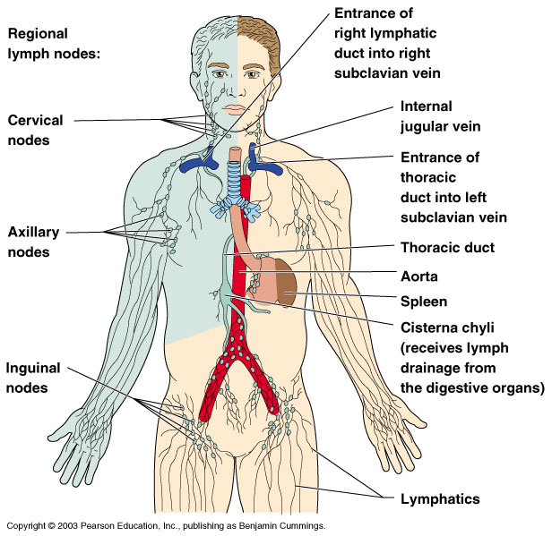
Lymph Nodes

Slide 95
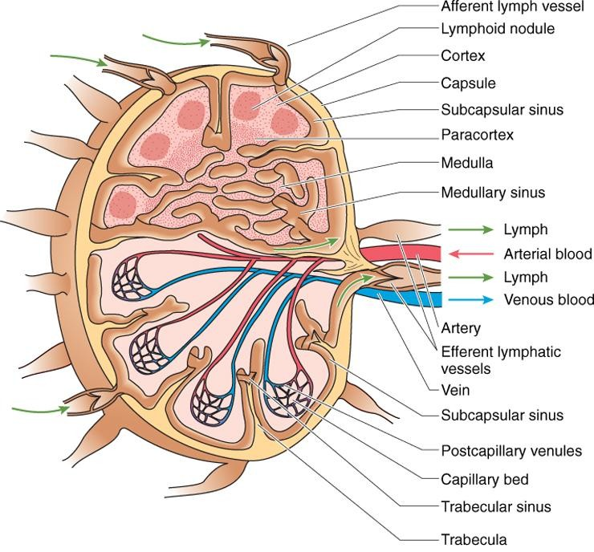
Lymph Nodes
Histology
  A connective tissue capsule surrounds the lymph node, sending trabeculae into its interior
  Show two regions, a cortex and a medulla

Slide 96
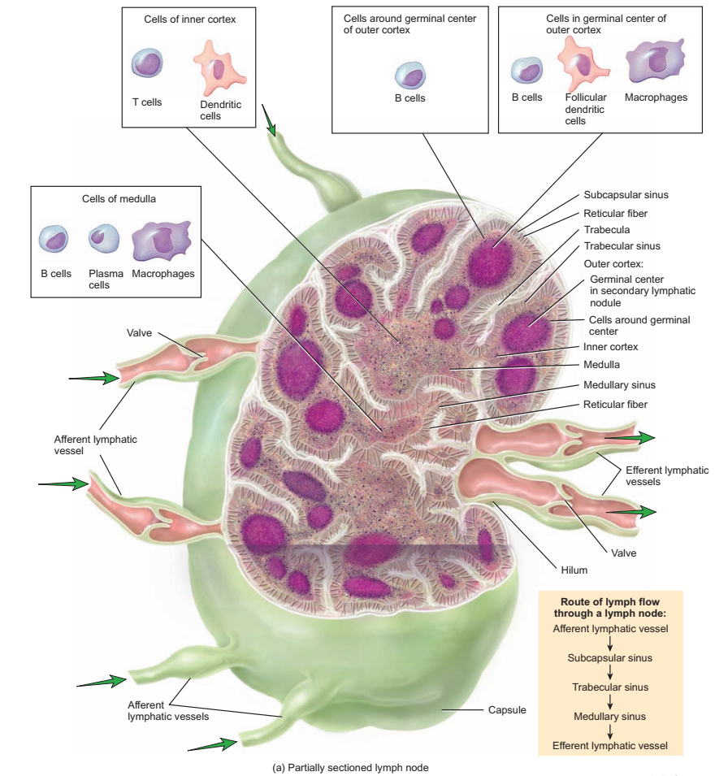

Slide 97
CORTEX
Outer cortex
  Contains follicles (lymphatic nodules)
  Inner cortex (paracortex)
  Does not contain lymphatic nodules
  Contains mainly T cells and dendritic cells that enter from other lymph node from other tissues.

Slide 98
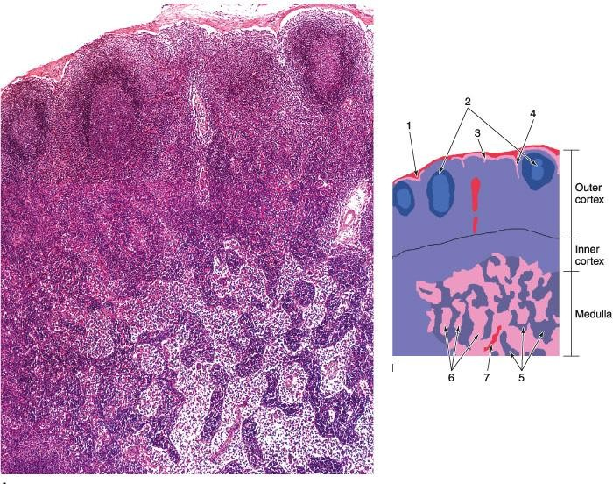
Lymph Nodes….
lymph node showing the cortex and the medulla and their primary components. B: (1) Capsule; (2) lymphoid nodule with germinative center; (3) subcapsular sinus; (4)
Intermediate sinus; (5) medullary cords; (6) medullary sinus; (7) trabecula

Slide 99
  Lymphoid nodules; Contains
    Primary lymphoid nodules – containing closely packed B lymphocytes
    Secondary lymphoid nodules- site of generation of B memory cell and plasma cell
        They are formed only in response to an antigenic challenge

Slide 100
Function: to filter lymph, to maintain and produce clones of T & B cells, and to house memory cells
The parenchyma of lymph node is divided roughly into three functional zones– cortex (outer cortex), paracortex (inner cortex), and medulla
    With the three different centers of immunological activity in the lymph node being dominated by B lymphocytes, T lymphocytes and plasma cells respectively.

Slide 101
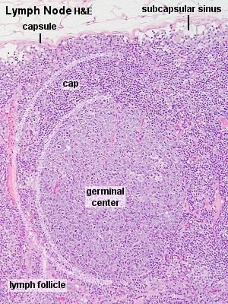

Slide 102
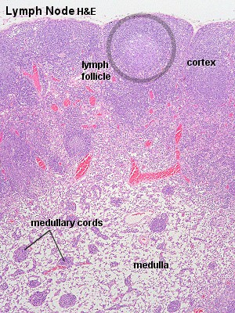
Paracortex

Slide 103
Sinusoids/Sinuses
endothelium-lined lymphatic channels that extend beneath the capsule (subcapsular sinus)
  along the trabeculae (trabecular sinus) and in the cortex (cortical sinus) and medulla (medullary sinus).
Afferent lymphatic vessel divides into small multiple branches outside the node.
These multiple lymphatics pierce the capsule and empty their content into lymph node at subcapsular sinus.

Slide 104


Slide 105


Slide 106

Cortical sinuses

Slide 107

lies deep to the paracortex and cortex except at the region of the hilum.
is composed of medullary sinusoids and medullary cords
MEDULLA

Slide 108
Medullary cords
are branched cordlike extensions of lymphoid tissue arising from the paracortex.
contain primarily lymphocytes, plasma cells and macrophages
are separated by dilated spaces, frequently bridged by reticular cells and fibers, called medullary sinuses.

Slide 109

Lymph node medullary cords

Slide 110
Medullary sinusoids
are endothelium-lined spaces supported by reticular fibers and reticular cells,
receive lymph from the cortical sinuses.
contain lymph, lymphocytes, often many macrophages, and sometimes even granulocytes
these sinuses are continuous with the cortical sinuses and join at the hilum to the efferent lymph vessel

Slide 111


Slide 112
Recirculation of Lymphocytes
lymphocytes may then leave the blood vessels by entering the tissues and return with other lymph to another lymph node.
However, most (90%) lymphocytes return to a lymph node by crossing the walls of specific postcapillary venules in the paracortex, called high endothelial venules (HEVs).

Slide 113


Slide 114
MEDICAL APPLICATION
Malignant tumor cells often reach lymph nodes and are distributed to other parts of the body via the efferent lymph vessels and blood vessels, a process known as metastasis.
Infection and antigenic stimulation often cause lymph nodes to enlarge.
These swollen nodules, which may be palpated under the skin as indicators of inflammation, have multiple germinal centers with active cell proliferation.

Slide 115
Lymph Circulation in the lymph nodes
  Afferent lymphatic vessels cross the capsule and pour the lymph into subcapsular sinus
  The lymph passes through the intermediate sinuses and, finally, into the medullary sinuses
  During this passage, the lymph perfuse in to the paranchyma for uptake and digestion of foreign materials by macrophages

Slide 116
  Finally the newly formed and circulating lymphocyte enters to efferent lymphatic vessels at the hilum
  Valves in both the afferent and efferent vessels aid the unidirectional flow of lymph

Slide 117
Blood circulation in lymph nodes
  The major blood supply reaches the node through the hilus, and give medullar and cortical branches
  Postcapillary venules (high endothelium venules) in the paracortex are lined by cuboidal to columnar epithelium -which leave B cells to the cortex and T cells that circulate for monitoring the body parts

Slide 118

Lymph Nodes….
Blood and lymph circulation in the lymph nodes

Slide 119
Any question????

