Slide 1
Genetics

Slide 2
Genetics is a branch of biology concerned with the study of gene, genetic variation, and heredity in organisms.
Heredity (biological inheritance), is the passing on of one traits from parents to their offspring.
what is the relation between ?
√ Chromosomes
√ Genes
√ Alleles

Slide 3
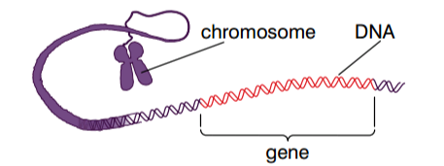
▪ Chromosomes - are a thread-like structures located in side the nucleus of a cell.
- made from DNA which is bound with histone protein
● Gene – is a section of DNA (therefore a section of chromosome that determines a particular feature). For example - earlobe hang or free
- purple or white flower
- tall or short plant …etc.
* gene is a basic physical and functional unit of heredity that occupies a fixed position(locus) on a chromosome.

Slide 4
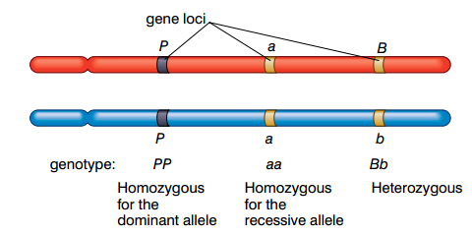
Alleles - are different “ versions” of a gene
example a pea plant have purple and white allele.
▪ Homologous chromosomes (a set of one maternal and one paternal chromosome that pair) carry alleles of the same genes at the same loci.

Slide 5
Dominant allele- expressed in the homozygote and heterozygote.(represented usually by capital letter)
Example - PP Pp
purple purple
- appear in F₁ generation
Recessive allele- are only expressed in homozygote
Example - pp
-not appear in F₁ generation
Co-dominant allele -both allele are expressed in heterozygote. Both allele of a gene equally expressed.
Example - flower color of snapdragons
R-red petals RR-red flower
r-white petals Rr-pink flower
rr-white flower

Slide 6
▪ Multiple allele inheritance - these are more than two alleles of a gene.
Example - allele involved in the inheritance of blood group.
Genotype Blood group
I^{A}I^{A},I^{A}I^{O} A
I^{B}I^{B},I^{B}I^{O} B
I^{A}I^{B} AB
I^{O}I^{O} O

Slide 7
Monohybrid cross- is a genetic cross or breeding situation that relate to just one trait or feature.
The rule of inheritance was discovered by the Austrian monk Gregor Mendel .
▪ Mendel use the seven contrasting characteristics of pea plants in his experiments.
The contrasting characteristics are
√ Height tall √ seed color yellow
short green
√ Flower color purple √ seed shape round
white wrinkled
√ Flower position axial √ pod color green
terminal yellow
√pod shape inflated
constricted

Slide 8
He crossed the trait following the same procedure for all contrasting characteristics .
Example PP ⨉ Pp(white)
F1- Pp all purple F2 – 3 purple, 1 white
● Meiosis – For gametes to be formed special cells in the sex organ of the organism divide by a process known as meiosis.
- a special type of a cell division is sexually reproducing organisms , used to produce the gametes(sex cells). The process is Gametogenesis.
Outcomes of meiosis
* 4 haploid daughter cells
* The daughter cells have only half the number of chromosome of original cells.
* Daughter cells show genetic variation(as a result of crossing over in prophase I )

Slide 9
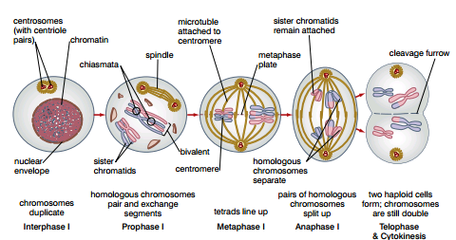
Two division of meiosis
Meiosis I – chromosome that make up homologous pair are separated.

Slide 10
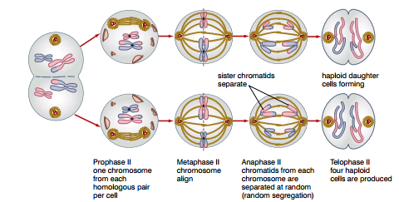
Meiosis II – the chromatids that make up chromosome are separated.

Slide 11
Genetic linkage
* if genes did not segregate, the genes are linked and inherited together because they are on the same chromosome. The two genes inherited as a single unit.
parent genotype PL/PL ⨉ pl/pl
Gametes PL pl
F1 genotype PL/pl
(self-fertilised)
Gametes male female
PL pl PL pl
 | PL | pl
PL | PL/PL Purple, long | PL/pl Purple, long
pl | PL/pl Purple, long | Pl/pl Red, round

Slide 12
Crossing over in meiosis produces recombinant type of the offspring. So we get four types of offspring from a cross between two plants both heterozygous for both features. But not 9:3:3:1 ratio.
Cross breeding results in hybrid vigour (heterosis) and can be used to combine desirable trait in one variety , whilst inbreeding is used to establish pure line.

Slide 13
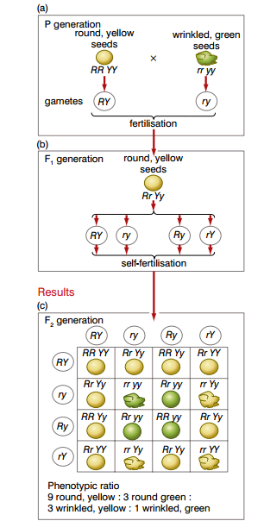
Independent assortment
- state that the inheritance
of one trait is independent
of the inheritance of another.
Dihybrid inheritance
– the inheritance of two
characteristics at the same time.

Slide 14
Sex determination
. Gender in humans determine by x and y chromosomes.
Male- xy
Females- xx
* The SRY gene found in x-chromosome determine sex in humans .
* If SRY gene activated bi potential gonad develop to testes and the embryo is male.
* If SRY gene is absent(or inactivated) bi potential gonad develop to ovary and the embryo is female.
* Turner syndrome⟹ sterile female 45 chromosomes
* Klinefelter syndrome⟹ sterile male 47 chromosomes
results of non disjunction of sex chromosomes during meiosis

Slide 15
sex- linked chromosome - determined by alleles carried on the sex – chromosomes.
. Gene found on Y- chromosomes
Example retnitis pigmentosa
. Gene found on X- chromosome
Example - red green color blindness
- haemophilia
* Most sex-linked conditions are determined by recessive alleles on the x-chromosome , males are affected more frequently than female by these because they need only inherit one x-chromosome with recessive allele whilst females must inherit two.
* Sex influenced and sex limited traits are expressed differently in two sexes. However the gene determines these trait.

Slide 16
Sex influenced trait is more likely to occur in one sex but may sometimes occur in other sex.
Example – baldness
Sex limited trait occur only in one sex and never occur in other sex.
example – gene that stimulate lactation.
DNA molecule – double helix in which the base sequence on the sense strand is complementary to the base sequence on antisense strand.
- DNA is a huge molecule made from two anti-parallel polynucleotide strand.
- The basic unit of a DNA strand is a nucleotide
- Three components of nucleotides are
. A phosphate group
. Four nitrogenous base
. A pentose sugar
* DNA must replicate semi conservatively means each new DNA molecule formed contain one strand from original DNA.

Slide 17
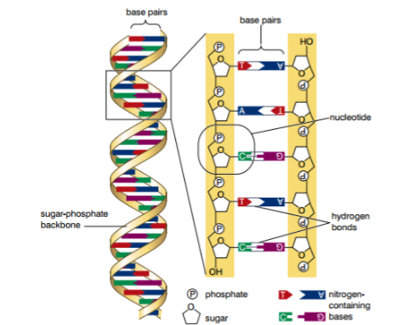
Cloning – is the process of producing genetically identical individuals of an organism either naturally or artificially.

Slide 18
A clone of an organism is a group of organism that are genetically identical to each other and to organism from which they derived.
Plants cloned using the technique of micropropagation.
Animals have been cloned. The first mammal to be cloned was dolly the sheep.
There are two types of cloning in vivo-cloning and in vitro-cloning.
Genetic engineering – is a process in which the genome of an organism is altered, usually by having an extra gene from different organism added.
A genome is an organism’s complete set of DNA including all of its gene.
A transgenic organism has had genes from a different type of organism (usually a different species) added to its genome.
Restriction enzymes cut DNA at specific sequences, called restriction site, to leave overlapping stick ends.
A gene inserted into a plasmid using a ligase enzyme.

Slide 19
Genetically modified organisms can be used to manufacture specific products to benefit humans (for example insulin, vaccine, etc).
Other organisms have also been genetically modified to produce increased yields.
Genetic fingerprinting – is a technique of comparing the DNA of different people.
The main stages in preparing genetic fingerprint
√ preparation of fragments using restriction enzyme
√ The fragments separated by gel electrophoresis.
√ DNA fragment transferred from the gel to nylon membrane(blotting DNA to membrane).
√ Hybridization with radio active probe made of single stranded DNA.
√ Autoradiography (the pattern of complementary sequence revealed using x-ray film.

Slide 20
Protein synthesis
- ribosome is the organelle of a cell that make protein.
- the code for protein is specified by DNA.
* Genetic code – is a triple code meaning that three bases in DNA code for amino acid in protein, only one of the strand of DNA molecules carried. The other strand is non-coding (antisense strand).
* There are only 20 amino acids but 64 possible triplets codes.

Slide 21
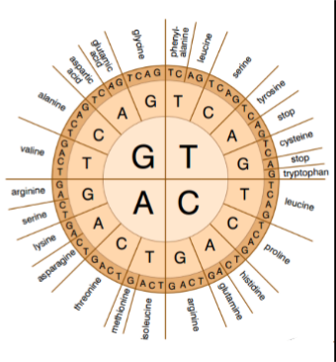

Slide 22
m RNA is similar to DNA it is built from nucleotide
How ever ,it is different from DNA in the following ways
√ it is much smaller molecule.
√ it is single stranded.
√ the base thymine is replaced by uracil.
√ the sugar in the nucleotide is ribosome.
∎ the triple of base in m RNA that code for amino acid are called codons .The mRNA codons are identical to DNA triplet except that uracil is substituted for thymine.
The main events during protein synthesis are transcription and translation.

Slide 23
Transcription – the mechanism by which the base sequence of a section DNA representing gene is converted into complementary base sequence of mRNA occur in the nucleus.
In the transcription of the DNA in gene RNA polymerase uses RNA nucleotide to build the single-stranded mRNA molecule that has a base sequence complementary to the strand of DNA being transcribed.
To form mRNA by transcription only the antisense strand transcribed.
Translation - the mechanism by which sequence of a base in mRNA molecule converted into sequence of amino acid in a polypeptide chain. It occurs in ribosome.
- During translation of mRNA into polypeptide chain, tRNA molecules with anticodon complementary to mRNA ; their amino acids from a peptide bond and one of the tRNA molecules leaves and the process in repeated.

Slide 24
The protein produced have a variety of function, they may be
structural protein - collagen keratin
enzymes – ATP synthase, DNA helicase
peptide hormones – insulin, adrenaline
anti-genes - antigen on red cells CD4
antibodies – HIV antibodies
● Gene switch on
- transcription factors are necessary to activate genes, these are protein that bind the promoter regions next to a gene and allow RNA polymerase to transcribe the gene.
● Gene switch off
- molecules of short interfering RNA (si RNA) can silence genes by degrading the mRNA transcribed from the genes.
- si RNA has the potential to treat condition such as AIDS by preventing replication of HIV and cancers by silencing genes that enhance cell division.
● Mutation is any spontaneous change in the genetic material of organism.

Slide 25
Mutation classified into two as
1. Point mutations(gene mutations) – are spontaneous changes in a single base on DNA molecule.
different types of gene mutation are ◦ substitution
◦ addition
◦ deletion
- Substitution replace one base with another , because the code is degenerate, there may be no change in the amino acid coded for.
- Deletion and addition both cause a frame shift, these mutations after all this point also.
- In addition mutation an extra base added
- In a deletion mutation a base missed out during replication.

Slide 26
2 Chromosomal mutation occur when there is any change in the arrangement or structure of chromosomes.
example of chromosomal mutation
√ inversion √ duplication
√ deletion √ chromosome non-disjunction
√ insertion √ translocation

Slide 27


