Slide 1
Geography of Ethiopia and the Horn
(GeEs 1011)

Slide 2
Chapter one: Introduction
1.1.Geography: Definition, scope, themes and approaches
a) Definition of Geography
It is difficult to forward a definition acceptable to all geographers at all times and places because of the dynamic nature of the discipline and the changes in its scope and method of study.
Scholars have defined geography as per their view point. Some of these are as follows:
1. Richard Hartshorne
Geography is a discipline that seeks to describe and interpret the variable character from place to place of the earth as the world of man’.
2. Bowman- ‘Geography tells what is where, why and what it is made of.
3. Vidal de la Blache defines Geography as the science of places.

Slide 3
4. Griffith Taylor -‘Geography is the correlative science’.
5. David Harvey ‘Geography is concerned with the description and explanation of the areal differentiation of the earth’s surface’.
6. Humboldt
geography is the science related to nature and it studies and describes all material things found on earth. Another important school of thought defined geography as the study of man-environment relationships.
Most accepted working definition of Geography is
the scientific study of the Earth that describes and analyses spatial and temporal variations of physical, biological and human phenomena, and their interrelationships and dynamism over the surface of the Earth.

Slide 4
Geographers
Explore both the physical properties of Earth’s surface and the human societies spread across it.
Examine how human culture interacts with the natural environment & the way that locations & places can have an impact on people.
Use maps for representing various features found on the earth.
Study the pattern of distribution of a particular phenomenon under study for e.g. population, where population is concentrated and why? This geographical approach is also termed as Spatial Analysis. Spatial means related to space.

Slide 5
b) Nature and scope of geography
Nature of Geography
Spatial science concerns with many different topics—people, culture, politics, settlements, plants, landforms, and much more.
Interdisciplinary field of study that helps us to understand our physical environment with its elements and components
understand where things are found, why they are there, and how they develop and change over time
The scope of Geography
Surface of the Earth, which is the very thin zone that is the interface of the atmosphere, lithosphere, hydrosphere & biosphere, which provides the habitable zone in which humans are able to live.

Slide 6
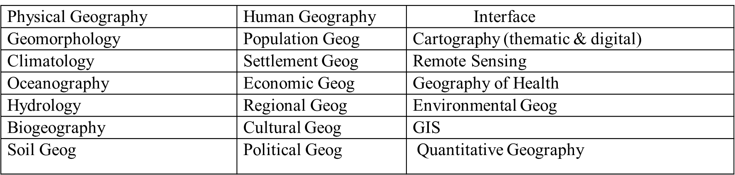

Slide 7
C) Approaches/methods in Geography
1. Topical (systematic) approach-developed by Alexander V Humbolt
view particular categories of physical or human phenomena as distributed over the Earth .
In this approach various aspects of the natural and human environments are analyzed and studied separately. Examples of systematic geography include-
  a) physical geography deals earth systems like atmosphere (air), the hydrosphere (water), the lithosphere (earth solid rock) and biosphere, which encompass all of earth’s living organisms
  b) human geography describes culture, populations, dynamics of social, economic, and political aspects of space.

Slide 8
2.Regional approach
This approach was developed by German Geographer, Carl Ritter (1779 – 1859).
In the regional approach, the world is divided in to regions at different hierarchical levels and then all the geographical phenomena in a particular region are studied.
A region is that part of the earth which has certain identical geographical features (such as climate, vegetation etc.) or man-made features (such as language, religion, government etc.) which in unison give the region a distinct identity of its own and also separate it from the rest.
Examples of Earth’s region include climatic regions, industrial regions, equatorial regions, Mediterranean region etc.
In regional geography approach, different regions of the earth from smaller to bigger in size are studied with the aim to understand their characteristics that consist of both natural and human elements.

Slide 9
Systematic and regional geography are not dichotomous but complementary to each other. The difference in systematic and regional approach is not in terms of subject matter rather it is methodology to perceive the things which leads to this false dichotomy. The selection of the approach between systematic and regional depends upon the purpose of the study.
If an individual has to concentrate on single phenomena he will adopt a systematic approach and if more than one phenomena or complex inter-relationship of phenomena in any region is to be studied by a regional approach.

Slide 10
Based on regional approach, geography has the following sub-fields / branches
  Regional Studies (Macro, Meso & Micro regional Studies)
  Regional Planning (rural & urban planning)
  Regional Development
  Regional Analysis (problems related to land use, urban development, rural development, regional policy, resource management, migration or environmental and ecological aspects are studied and analyzed)
The regions could be classified based on a single factor like relief, rainfall, vegetation, per capita income or there could also be multi-factor regions formed by the association of two or more factors. Administrative units like states, districts etc can also be treated as regions.

Slide 11
The difference in systematic and regional approach is not in terms of subject matter rather it is methodology to perceive the things which leads to this false dichotomy. The selection of the approach between systematic and regional depends upon the purpose of the study.
If an individual has to concentrate on single phenomena he will adopt a systematic approach and if more than one phenomena or complex inter-relationship of phenomena in any region is to be studied by a regional approach.
3. A model-oriented approach
Geography exists to study variations in phenomena from place to place, and it s value as an academic discipline depends on the extent to which it can clarify the spatial relations and processes that might explain the features of an area or a place.
4. Descriptive approach depicts where geographical features and populations are located.
5. Analytical approach seeks to find out why those features are located where they are

Slide 12
d) Themes of Geography
Geography has basic themes—location, place, region, movement, and human-environment interaction, size & scale. Understanding these themes will help you get a better picture of the world.
1. Location (absolute/astronomical & relative)
A. Absolute location is the exact spot on Earth where a place can be found.
Geographers use imaginary lines on Earth’s surface. This helps them locate any place in the world.
Lines that run in the same direction as the equator are called latitude lines. They measure distance north and south of the equator.
Lines that run between the North and South Poles are called longitude lines. They measure distance east and west of the prime meridian.
B. Relative location is where a place is in relation to other places
.

Slide 13
Relative location: using cardinals(N,S,E,W)

Slide 14
2. Place
  The concept of place refers to a description rather than a location (a degree of uniqueness) of features on Earth.
  It is physical and human aspects of a location (Every place on Earth has physical and human features), and it helps geographers to compare and contrast two places on Earth.
  Places are parts of the Earth’s surface that are identified and given meaning by people. They may be perceived, experienced, understood and valued differently.
  Place range in size from a part of a room or garden to a major world region.
  Places can be described by their location, shape, boundaries, features and environmental and human characteristics.
  Some characteristics are tangible, for example, landforms and people, while others are intangible, for example, scenic quality and culture

Slide 15
Physical Characteristics
    Landforms- mountains, valleys
    Ecosystems-examples: rainforest, arctic tundra, desert,
    Climate- examples: daily weather, hurricanes, blizzards, droughts, floods
Human Characteristics
    How people live, work and visit a place?
    Language, customs and beliefs
    Economic traits, issues and concerns
    Government

Slide 16
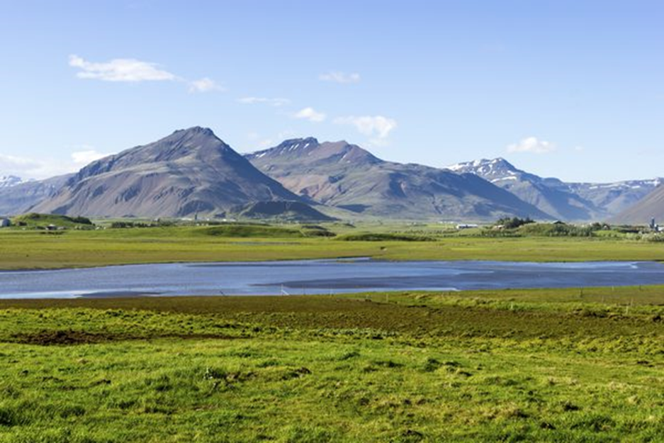
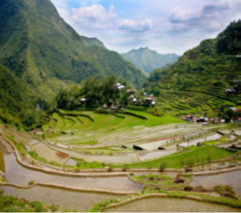
If we consider a physical aspects of a places, some have mountains, while others have plain/valley/gorge terrain.

Slide 17
Places are important to our security, identity and sense of belonging, and they provide us with the services and facilities needed to support and enhance our lives.
Environmental characteristics of a place are influenced by human actions (places in which we live are created, changed and managed by people) and the actions of environmental processes (natural hazards, climate change etc) over short to long time periods
human characteristics of a place are also influenced by its environmental characteristics and resources, relative location, connections with other places

Slide 18
3) Region
A group of places with at least one characteristic in common, physical or human characteristics. The world can be divided into different regions. A natural region has unique plant and animal life and a special climate.
1.Formal Regions-defined by
a) governmental or administrative boundaries (States, Countries, Cities)
b) similar characteristics such as a landform or climate type (Corn Belt, Rocky
Mountain region, Chinatown).
2. Functional Regions
  Regions defined by a function or common use (newspaper service area, cell phone coverage area)
3. Perceptual Regions
  Regions defined by peoples perceptions, experiences and thoughts (middle east, the south, etc.)

Slide 19
Regions can be defined at a range of scales i.e local, national and international by using various characteristics/criteria (see table below).
Region | Scale | Characteristics/criteria used the define a region
Addis Ababa Central Business District | Local | administrative, land use
Wheat producing area in North Shewa | Local | Land use
Rift valley region of Ethiopia | National | physical
Abay basin | National | physical
Nile basin | International | Physical
Sub sahran Africa | International | Location, common use
Tropics | International | Location, climate
Equatorial rainforest | International | Vegetation

Slide 20
4)Movement
It has different dimensions i.e movement of human beings, goods, and their ideas from one end of the planet to another.
Human Movement
  Trucks, Trains, Planes
  People move from one area to settle in another as a result of push and pull factors. People may be pushed out of an area by overcrowding. People may be pulled to an area in search of greater freedom.
  Natural barriers, such as mountain ranges and rivers, make migration hard. Oceans, flat land, and transportation make migration easier.

Slide 21
Information Movement
  Phones, computer (email), mail, internet, technologie
Idea Movement
  Fads/fashions moving from place to place TV, Radio, Magazines
Movement of items
  Trading goods
5) human-environment interaction.
One of the central contributions of the geographic discipline is its examination of the interactions between social and ecological systems. Types of Human-Environment Interaction
a) human dependence on the environment
  Dependence refers the ways in which humans are dependent on nature for a living — like natural resources — from the environment.
.

Slide 22
b) Modification of the Environment
  Human activities frequently result in environmental change, both with negative and positive results. for example, building roads through wildlife areas
c) How the environment changes humans (adaptation to the Environment )
  People seem to live in the strangest places on this planet, which is partly due to successes in evolution. The more successful species are able to adapt to changes in their environment, the more likely they are to survive.
  For example, when you find people living above the arctic circle, in dense jungles, and dry savannahs, you’ll get the idea of how much we have adapted to our natural environment. People in cold climates wear coats in the winter to shield themselves from the cold

Slide 23
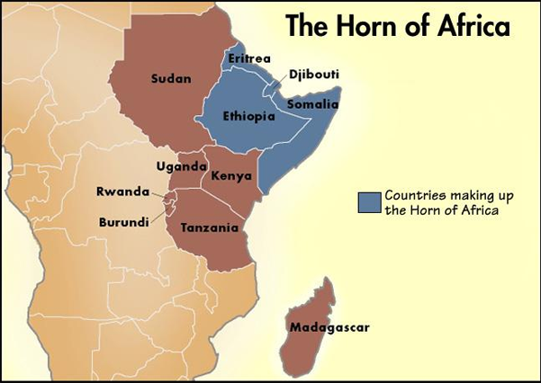
1.2. Location, Shape and Size of Ethiopia and the Horn
The Horn of Africa is a region of eastern Africa, narrow tip that protrudes into the northern Indian Ocean, separating it from the Gulf of Aden.
It is the easternmost extension of African land defined as the region that is home to the countries of Djibouti, Eritrea, Ethiopia (largest), and Somalia (smallest)
The Horn contains such diverse areas as
  highlands of the Ethiopian Plateau
  Ogaden desert, and
  Eritrean and Somali coasts
It is bordered by the
    Red Sea,
    Gulf of Aden
    Indian Ocean,
    Arabian Peninsula and
    southwestern Asia

Slide 24
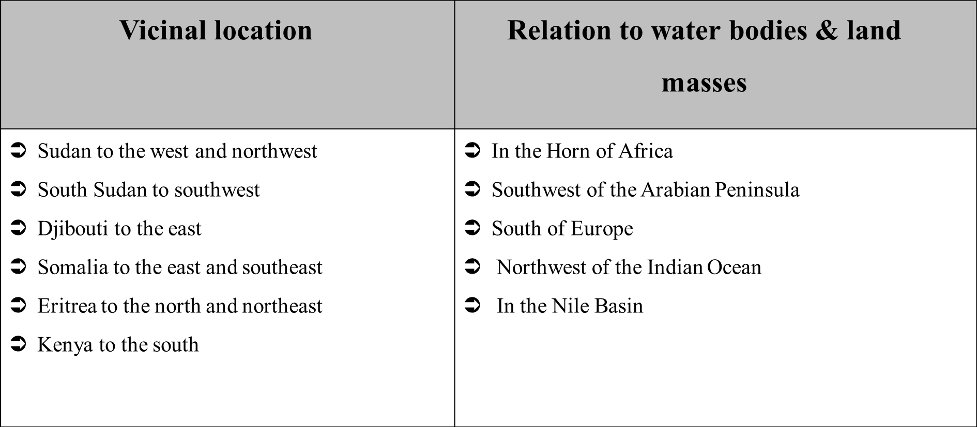
1.2.1. Location of Ethiopia
Astronomically, Ethiopia is a landlocked country located between 3ºN (Moyale) and 15ºN (Bademe - the northernmost tip of Tigray) latitudes and 33ºE (Akobo) to 48ºE (the tip of Ogaden in the east) longitudes.
The east west distance (15⁰) is longer than the north-south distance (12⁰).

Slide 25
The implications of the location of Ethiopia
a) Climate:
  The fact that Ethiopia is located between 30N and 150N (between the Equator and Tropic of Cancer) implies that the country has a tropical climate, though modified by its altitude.
  Its longitudinal extension there is a difference of one hour between the most easterly and most westerly points of the country. It is only for convenience that the 3 hours-time zone is used in all parts of the country.
  The location of Ethiopia relative to the Indian Ocean, the Atlantic Ocean and the African and Asian landmass has also various bearings on the climate of Ethiopia.
b) Socio-cultural condition:
Ethiopia is one of the earliest recipients of the major world religions namely Christianity, Islam and Judaism due to its proximity to the Middle East, which was the origin of these religions.
The linguistic and other cultural relationships, which Ethiopia shares with its neighbours, reflect the influence of location.
.

Slide 26
c) Politics: The political history of Ethiopia has been considerably influenced by:
  Geopolitical considerations of superpowers.
  Adjacency to the Red Sea (a major global trade route).
  The Middle East geopolitical paradigms.
Ethiopia has been exposed for external invasions in a number of times; though the country resisted foreign intervention and remains free of external domination
1.2.2. Size of Ethiopia
Ethiopia with a total area of approximately 1,106,000 square kilometers is the 8th largest country in Africa and 25th in the World.
It extends about 1,639 km East-West, and 1,577 km North-South.
About 0.7% of the country is covered by water bodies.
The size of Ethiopia also affects both the natural and human environment of the country

Slide 28
1.2.3. The shape of Ethiopia and its Implication
Countries of the World have different kinds of shape
Compact shape
  The distance from the geographic centre of the state to any of the borders does not vary greatly.
  It shows countries which have more or less circular shape. The main advantages of compact shape include-
      Make defence easier
      Facilitate socioeconomic and cultural integration..
      Speed mobilization of labour, resource
Fragmented shape: some are divided from their other parts by either water, land or other countries.
Elongated shape: They are geographically long and relatively narrow like Chile.
Perforated shape : A country that completely surrounds another country like the Republic of South Africa.
Protrude shape: Countries that have one portion that is much more elongated than the rest of the country like Myanmar and Eritrea.

Slide 29
There are various ways of measuring shape of countries. These measures are known as the indices of compactness. These indices measure the deviation of the shape of a country from a circular shape, which is the most compact shape.
Since there is no country with absolutely circular shape, those approximating a circular shape are said to be more compact. Measurements of compactness include
1. Area-Boundary length ratio:
  The higher the A/B ratio, the greater the degree of compactness.
2. Boundary-Circumference ratio:
  measures how far the boundary of a country approximates the circumference of a circle of its own size. Therefore, the nearer the ratio to 1 the more compact the country is.

Slide 30
3. Area-Circumference ratio.
  The ratio of the area of the country to the circumference of the smallest inscribing circle:
  It compares the area of the country with the circumference of a circle that passes touching the extreme points on the boundary of the country.
  The higher the A/C ratio, the greater the degree of compactness.
4. Area-Area (A/A’) ratio
  The ratio of the actual area of a country to the area smallest possible inscribing circle
  .The nearer the ratio to 1, the more compact the country is.

Slide 31
Country | Area(km²) | Boundary (km) | A/B ratio | B/C ratio | A/C ratio
Ethiopia | 1,106,000 | 5,260 | 210.27 | 1.41 | 296.61
Djibouti | 22,000 | 820 | 26.83 | 1.56 | 41.83
Eritrea | 117,400 | 2,420 | 48.51 | 1.99 | 96.83
Kenya | 582,644 | 3,600 | 161.85 | 1.33 | 215.28
Somalia | 637,657 | 5,100 | 125.03 | 1.80 | 225.22

Slide 32
1.3. Basic Skills of Map Reading
What is a Map?
  A map is simplified, diminished (scaled) & plain (two-dimensional) representation of part or whole of the Earth surface as viwed from vertically above mostly on a flat piece of paper.
Map reading
  A systematic identification of natural features &manmade features. E.g. mountains, plateaus, hills, valleys, river, ocean, rocks, plain etc; manmade features like roads, railway, buildings, dam etc.
Although many disciplines use maps, they have a special purpose for Geographers as tools for displaying and analyzing spatial distributions, patterns and relations.

Slide 33
Importance of maps
  Provide geographical facts of an area such as relief, drainage, settlement etc.
  Used for making spatial analysis of geographical facts of areas represented.
  Maps are used on various disciplines like land use planning, military science, aviation, tourism, marine science, population studies, epidemiology, geology, economics, history, archaeology, agriculture etc.
  Map makes storage of the geographical data of areas represented.
  Know location, area, distance, direction` etc of geographical features by varied methods of grid reference, place naming etc.

Slide 34
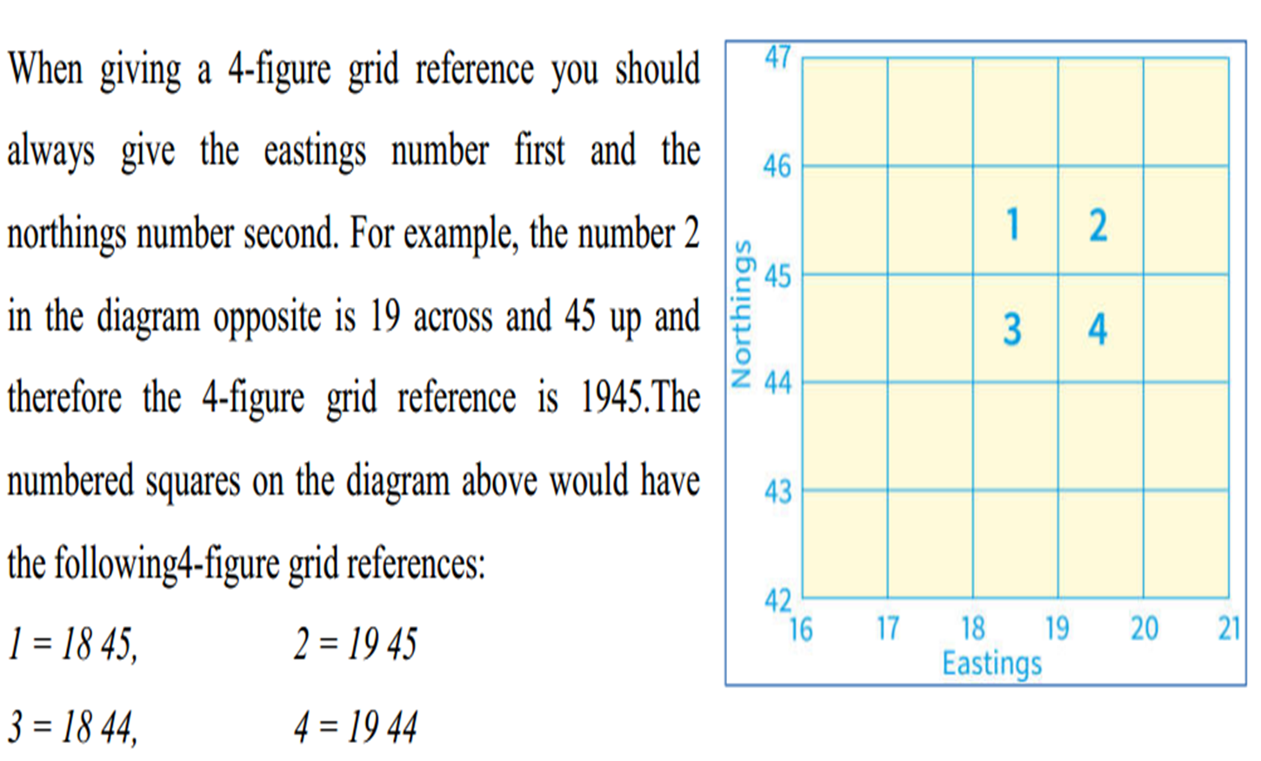
locating places using latitudes and longitudes or grid references
left to right,- easting (heading eastward), and
northing's (heading in a northward direction).

Slide 35
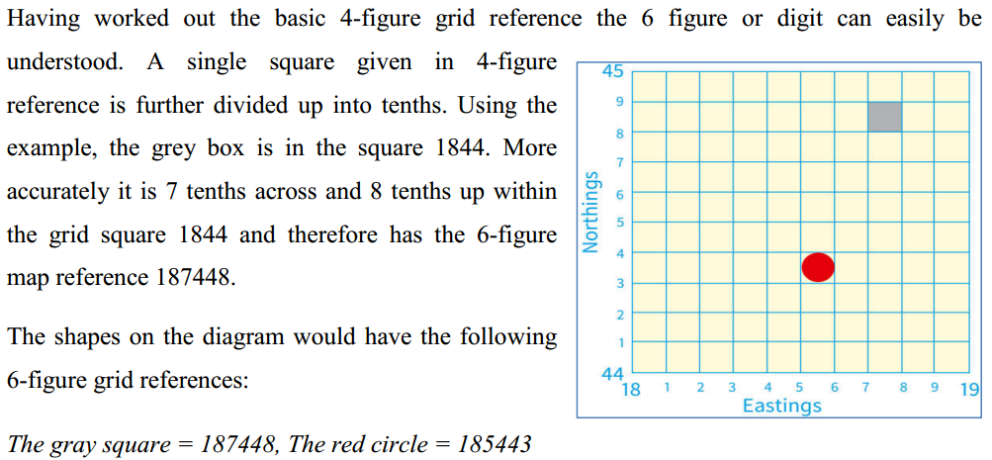

Slide 36
Types of Map
2. Based on scale
  Large scale (≥ 1:50,000)
  Medium scale 1:50,000—1:250,000
  Small scale (≤1:250,000)
2. Based on purpose and functions.
  Topographical maps-depict one or more natural and cultural features of an area. Contents of topographical maps depend on purpose of a map, scale of a map, date of compilation, and nature of the land represented.
  Special purpose/statistical maps: These are maps, which show distribution of different aspects such as temperature, rainfall, settlement, vegetation etc

Slide 37
Marginal Information on Maps (Elements of Maps)
Title: It is the heading of the given map which tells what the map is all about.
Key (legend): It is the list of all convectional symbols and signs shown on the map with their interpretation.
Scale-
Ratio b/n the distance on the map & the actual ground distance;
Given in representative fraction, statements/verbal scale, and linear (graphic) scale.
North arrow
Margin: Is the frame of the map. It is important for showing the end of the mapped area.
Date of compilation/publication.

Slide 38
Chapter 2: Geology of Ethiopia and the horn
2.1.Introduction:
Geology is one of the Earth’s science which deals with the
      origin,
      composition,
      structure,
      history & materials of the Earth and
      the forces which act upon the Earth & inside the Earth’s surface
Continental drift theory
Australian Climatologist Alfred Wegener proposed the hypothesis that the continents were once assembled together as a supercontinent, called Pangaea.
The large super continent was then split into Gondwanaland where Africa is a part and Laurasia; and later into smaller fragments over the last million years. These then drifted apart to form the present arrangement of continents.
Wegener’s evidences of continents were once assembled together as a supercontinent were:

Slide 39
1.Fit of the continents: The opposing coastlines of continents often fit together.
2. Match of mountain belts, rock types: mountains in West Africa, North America,
Greenland, and Western Europe match up.
3. Distribution of fossils: The distribution of plants and animal fossils on separate
continents forms definite linked patterns if the continents are reassembled.
4. Paleo-climates: rocks formed 200 million years ago in India, Australia, South
America, and southern Africa all exhibited evidence of continental glaciations.
2.2. The Geologic Processes: Endogenic and Exogenic Forces
a) The external (exogenic) processes
  Geomorphic processes which include weathering, mass transfer, erosion and deposition.
  They act upon the volcanic and structural landforms by modifying, roughening and lowering them down.

Slide 40
b) Endogenic/internal processes
1) Epeirogenesis-
  slow rising and sinking of the landmass ,vertical movement of land mass; It is continental building process. E.g. East Africa, Himalya region.
2. Volcanism-
  movement of magma in or out side earth surface. Extrusive and intrusive
3. Diastrophism-
  Ffolding, faulting, ogenesis or mountain building by great pressure from inside the earth
These process form features plateaus, rift valleys, Block Mountains, volcanic mountains, etc. The landmass of Ethiopia, as elsewhere, is the result of the combined effect of endogenic and exogenic processes.

Slide 41
2.3. The Geological Time Scale and Age Dating Techniques
Geological time scale
  The geologic time scale is a reference scale developed by scientist to describe the geology and history of life on Earth. It helps to understand the entire history of the earth into workable units
  The Geological Time Scale was constructed using the evidences collected from Field observations, Fossil records, Radioactive dating etc
Several major incidences have happened in the history of the earth. Some of the major events include-
a) mass extinctions,
b) appearance of new species or genera of life,
c) mountain-building movements
d) drifting of continents
e) spreading of ocean floors
f) widespread glaciations
g) dominance of certain species
h) massive migration of life between land and water

Slide 42
Geological time divisions basically differ from each other in such characteristics as the /based on
    Relative position of land and sea,
    occurrence of significant geological events (e.g. mass extinctions).
    Kind of climate
    Important kind of animal and plant life that developed and existed during that geological time.
Geological time is difficult to measure precisely. The first major boundary is defined by what was believed at the time to be the first appearance of life on earth.
The geological time categories do not usually consist of a uniform length of time

Slide 43
The geological time scale measures time on a scale involving four main units:
1. Eon
  The longest/ largest period of geological time e,g Haddian/ no rock record, Achaean)
2. Eras
  It is combination of periods or subdivisions of Eons
  a) Precamberian Era (Archean & Proterozoic periods)
  b) Paleozoic Era (ancient life)
      It is the age of invertebrate
      Consists of Cambria, Ordovician, Silurian, Devonian, Mississippian Pennsylvanian & Permian periods
  c) Mesozoic Era (the middle life)
      Consist of Triassic, Jurassic & Cretaceous periods
      Age of reptiles

Slide 44
  d) Cenozoic Era (recent life)
    Age of mammals
    Divided into Tertiary, & quaternary periods
3. Periods- epochs are clumped together into larger units called periods
4. Epoch-is the smallest unit of time on the scale and encompasses a period of millions of years.

Slide 45
Era | Period | Began (in Million Years) | End (my) | Major Events (million years ago)
Cenozoic | Quaternary | 1.6 | Present | Major glaciers in North America and Europe (1.5)
 | Tertiary | 70 | 1.6 | Rocky Mountains (65), individual continents take shape.
Mesozoic | Cretaceous | 146 | 70 | Dinosaurs extinct (65), western interior seaway and marine reptiles (144 – 65)
 | Jurassic | 208 | 146 | Pangaea (one land mass) begins to break up (200)
 | Triassic | 225 | 208 | First mammals and dinosaurs
Paleozoic | Permian | 290 | 225 | Greatest extinction on Earth (245)
 | Pennsylvanian | 322 | 290 | First reptiles
 | Mississippian | 362 | 322 | Coal-forming forests
 | Devonian | 408 | 362 | First land animals and first forests (408)
 | Silurian | 439 | 408 | Life invades land
 | Ordovician | 510 | 439 | First fish appeared
 | Cambria | 600 | 510 | Great diversity of marine invertebrates
Precambrian | Proterozoic | 2,500 | 600 | Marine fossil invertebrates (600)
 | Archean | 4,500 | 2,500 | Earliest fossils recorded (3,500), earliest rock formation (4,000)

Slide 46
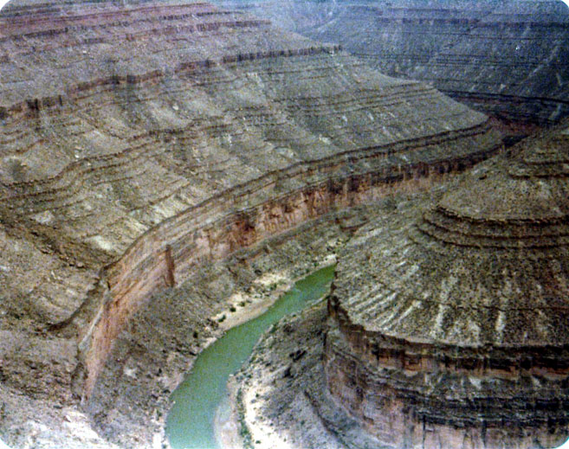
Rocks age dating techniques
1.Relative dating methods
a) If any of the fossils are unique to one of the geologic time periods, then the rock was formed during that particular time period
b) Principle/law of superposition
In rock that is not disturbed (moved around by tectonic forces). The older rocks are on bottom. The younger rocks are on top.

Slide 47
Unconformity: a gap in the rock sequence that happens because
  agents of erosion (water, wind, glaciers) move layers or parts of layers away
  Deposition does not evenly distribute sediments (higher areas may not get as much as lower etc..)
  Earthquakes/plate movement, volcanic activity all change the landscape (some quickly and some slowly)

Slide 48
B. Absolute Dating/Radiometric techniques
Techniques used to to date materials like rocks by observing the abundance of naturally occurring radioactive isotope and it’s decay products.
1) Uranium-Lead dating method
It is one of the oldest & if done properly one of the most accurate. Uranium comes as two common Isotopes; U235 & U238.
Both are radioactive & unstable, shedding nuclear particles in cascade that does not stop until they become lead (Pb). The two cascades are different, U235 becomes Pb 207 (half-life 704 million years), and U238 becomes Pb 206 (half-life 4.47 billion years).
Lead atoms created by uranium decay are trapped in crystal and build up in concentration with time; helping us in dating. Uranium-Lead dating works mainly for metamorphic & igneous rock

Slide 49
B. Absolute Dating/Radiometric techniques
Techniques used to to date materials like rocks by observing the abundance of naturally occurring radioactive isotope and it’s decay products
It is based on the decay of natural, long-lived radioactive isotopes (the parent) of certain elements, incorporated into a rock or mineral at the time of formation, into other stable isotopes (the daughter).
The regular rates of decay for unstable, radioactive elements were found to constitute virtual “clocks” within the earth’s rocks.
The life of the radioactive element is expressed in terms of its half-life, which is the time required for half of any original amount of the material to be transformed. Every radioactive element has its own half-life.
At the end of the period constituting one half-life, half of the original quantity of radioactive element has decayed; after another half-life, half of what was left is halved again, leaving one-fourth of the original, and so on.

Slide 50
Terminologies
Isotopes: Same number of protons, differing numbers of neutrons chemically similar, different mass (kinetics), different radioactive properties.
Half life: time needed for one-half of the parent atoms to turn into daughter atoms. It is the time taken by an isotope to be reduced to half of its original amount. So if we can measure the proportion of parent and daughter isotopes in rocks now, we can calculate when the rocks were formed
Daughter product
The nuclear decay of radioactive isotopes is a process that behaves in a clock-like fashion and is thus a useful tool for determining the absolute age of rocks.
By counting the parent and daughter atoms in some very old rocks, scientists say that the solar system (including Earth) is about 4.6 billion years old

Slide 51
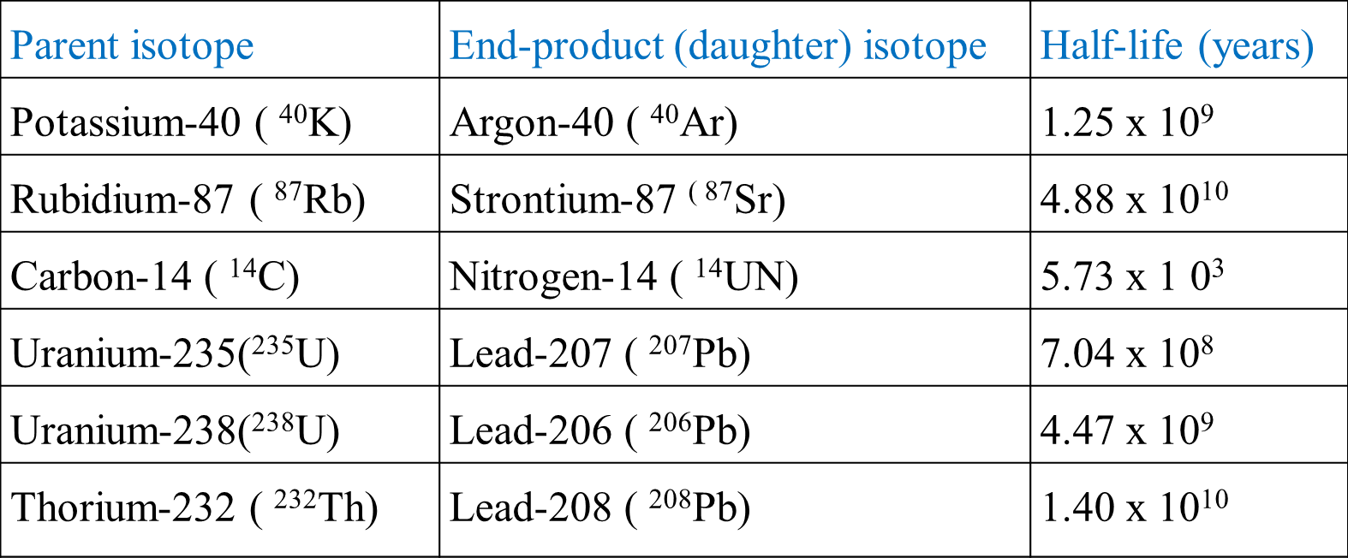

Slide 52
1) Uranium-Lead dating method
It is one of the oldest & if done properly one of the most accurate.
Uranium comes as two common Isotopes; U235 & U238. Both are radioactive & unstable, shedding nuclear particles in cascade that does not stop until they become lead (Pb).
The two cascades are different, U235 becomes Pb 207 (half-life 704 million years), and U238 becomes Pb 206 (half-life 4.47 billion years).
Lead atoms created by uranium decay are trapped in crystal and build up in concentration with time; helping us in dating.
Uranium-Lead dating works mainly for metamorphic & igneous rock

Slide 53
2) Potassium-Argon Technique:
The potassium-Argon (K-Ar) Isotope dating method is especially useful for determing the age of lavas/volcanic rocks.
Potassium has one radioactive isotope (40K). Potassium -40 decay with half life of 1250 million years.
Geologists are able to date entire rock samples in this way, because potassium-40 is abundant in micas, feldspars & hornblendes.

Slide 54
3) Carbon-14 Technique:
Upon the organism’s death, carbon-14 begins to disintegrate at a known rate, and no further replacement of carbon from atmospheric carbon dioxide can take place.
Carbon 14 decays with half life of about 5730 years by the emission of an electron, disintegrating to nitrogen 14.
Carbon dating only works on fossils that used to be a lived. You can not carbon date a rock or a sedimentary layer

Slide 55
2.4. Geological Processes and the Resulting Landforms of Ethiopia and the Horn
1. Precambrian Era
  Covers 5/6th of the Earth’s history.
  Due to its remoteness in time and the absence of well-preserved fossils, our knowledge of the events is limited.
  Nevertheless, some general description of the main geologic processes can be made.
  The major geologic event of the Precambrian include-
a) Orogenesis
Formation of huge mountain ranges mainly by folding. This was accompanied by intrusive igneous activity
b) Denudation
In between the orogenic periods and after the last orogenesis, there were long periods of denudation, which finally reduced these mountains to near-level (peneplained) rock surfaces.

Slide 56
This “levelled” surface was later (in the Mesozoic and Cenozoic Eras) covered by younger rock formations.
Therefore, in most parts of Ethiopia rocks belonging to this Era are found beneath all other rocks, forming the basement rocks (called basement rock).
Since, they had been subjected to pressure and heat from
a) overlying weight,
b) earth movements (folding, orogenesis) and
c) to intrusive igneous activity; the original rocks (both sedimentary and igneous) were altered into metamorphic rocks of varying stages of metamorphism.
Since these same processes have allowed mineralization and crystal formation, the rocks are also collectively described as crystalline rocks.

Slide 57
Precambrian rocks as surface rocks covering 25% of the land mass of the country; they are found exposed in the following areas: .
A) Western Part:
  Gambella,
  Benishangul-Gumuz (Metekel and Asossa),
  western Gojjam,
  western Wellega, Illuababora, and
  Abay gorge. Baro river valley
B) Southern Part:
  Guji,
  Southern Omo, and
  parts of southern Bale and Borena. Gamgofa
C) Eastern part: Eastern Hararghe.
D)North- Gondar, northern and central Tigray

Slide 58
2) The Paleozoic Era Geologic Processes (600million - 225 million years ago)
It is the second oldest era & the resulting features were mostly geomorphic features.
The life forms existed in this era include Fish, Amphibians & low forms of plants like Ferns & Mosses.
The major geological events in Ethiopia during this Era were denudation. And peniplanation.
This was b/c heavy erosion degraded the basement complex as a result most of the land surface was reduced to a pen plain (land surface degraded by erosion to a low lying position).
The gigantic/huge/massive mountains that were formed during the Precambrian orogeny were subjected to intense and prolonged denudation. At the end, the once gigantic mountain ranges were reduced to a “peneplained” surface.
Undulating plain with some residual features (inselbergs) here and there was formed.

Slide 59
The sediments were transported southward and eastward to form continental (in Africa) and marine deposits, respectively.
Because of the limited deposition within Ethiopia, rocks belonging to this Era are rare in the country.
3) The Mesozoic Era Geologic Processes (225-70 million years ago)
The major geological events that took place in this era include:
    Mt. building
    Formation of sedimentary rock
    Existence of higher orders of life (flowering plants, birds & mamals)
    Epeirogenesis
Epeirogenesis
    The process of alternative slow sinking & rising of the land mass & took place in the 3 consecutive periods of the era
    The whole present day Africa & Arabian land mass were affected by this process

Slide 60
a) Triassic period (early period & lasted from 225-180 mil.yr. ago)
The horn of Africa began to subside b/c of internal forces which let gradual invasion of sea water from Indian ocean (SE-direction) and slowly spreading NW in the late Triassic. This phenomenon continued up to Jurassic period.
Thus the peniplained Precambrian rock surfaces started to be occupied by the sand carried by the shallow sea.
This gradual invasion of sea water is called Transgression of sea water
The invasion/transgression of sea resulted in deposition of the 1st & oldest sedimentary rock in Ethiopia, called Adigrat Sand stone (named after the place where it might have been 1st identified).

Slide 61
Due to the tilting of the land mass and the direction of the invading sea the age & thickness of Adigrat sand stone varies from SE to NW direction (it is older & thicker towards SE-direction)
As the depth of the sea increased another transported materials & remnants of marine life decaying & precipitating like shale, gypsum & lime were deposited. The latter is associated with the flourishing of marine life and decaying and precipitating of their remains, as the sea stayed long.
Hence, Mesozoic rocks are considered to have the greatest potential for oil and gas deposits.

Slide 62
b) Jurassic period (180-135 million years ago)
The sinking of the land mass continued in this period
The land surface of Ethiopia remained under sea water
The water body was occupied by various life forms and hence the dead body of these organisms formed the second layer of sedimentary rock known as Hintalo limestone.
c) Cretaceous period (135-70 million years ago)
At the end of Jurassic & beginning of cretaceous the Horn of Africa & Arabia area were up lifted
Following the uplifting of the land the regression of the sea began

Slide 63
In Ethiopia the up lifting 1st began in the NW part and then it continued in the SE direction.
In the process of uplifting and in turn regression/retreat of sea the 3rd & youngest sedimentary rock called upper sandstone formed on Hintalo limestone.
The age & thickness of upper sand stone varies from NW to SE direction (upper sand stone is older & thinner in NW direction and younger & thicker in the SE direction)
The transgressing sea & Mesozoic sediments nearly covered the whole of Ethiopia. In most parts of Ethiopia, the Mesozoic rocks are overlaid by the Cenozoic rocks.
As surface rocks, these old marine sediments are extensively found in the
    Southeast lowlands
    central Tigray.
    gorges of Abay and Wabishebelle rivers

Slide 64
4) The Cenozoic Era Geologic Processes (70million years ago - Present)
During this Era there have been Mt. building processes, fracturing & subsidence of the land surface occurred. These processes were accompanied by erosion & deposition.
The present day landmass of Ethiopia was formed due to the effect of tectonic & volcanic activities of this Era.There was a continuing process of uplifting accompanied by an out flow of lava.
a) Tertiary period (70-2 mill. Yrs. Ago)
The present land surfaces of Ethiopia were formed during this period and the major geological events of this era include-
i) Uplifting of the Arabo-Ethiopian landmass & out pouring of large quantity of lava.
ii) Formation of rift valley

Slide 65
i) Uplifting of the Arabo-Ethiopian landmass & out pouring of large quantity of lava
The uplifting of the Arabo-Ethiopian landmass was a continuation of the slow rise that began in the upper Jurassic & cretaceous periods of Mesozoic Era.
The whole of the Arabo-Ethiopian landmass was pushed up in blocks as one mass. The greatest uplift was in central Ethiopia.
This immense tectonic force also fractured the crust at many places and hence huge quantity of lava came out through these fractures
      The volcanic material is known as Trappean lava or Trap Series lava
      Out pouring of this flood of basalt spread widely and extensively and covered a large part of the Mesozoic sedimentary layer form the Ethiopian plateau surface and also the floor of the present-day Rift Valley (before its formation).
      The mass of lava was so immense, that it formed a thick layer of volcanic rocks on the plateau,
      Where the lava comes out through vents, huge volcanic rocks were piled up to form many and huge Volcanic Mountains’ towering the flat basaltic plateau.

Slide 66
Due to the out flow & extensive spread of the lava, the Ethiopian plateau has got flat & nearly horizontal surface. The flat & horizontal nature of the Ethiopian plateau is an indicator of-
    Pene plained Precambrian Mt.
    Smoothening of rough earlier rock surface by Mesozoic deposition
    Spreading of Trapean series lava over the Mesozoic sediments
ii) Formation of the Rift valley
Rift valleys are formed when land b/n two faults sinks down. The blocks on both sides of the valley from plateaus.
Related with the theory of plate tectonics. According to the theory, the Rift Valley may be lying on the Earth’s crust below which lateral movement of the crust in opposite directions producing tensional forces that caused parallel fractures or faults on the sides of the up-arched swell.

Slide 67
As the tension widened the fractures, the central part of the landmass collapsed to form an extensive structural depression known as the Rift Valley.
Due to swelling earlier basement rocks & overlying sedimentary rocks cracked which resulted in the formation of Ethiopian rift valley as well as the great rift valley which passed through east Africa in Tertiary period of cenozoic Era.
This rifted the Red Sea trough/channel, which began to be flooded from the north.
Both the uplifting of the Arabo-Ethiopian land mass and the formation of RV were results of the same tectonic force.

Slide 68
Faulting-Rift valley formation

Slide 69
Ethiopian rift valley
Part of the longest rift valley in the world that extends from Syria in middle east to Mozabique in Africa (total length=7200, 5600km= in Africa &1,700 km in Eritrea and Ethiopia).
The Rift Valley region of Ethiopian is the most unstable part of the country. There are numerous hot springs, fumaroles, active volcanoes, geysers, and frequent earthquakes.
Ethiopian RV is funnel shaped, and wider to the north & narrower to south. Its wider part is the Afar region for about 200-300km.
The Red Sea, the Gulf of Aden, and the East African System meet and form the triangular depression of the Afar where the Kobar Sink lies about 125 meters below sea level.
The Afar depression (including the Gulf of Zula) was down-faulted allowing the Red Sea water to penetrate far inside.

Slide 70
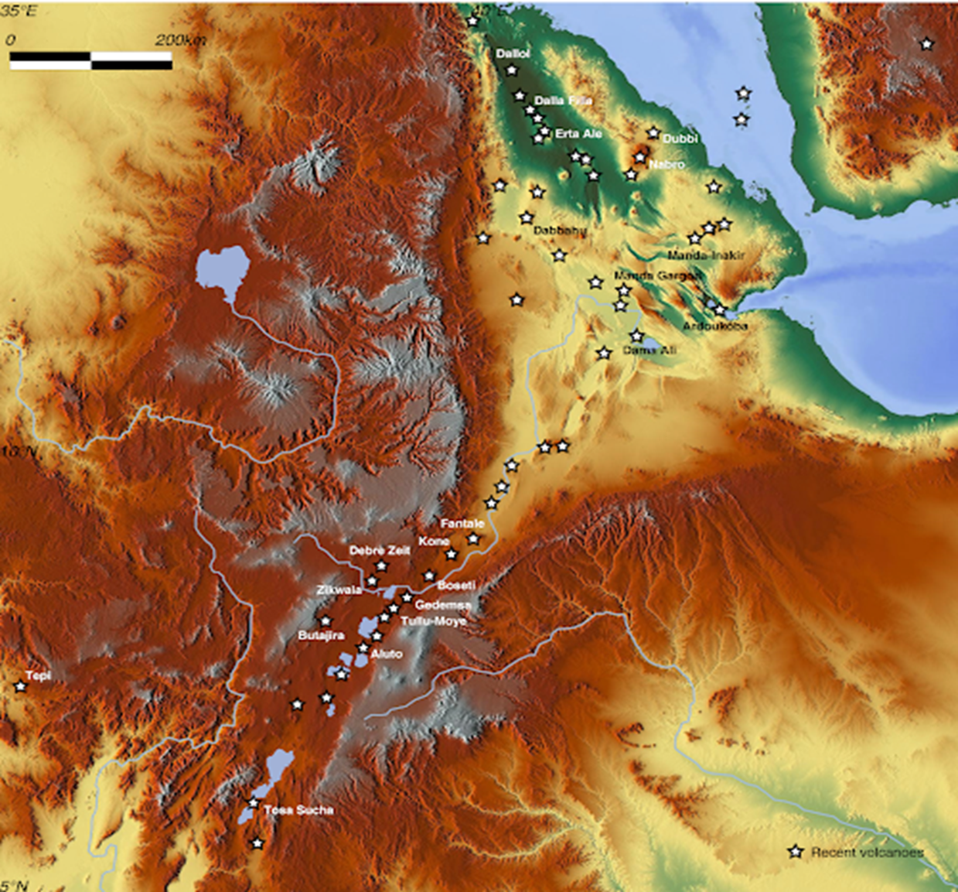


Slide 71
Reversed tilting and volcanic activity
      blocked the connection & isolated the extension of the sea,
      allowing much of the water to evaporate.
      As a result, thick saline materials accumulated.
During the same period, the area between the Danakil Depression and the Red Sea was uplifted to form the Afar Block Mountains.
Ethiopian RV with its NE to SW extension has effect on the physiography of Ethiopia i.e
      Divide the Ethiopian plateau into two
      Create many grabbens & structural basins in RV floor itself
      It separates the Arabian landmass from African landmass.
      It causes the formation of the Dead Sea, Red Sea and the Gulf of Aden troughs/channel.
      It creates basins and fault depressions on which the Rift Valley lakes are formed.

Slide 72
b) Quaternary period (2 million-yrs. ago--present day)
The 2 major geological events observed in this period were
    volcanic activities
    marked climatic change
    appearance of modern man & abundance of large mammals
a) Volcanic activity
The quaternary volcanics are called Aden volcanic or Aden series.
They are recent volcanic activities that took place after the formation of rift valley.
Aden volcanic & recent faulting are extensively developed in the Afar region. The area is shattered by numerous faults & subject to the extensive scoraceous basalt eruptions.
The eruption was also a common character of the northern section of lakes region of Ethiopia & even some eruption took place in the last few hundred years

Slide 73
The basic visible volcanic features include-
        volcanic cones
        volcanic hills
        Calderas with huge depressions
        Extensive lava sheets
        Lava ridges
        Thermal springs

Slide 74
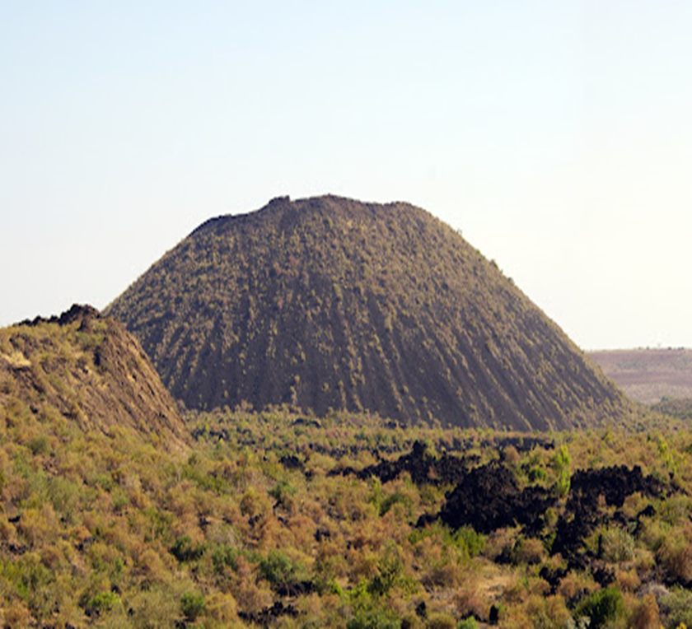
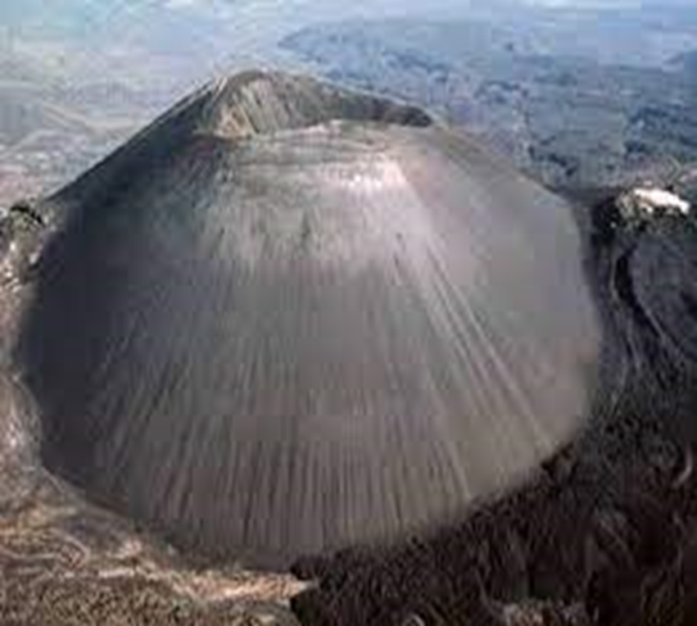
Volcanic cones

Slide 75
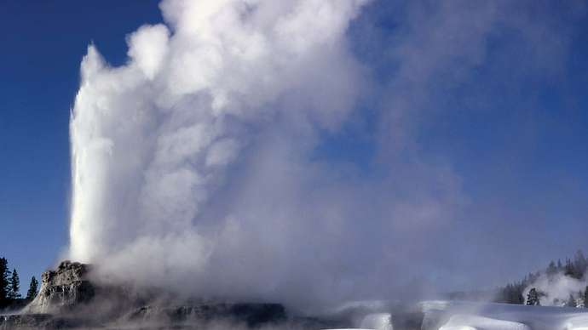
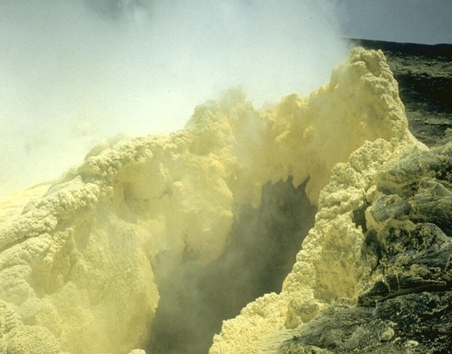



Slide 77
b) Marked climatic change
Resulting in rains known as the pluvial in Africa. It was a period of extensively heavy rain fall.
In the middle & higher latitudes it was period of an ice cover & glaciation.
Due to the pluvial rain in Africa Ethiopian plateau were altered by heavy erosion.
There was an excessive surface flow & enlargement in size and number of rivers, lakes & marsh areas.
Some lakes regions of Ethiopia were merged together. Example
    Ziway, Langano & Shalla
    Awassa & Shalla (East of Awassa lake)
    Chamo & Abaya
    Abbe & near by smaller lakes

Slide 78
Sediments were washed & carried by heavy erosion and deposited along plain, basins, marsh area, RV lakes shores & beds as well as on their flood plains
After the pluvial period when the climate was changed to warm & dry condition
    Heavy rain was replaced by dryness which increase evapotranspiration
    Then rift valley lakes became smaller & previously merged lakes were left apart
    Rivers decrease in size & flooding
    Areas that were already covered by water bodies in pluvial period were exposed & left observable their deposits. These are what we call the quaternary deposit-
    The quaternary deposit include-

Slide 79
a) Lacustrine deposit (found in lakes bed)
b) Fluvial deposit (deposits on banks of river)
c) Glacio-fluvial deposits (deposits on higher altitudes & Mt.)
d) Coastal deposits (deposits transported by wind)
e) Marine deposits (deposits around & on the floor of Seas)- include the salt deposits at
Danakil depression

Slide 80
2.5. Rock and Mineral Resources of Ethiopia
There are many resources (rocks & minerals) in which their formation is related to geological activities.
Rocks
a) Igneous rocks-formed from molten rock/magma. It is dominantly found in central parts of Ethiopia
b) Sedimentary rocks- formed by deposition of sediments e.g lime stone, coal, rock salt etc. Mainly found in east & southeast coastal areas of Ethiopia.
c) Metamorphic rocks- modified/changed rocks from igneous/sedimentary rock even from metamorphic rock itself by heat & pressure effect. Mainly found in south & north west Ethiopia

Slide 82
Minerals
The occurrence of metallic minerals in Ethiopia is associated with the Precambrian rocks.
Geological surveys proved that Ethiopia has abundant mineral resources of metals and precious metals, coal, and industrial minerals.
Gold
Gold has been mined in Ethiopia for quite long time, mainly from Benishangul-Gumuz (Metekel) and Adola.
Operating mines produce gold from primary sources in such localities as Dermi-dama, Sakoro and Lega-dembi.
Mechanised alluvial working is confined to the state-operated gold field of Adola.

Slide 83
Secondary gold deposits are common in the following localities
      Adola, Murmur Basin, Shakiso, Awata Basin,
      Dawa Basin,
      Ghenale Basin,
      Ujama Basin,
      Makanisa (Guba and Wombera),
      Kaffa.
      In Gambella and Illuababora (Akobo River),
      in Sidama (Wondo),
      Borena (Negele-Yabelo area) and
      in Benishangul-Gumuz (Sherkole),
      west Wellega, Mengi-Tumat-Shangul areas to the Sudanese border, and
      the drainage of the Didessa and Birbir.

Slide 84
Platinum
The Yubdo area in Wellega, is the only active Ethiopian Platinum mine.
Platinum occurrences have been reported from Delatti in Wellega, and the valley of Demi-Denissa and Bone Rivers as well as Tullu Mountain area in Sidama.
Tantalum
Significant deposit of tantalum and niobium is found in southern Ethiopia.
It occurs in Adola area where Kenticha Tantalum mine with resources of more than 17,000 metric tons of world class ore reserve is found.
Coal
Extensive lignite deposits in Ethiopia are found in Nedjo (Wellega), and in small amounts in Chilga (Gonder) are found in the sedimentary formations laid in between Trapean lava.

Slide 85
However, important Lignite, one of the lowest ranked coal, is known to occur in many localities such as in the Beressa Valley andAnkober (North Shewa), Sululta (nearAddis Ababa), Muger Valley (West Shewa), Aletu valley (near Nedjo), Kariso and Selmi Valleys (Debrelibanos), Zega wodem gorge (near Fiche), Didessa Valley (southwest of Nekemte), Kindo and Challe Valley (Omo confluence), Adola,Wuchalle (north of Dessie), Chukga area (on Gonder-Metema road), Dessie area (near Borkena River).
Gemstones
Gemstones, including amethyst, aquamarine, emerald, garnet, opal, peridot, sapphire, and tourmaline occur in many parts of Ethiopia, mainly in Amhara and Oromia Regional States. Quality Opal was first discovered by local people in Wadla and Dalanta woredas, North Welloin Amhara Regional State.
Potash
The potash reserve in the Danakil (Dallol Depression) of the Afar region is believed to be significant.

Slide 86
Gemstones
Gemstones, including amethyst, aquamarine, emerald, garnet, opal, peridot, sapphire, and tourmaline occur in many parts of Ethiopia, mainly in Amhara and Oromia Regional States. Quality Opal was first discovered by local people in Wadla and Dalanta woredas, North Welloin Amhara Regional State.
Potash
The potash reserve in the Danakil (Dallol Depression) of the Afar region is believed to be significant.
Gypsum and Anhydrite
A limited amount of gypsum is produced for domestic consumption in Ethiopia, mainly for the cement industry, but very large deposits are known to occur in sedimentary formations of the Red Sea coastal area, Danakil Depression, Ogaden, Shewa, Gojjam, Tigray, and Hararghe.
.

Slide 87
Total reserves are probably enormous because the thickness of the gypsum deposits is many hundreds of meters and the formation are known to extend laterally for hundreds of kilometers.
Marble
Crystalline limestone is widespread in the basement rocks of Ethiopia. Marble has been quarried in such localities as west of Mekelle and south of Adwa in Tigray.
In the east in Galetti, Soka, Ramis, Rochelle, Kumi and other valleys of Chercher Mountain in West Hararghe.
In the northwestern also in areas built of Precambrian schist in Gonder, and the Dabus River and other neighboring river basins in Benishangul-Gumuz and Gojjam.

Slide 88
Construction stones
Basalt, granite, limestone and sandstone are important building stones.
For the surfacing of roads and compaction, basalt, scoria and other volcanic rocks are extensively used.
Mesozoic limestone is an important raw material for cement and chalk production.
The earlier cement works at Dire Dawa and the recent ones at Muger Valley, Abay gorge (Dejen), Tigray (Messebo) are using similar raw materials from these rock formations.
Clay
Ethiopia is endowed with industrial clay material. Alluvial clay deposits for bricks and tile, pottery and pipe industry occur in Adola, Abay gorge, and the Rift Valley lakes region. Ceramic clay for the production of glasses, plates, bricks is found at Ambo and Adola. Tabor ceramic industry in Hawassa gets most of its raw materials from local sources

Slide 89
Mineral Potential Sites of Ethiopia
The Western and South-western-greenstone belt: They contain various minerals:
primary gold occurrences (Dul,Tulu-Kape,Oda-Godere, Akobo,Baruda,Bekuji-Motish and Kalaj);
Yubdo Platinum,
Base metals of AzaliAkendeyu, Abetselo and Kata;Fakushu
Molybdenite and the iron deposits of Bikilal, Chago, Gordana and Korre, Benshagul-Gumuz-
Marble, Akobo and Asosa placer gold deposits and etc.
2. The Southern greenstone belt: It is known as the Adola belt, which comprises the primary gold deposits and occurrences of Lega-dembi, Sakaro, Wellena, Kumudu, Megado-Serdo, Dawa Digati, Moyale and Ababa River;the columbo-tantalite of kenticha and Meleka, andthe Adola nickel deposit and other industrial minerals.
3. The Northern greenstone belt (Tigray): This belt comprises of the primary gold occurrences of Terakemti, Adi-Zeresenay, and Nirague.The base metals of Terer, Tsehafiemba and other parts of Tigray, Placer gold occurrences of Tigray.

