Slide 1

Computer Programming
(CoSc1012)
College of Computing and
Informatics
Department of Computer Science

Slide 2
Remainder
We are having class on Saturday, 07 August 2021
Time -> 8:50 AM(GMT+3)-11:30AM(GMT+3)
Venue->CS-Lab2

Slide 3
Why We Learn Programming?
You can Create Anything you want.
You get to Work From Home
You understand How Software Works
It teaches you Persistence
You learn to combine Technical Skills and Creativity
You develop Problem Solving Skills
It guarantees you a job

Slide 4
          Introduction
  Programming Language is indeed the fundamental unit of today’s tech world.
  It is considered as the set of commands and instructions that we give to the machines to perform a particular task.
  For example, if you give some set of instructions to add two numbers then the machine will do it for you and tell you the correct answer accordingly.
  But do you know that Programming Languages are having a long and rich history of their evolution? And with a similar concern, we’ll take a look at the evolution of Programming Languages over the period.

Slide 5
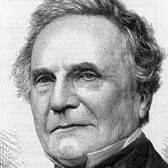
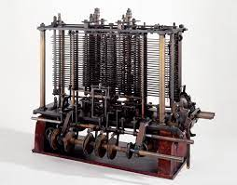
Introduction…
1883: The Journey starts from here…!!
Charles Babbage had made the device(analytical engine), but he was confused about how to give instructions to the machine.
Analytical Engine", a mechanical general-purpose computer he designed, but never completed, included memory, an arithmetic logic unit (processor), and control flow for looping. This means it would have had all of the key elements of a modern computer.

Slide 6
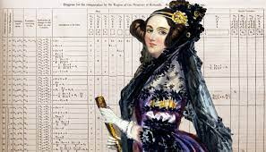
Introduction…
              Analytical Engine…
The device was made by Charles Babbage and the code was written by Ada Lovelace for computing Bernoulli’s number.
First time in history that the capability of computer devices was judged.

Slide 7
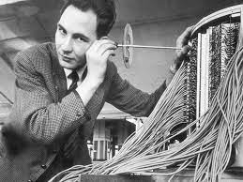
Introduction…
              1949: Assembly Language
It is a type of low-level language
It mainly consists of instructions (kind of symbols) that only machines could understand.
In today’s time also assembly language is used in real-time programs such as simulation flight navigation systems and medical equipment e.g. – Fly-by-wire (FBW) systems.
It is also used to create computer viruses.
1952: Autocode,
Developed by Alick Glennie.
The first compiled computer programming language.
COBOL and FORTRAN are the languages referred to as Autocode.

Slide 8
Introduction…
              1957: FORTRAN
Developers are John Backus and IBM.
It was designed for numeric computation and scientific computing.
Software for NASA probes voyager-1 (space probe) and voyager-2 (space probe) was originally written in FORTRAN 5.

Slide 9
Introduction…
              1958: ALGOL
ALGOL stands for ALGOrithmic Language.
The initial phase of the most popular programming languages of C, C++, and JAVA.
It was also the first language implementing the nested function and has a simple syntax than FORTRAN.
The first programming language to have a code block like “begin” that indicates that your program has started and “end” means you have ended your code.

Slide 10
Introduction…
              1959: COBOL
It stands for COmmon Business-Oriented Language.
In 1997, 80% of the world’s business ran on Cobol.
The US internal revenue service scrambled its path to COBOL-based IMF (individual master file) in order to pay the tens of millions of payments mandated by the coronavirus aid, relief, and economic security.

Slide 11
Introduction…
              1964: BASIC
It stands for beginners All-purpose symbolic instruction code.
In 1991 Microsoft released Visual Basic, an updated version of Basic
The first microcomputer version of Basic was co-written by Bill Gates, Paul Allen, and Monte Davidoff for their newly-formed company, Microsoft.

Slide 12
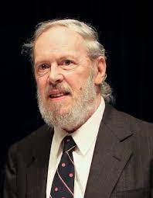
Introduction…
              1972: C
It is a general-purpose, procedural programming language and the most popular programming language till now.
All the code that was previously written in assembly language gets replaced by the C language like operating system, kernel, and many other applications.
It can be used in implementing an operating system, embedded system, and also on the website using the Common Gateway Interface (CGI).
C is the mother of almost all higher-level programming languages like C#, D, Go, Java, JavaScript, Limbo, LPC, Perl, PHP, Python, and Unix’s C shell.

Slide 13
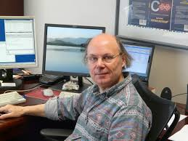
Introduction…
              1983: C++
Developed by Bjarne Stroustrup.
It is compiled language
C++ is the fastest high-level programming language.
mainly used in applications and operating systems
used for building higher-level applications with graphics libraries, applications to communicate with network devices and computer network simulators as well as remote device systems and network management

Slide 14
Introduction…
              What is Programming?
              Programming is writing computer code to create a program, to solve a problem.
              Programs are created to implement algorithms.
              Algorithms can be represented as pseudocode or a flowchart, and programming is the translation of these into a computer program.

Slide 15
Introduction…
              What is a programming language?
              A programming language is an artificial language that a computer understands.
              The language is made up of series of statements that fit together to form instructions. These instructions tell a computer what to do.
              Programming languages are designed to be easy for a human to understand and write in. However, a computer cannot run programs written in these languages directly.
              Most programming languages have to be translated into machine code before the computer can execute the instructions.

Slide 16
Introduction…
              Problem Solving Techniques
              Problem solving is the act of defining a problem; determining the cause of the problem; identifying, prioritizing, and selecting alternatives for a solution; and implementing a solution.
              In order to effectively manage and run a successful organization, leadership must guide their employees and develop problem-solving techniques.
              Finding a suitable solution for issues can be accomplished by following the basic four-step problem-solving process and methodology outlined below.

Slide 17


Introduction…
I Think Ethiopia should practice presidential system of Gov’t
              Problem Solving Techniques…
              Define the problem:
                Differentiate fact from opinion
                Specify underlying causes
                Consult each faction involved for information
                State the problem specifically
                Determine in which process the problem lies
                Avoid trying to solve the problem without data
Sunlight Takes Around 8 Minutes To Reach Earth. ...

Slide 18
Introduction…
              Problem Solving Techniques…
              Generate alternative solutions:
          Postpone evaluating alternatives initially
          Include all involved individuals in the generating of alternatives
          Specify alternatives consistent with organizational goals
          Specify short- and long-term alternatives
          Brainstorm on others' ideas
          Seek alternatives that may solve the problem

Slide 19
Introduction…
              Problem Solving Techniques…
              Evaluate and select an alternative:
          Evaluate alternatives relative to a target standard
          Evaluate all alternatives without bias
          Evaluate alternatives relative to established goals
          Evaluate both proven and possible outcomes
          State the selected alternative explicitly

Slide 20
Introduction…
              Problem Solving Techniques…
              Implement and follow up on the solution:
          Plan and implement a pilot test of the chosen alternative
          Gather feedback from all affected parties
          Seek acceptance or consensus by all those affected
          Establish ongoing measures and monitoring
          Evaluate long-term results based on final solution

Slide 21
Algorithms
              Is a finite sequence of well-defined, computer-implementable instructions, typically to solve a class of specific problems or to perform a computation.
              Algorithms are always unambiguous and are used as specifications for performing calculations, data processing, automated reasoning, and other tasks.
              Algorithms are usually written in pseudocode, or a combination of your speaking language and one or more programming languages, in advance of writing a program.

Slide 22
Algorithms
              Example-1: Recipe to cook certain food
              Example-2: An algorithm to add two numbers
                Initialize Sum to zero (process)
                Enter the numbers (I/O)
                Add the numbers and store the result in Sum(Process)
                Print sum(I/O)

Slide 23
Algorithms
              Example-3: An algorithm to find sum of five numbers
                Initialize Sum and counter to zero (Process)
                Enter the number n (I/O)
                Find Sum + n and assign it to Sum and then increment counter by 1
                Is Counter < 5
                if YES go to step 2
                else
                display Sum

Slide 24
Algorithms
              Example-4: An algorithm to find Area of a Square
                Start
                Read Length, L
                Calculate area = L*L
                Print or display area
                Stop

Slide 25
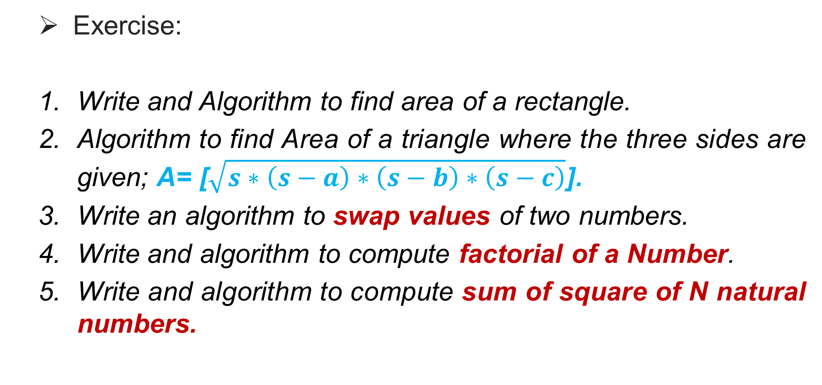
Algorithms
              Exercise:
              Write and Algorithm to find area of a rectangle.
              Algorithm to find Area of a triangle where the three sides are given; A= [$\sqrt{s∗\left(s−a\right)∗\left(s−b\right)∗\left(s−c\right)}$].
              Write an algorithm to swap values of two numbers.
              Write and algorithm to compute factorial of a Number.
              Write and algorithm to compute sum of square of N natural numbers.

Slide 26
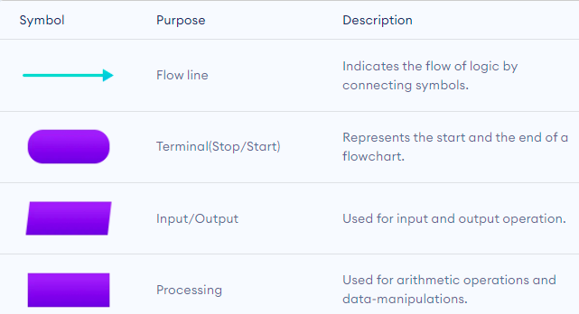
Flowcharts
              A flowchart is a diagrammatic representation of an algorithm. A flowchart can be helpful for both writing programs and explaining the program to others.

Slide 27
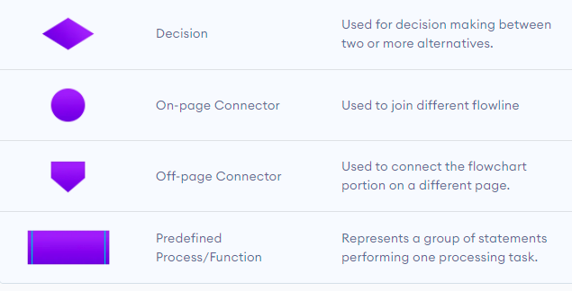
Flowcharts…
              .

Slide 28
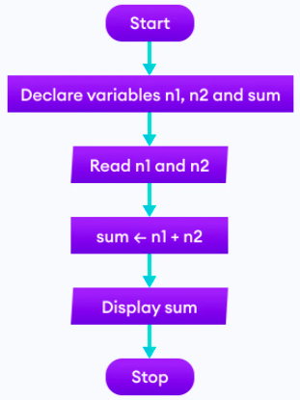
Flowcharts…
              Examples of flowcharts in programming
              Add numbers entered two by the user.

Slide 29
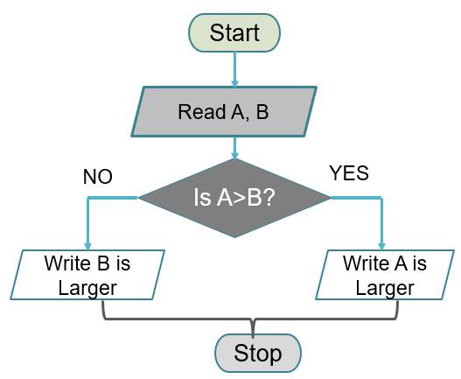
Flowcharts…
              Examples of flowcharts in programming
              Flowchart that represents Greatest of two numbers

Slide 30
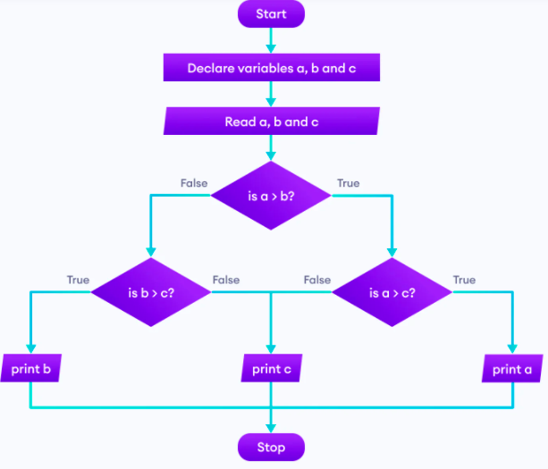
Flowcharts…
              .
              Flowchart that represents Greatest of three numbers

Slide 31
Flowcharts…
              Homework
              Find all the roots of a quadratic equation ax²+bx+c=0
              Find the Fibonacci series till term≤100
              Draw a flowchart that represent factorial of N
              Find the sum of the first five natural numbers
              Sum of square of N natural numbers

Slide 32
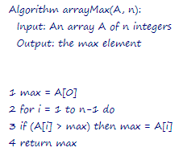
Pseudocode
              Examples of Pseudocode in programming

