Slide 1
Evolution

Slide 2
What is evolution ?
- change over period of time
- history of life
- the origin of life
Evolution start with the origin of life and end with the current biodiversity.
Evolution can be defined as
The change in genetic composition of a population over successive generations, which may lead to a population diverging from others of the same species and may lead to the origin of new species.

Slide 3
Theory of evolution describes how the various form of life on earth (including human) emerged and develop.
Theories of origin of life
1. Special creationism
2. Spontaneous generation
3. Eternity of life
4. Cosmozoan theory
5. Biochemical origin

Slide 4
1. Special creation theory
- A theory claiming that life created by super-natural being(God) at a particular time.
- “theological truth”
different version of special creation theory
* young earth creationism- earth is only few thousand years and created in six 24 hours days.
* old earth creationism – genesis account creation of all living things through power of God.
- Suggest earth is very old.

Slide 5
Day – age and gap creationism- suggest that a large gap between formation of the earth and creation of all animals and humans.
Progressive creationism- accept big-bang as the origin of universe.
Theistic evolution/ evolutionary creationism
- God invented evolution.
Intelligent design- God’s handiwork can be seen in all creation.

Slide 6
2. Spontaneous generation- in which life is believed to arise from non-living matter; this was finally disproved by experiments of Francisco Redi and Louis pasture.
- rotting meat turned into flies wine produce bacteria as went sour.
3. Eternity of life(steady-state theory)- in which life is believed to have existed forever and will to exist forever and so no origin required. “The universe is unchanging.”
* Suggest that “There is no beginning and no end to life.”

Slide 7
4. Cosmozan theory- in which either life forms of the organic molecules need for origin of life believed to have been brought to earth by meteorites and comet from other planet.
proposed by Richer and supported by Arrhenium
pauspermia- bacteria spore
weak panuspermia- organic compound arrived from other space added to chemical on earth give rise to life
“ Extraterrestrial origin”

Slide 8
5. Biochemical origin theory- in which life is believed to have originated, as a result of biochemical reactions creating first the necessary organic molecules which then became assimilated into ‘pre-cells’ which eventually evolved into cell.
* proposed by Alexander oparin and John haldane.
Stanly Miller’s spark discharging experiment showed that organic molecules essential for life could be synthesized in the condition on earth 4.5 billion years ago.

Slide 9
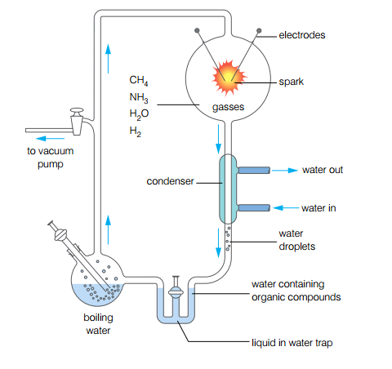

Slide 10
Prokaryotes are the first organisms to appear about 4 billion years ago(chemo-autotrophs).
They have give rise to three distinct line of evolution.
- archeabacteria
- eubacteria
- eukaryotes
The fossil record shows that cynobacteria (oldest photo-autotrophs) had been producing oxygen by photosynthesis about 3.5 billion years ago.
Theories of evolution
* Lamarkism
* Darwinism
* Neo Darwinism

Slide 11
Lamarkism (the theory of transformation)
- In 1809 Lamark proposed a two part theory to explain evolution based on
Use and disuse- continually using a structure or process, that structure or process will became enlarged or more developed. Conversely structure or process not used, will became reduced in size or less develop.
Example- elongated neck of giraffe
- elongated wee bed
- toes of bird
Inheritance of acquired traits- traits changed or acquired during an individuals life time could be passed on to its offspring .

Slide 12
▪ Natural selection based on
- a struggle for existence between members of species because they over reproduce and resources are limited.
- same members of species will be better adapted than others to their environment (because there is variation in the offspring).
Darwin's theory of natural selection stated that those members of a species which are best adapted to their environment will survive and reproduce in a greater numbers than others less well adapted.

Slide 13
Darwin's evidence came from a visit to Galapagos island finch.
Neo-Darwinism takes into account our knowledge of genetics, biochemistry, and ethology to modifies Darwin’s evolution to include the effect of selection on allele frequency and frequency of behavior pattern.
Incorporate our knowledge of genes and gene action into the theory of natural selection to give a better understand of what drives evolution, in terms of alleles(of all the genes present in population (gene pool)).
Neo-Darwinism = natural selection + mendelian inheritance

Slide 14
Evidence supporting the theory of evolution includes
- paleontology
- comparative anatomy
- comparative embryology
- comparative biochemistry
- plant and animal breeding
*paleontology- refers to the study of ancient life.
Fossils from the basis of paleontology
- Fossils are remain or trace of animal plants and other organism from the remote past.

Slide 15
There are two categories of fossils
category 1 category 2
bones, teeth, - footprints
skin impressions ,hair, shell - borrows
- coprolite
4 main stages by which fossils are formed are death without decomposition, sedimentation, permineralisation and uplift.
Fossils can be dated using
- stratigraphy- analysing the sequence and thickness of different layers(strata)of rocks.

Slide 16
Two techniques of dating
C¹⁴ - dating radioactive C14 decay at non-radioactive nitrogen atom N14 suitable for fossils up to 60,000 years old.
K⁴⁰ - dating radioactive potassium atom K⁴⁰ decay into argon atom A⁴⁰ is suitable to fossil million years old.
▪ half life- the time required to convert 50% of the unstable isotope stable form.
▪ homologous structures- structure with same basic anatomy and common evolutionary origin but having different function.

Slide 17
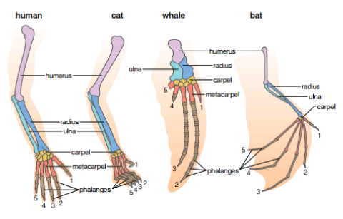
Homologous structures are evidence of a common origin and divergent evolution.
example- homologous structure in the forelimbs of mammal.

Slide 18
Analogous structure- structure having the same function but different anatomy and different evolution origin.
example wings of bird and mosquitoes
Analogous structures are evidence of a different origin and convergent evolution.
Similar patterns of embryological development on vertebrates suggest common origin.

Slide 19
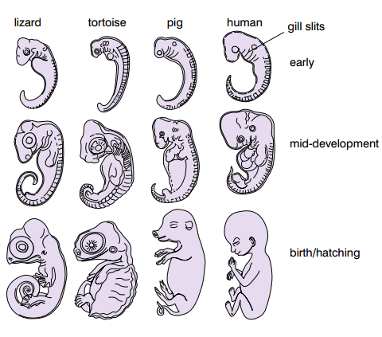

Slide 20
The extent of differences on molecules common to many species.(for example DNA cytochrom c, hemoglobin) is a measure of their relatedness.
Selective breeding- a technique used to produce organism with a desired trait by allowing only those organism with that trait to reproduce.
Selective breeding bring significant changes to the organism involved over many generation and new verities can be produced(human choose which individual will survive to breed)
example by selective breeding wild pig(wild boar)modified to domestic pig.

Slide 21
The process of evolution
* Natural selection
* Speciation
* Polyploidy
* divergent and convergent evolution.
Natural selection
- individuals with advantageous alleles survive to reproduce in greater number than other type.
- they pass on their advantageous allele in greater number than other types.
- the frequency of the advantageous allele in the population increase in the next generation.

Slide 22
The frequency of the advantageous allele in the population increase in the next generation.
the process repeat over many generation.
different types of selection includes
• directional selection
• stablising selection
• disruptive selection
◦ In directional selection one extreme of range values for feature has survival advantage.
Example
* thick fur foxes- an advantage in a cold climate
* thin fur foxes- an advantage in hot climate

Slide 23
In stablising selection individual at both end of the range value for a feature are the least well adapted.
Example
Babies birth mass in human.
* very heavy higher neonatal
* very light mortality than medium mass
In disrupting selection both extremes has some advantages than mean value.
Example Darwin’s finches shorter beaks crush seeds longer beaks obtain insect average length beaks cannot obtain insect and crush seed.

Slide 24
A species can be defined as a group of similar organism with a similar bio chemistry, physiology and evolutionary history that can interbreed to produce offspring that are fertile.
speciation is the formation of new species. There are two types of speciation called
* Allopatric speciation
* Sympatric speciation
speciation involving geographical isolation is called allopatric speciation.

Slide 25
sympatric speciation occur in a number of ways
- seasonal isolation- reproduce in different time of year.
* temporal isolation- reproduce at different time of the day
* behavioral isolation- have different courtship pattern
Divergent evolution involves adaptive radiation and is the evolution of one basic type into several types as a result of different selection pressures.

Slide 26
example
* the divergent evolution of the pentadactyl limb into flippers, legs, wings, etc.
* the divergent evolution of the beaks(and other features of Darwin’s finches on the Galapagos Island
Convergent evolution is the evolution of similar types with similar adaptations from several different original types.
Example
* The elongated snouts(and other features) of the different anteaters of the world
* The wings of birds, insects, pterodactyls, etc.

Slide 27
Modern humans and other primates have evolved from a common primate ancestor that lived before the dinosaurs became extinct.
modern humans and chimpanzees have evolved from a common ancestor that lived about 6 million years ago.
two distinctive features of modern humans are
- large brain
- true bipedalism
The fossil Lucy was significant because it showed that bipedalism evolved before large brains.

Slide 28
the fossil Ardi was significant because it showed that the common ancestor of human and chimpanzees cannot have resembled a chimpanzee.
Brain size has increased as hominids have evolved.
modern humans evolved in Africa, in and near Ethiopia, and have since migrated to all parts of the world.
Human evolved into different races because natural selection favoured different features in different environment.

Slide 29
The three main races of humans are:
* African
* Eurasian
* East Asian
Despite genetic differences between the race, it seems unlikely that they will evolve into distinct species because of:
* increasing interbreeding between the races as a result of increased travel
* increasing ability to modify the environment.

