Slide 1
Principles of marketing
  Introduction
  What image comes to your mind when you hear the word “marketing”?

Slide 2
Meaning and definitions of marketing
Marketing is defined:
About managing profitable customer relationships
  Attracting new customers
  Retaining and growing current customers
Kotler et al:
Marketing is a social and managerial process by which individuals and groups obtain what they need and want through creating and exchanging products and value with others.
The essence of marketing is a transaction or exchange.
In general “Marketing is a social and managerial process by which individuals and groups obtain what they need and want through creating, offering, and exchanging products of value with others.”

Slide 3
Cont’d…
The definitions of marketing resets on the following core concepts:
Needs, wants and demands;
Products (Goods, Services and Idea),
Value, cost and satisfaction:
Exchange and transaction;
Market

Slide 4
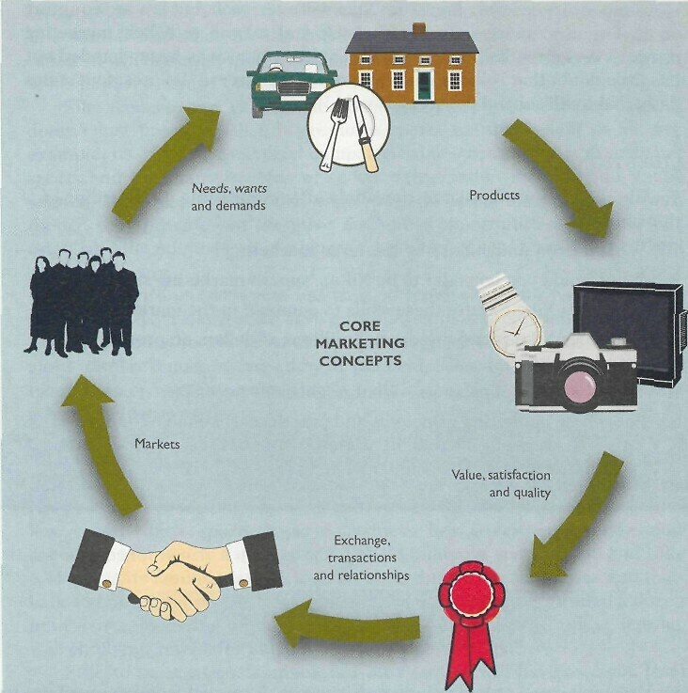
Core Marketing Concepts

Slide 5
Core concept of marketing
1. Needs, wants and demands
Marketing starts with human needs and wants.
Needs - state of felt deprivation for basic items such as food and clothing and complex needs such as for belonging.
i.e. I am thirsty
A person has many needs at any given time.
Some needs are biogenic.
They arise from physiological states of tension such as hunger, thirst and discomfort.

Slide 6
Cont’d…
Therefore, the marketer’s duty is to identify the unfilled needs of their product purchasers and tailor all activities towards fulfilling them.
Wants: - Wants are desires for specific satisfiers of needs.
Human wants are continually shaped and reshaped by social forces Increased buying power.
E.G Abebe needs food but wants burger
Demands - Demands are wants for specific products that
are backed by ability and willingness to buy them.
Wants become demand when supported by purchasing power…i.e. I have money to buy a burger.

Slide 7
2. Product
Goods
Places
Services
Ideas
Product
Information
Persons
Experiences
Properties
Organizations
Events

Slide 8
Cont’d…
A Product is any offering that can satisfy a need or want, while a brand is a specific offering from a known source.
When offerings deliver value and satisfaction to the buyer, they are successful.
In general, a product can consists of as many as three components; physical goods, services, and ideas. The following concept is illustrated with the following example.
Example: A restaurant is supplying goods (foods, drinks, etc), services (cooking, seating, etc) and an idea (saves my time)

Slide 9
Cont’d…
Products broadly classify as tangibility and intangibility.
Tangible products (Goods) are those products, which can be seen, touched, felt etc.
Intangible products (services) are those products which can’t be seen, touched, felt etc.
Furthermore, products could be classified as durability and use.
Durable products are those products which last longer and which require more time to make a purchase decision.
Non-durable products: are those products which are consumed on a day-to-day basis and which does not require much time for purchases decision.

Slide 10
3. Value, Cost, and Satisfaction
How do consumers choose among the many products that might satisfy their needs and wants?
In terms of marketing, the product or offering will be successful if it delivers value and satisfaction to the target buyer. The buyer chooses between different offerings on the basis of which is perceived to deliver the most value.
Value can be defined as a ratio between what the customer gets and what he gives.
Value= Benefits = Functional Benefit + Emotional Benefit
Cost Monetary cost+ Time Cost+ Energy Cost + Psychic Costs

Slide 11
Cost is the amount of money that is going to be expended or already incurred to acquire a product.
Customers often do not judge product values and costs accurately or objectively.
They act on perceived value. Customers perceive the firm to provide faster, more reliable delivery and are hence prepared to pay the higher prices that the company charges.
Customer satisfaction depends on -A product's perceived performance in delivering value relative to a buyer's expectations.

Slide 12
Cont’d…
If the product's performance falls short of the customer's expectations, the buyer is dissatisfied.
If performance matches expectations, the buyer is satisfied.
If performance exceeds expectations, the buyer is delighted.
Smart companies aim to delight customers by promising only what they can deliver, then delivering more than they promise.

Slide 13
4. Exchange and Transactions
People can obtain products in one of four ways.
The first way is self-production. People can be relieving hunger through hunting, fishing or fruit gathering.
The second way is coercion (applying forces).
The third way is begging.
Exchange
Marketing emerges when people decided to satisfy needs and wants through exchange.
Exchange is the act of obtaining a desired product from someone by offering something in return.

Slide 14
Cont’d…
For exchange potential to exist, the following five conditions must be satisfied: -
There are at least two parties
Each party has something that might be of value to the other party
Each party is capable of communication and delivery
Each party is free to accept or reject the exchange offer
Each party believes it is appropriate or desirable to deal with the other party.

Slide 15
Cont’d…
Transaction: - is the( trade of values between two parties)
It is marketing’s unit of measurement
Eg. If Mr. Tomson gives ‘X’ to W/ro Meron. and receives Y in return, that is a transaction.
Eg. If Mr. Tomson gives $400 to W/ro Meron and obtained a TV set. This is a classic monetary transaction.
Transaction however does not require money as one of the traded value

Slide 16
When an agreement is reached, we say that a transaction takes place which is the trade of values between two parties. A transaction involves
At least two things of value,
Agreed-upon conditions,
A time of agreement, and
A place of agreement.

Slide 17
5. Market
Market:- Set of actual and potential buyers of a product
A market consists of all potential customers sharing a particular need or wants who might be willing and able to engage in exchange to satisfy that need or want.
Traditionally, a "market" is a physical place where buyers and sellers gathered to exchange goods.
Economists describe a market as a collection of buyers and sellers who transact over a particular product or product class.
But marketers view the sellers as constituting the industry and the buyers as constituting the market.

Slide 18
Simple Marketing System
Communication
Industry
(a collection
of sellers)
Market
(a collection
of Buyers)
Products/services
Money
Information

Slide 19
Importance of Marketing
To meet our needs, making products readily available when and where we want them, and informing us about producers. These activities add want satisfying ability or what is called utility, to products.
A customer purchases a product because it provides satisfaction.
Something that makes a product capable of satisfying want is its utility.
And it is through marketing that much of a products utility is created.

Slide 20
Cont’d…
Then potential buyers must be informed about the products existence and the benefits are offers through various forms of promotion.
The kinds of utility that marketing provides in the process are as follows: -
Form utility:-the physical or chemical changes that makes a product more valuable.
Place Utility:- Place utility exists when a product is readily accessible to potential customers. So physically moving the products to a store near the customers add to its value.

Slide 21
Cont’d…
3. Time Utility:-Time utility means having a product available when you want it.
4. Information Utility:-Information utility is created by informing prospective buyers that a product exists
5.Possession Utility:- Possession utility is created when a customer buys the product-that is, ownership is transferred to the buyer. has no value.

Slide 22
Cont’d…
In general importance of marketing can be summarized as follows:
As a producer and businessman we usually make such marketing related decisions such as finding out who are our customers? What are their need and want and what good and service to offer and at what price.
As a consumer we make such marketing related decision where to shop, which salesperson to contact, what price to pay, what to buy.
As an employee we are concerned with the employment opportunity that can be created by marketing activities.
To the society, marketing contributes to the economic growth of the society through making profit and make people at a better off.

Slide 23
Marketing philosophy
Production Concept
Product Concept
Marketing
Concept
Marketing philosophy
Selling Concept
Societal
Marketing

Slide 24
Cont’d…
There are five competing concepts:
The production concept: holds that consumers will favor products that are widely available and low in cost.
Concentrate on achieving high production efficiency and wide distribution.
The assumption that consumers are primarily interested in product availability and low price
The production concept is a useful philosophy in two types of situation.
The first occurs when the demand for a product exceeds the supply. Here, management should look for ways to increase production.
The second situation occurs when the product's cost is too high and improved productivity is needed to bring it down.

Slide 25
Cont’d…
The product concept: holds that consumers will favor products that offer the most quality, performance and innovative features, and that an organization should thus devote energy to making continuous product improvements.
Selling concept: holds that consumers will not buy enough of the organization's products unless it undertakes a large-scale selling and promotion effort.
The concept is typically practiced with unsought goods - those products that buyers do not normally think of buying, such as encyclopedias and life insurance.
The marketing concept holds that achieving organizational goals depends on determining the needs and wants of target markets and delivering the desired satisfactions more effectively and efficiently than competitors do.

Slide 26
Cont’d…
Four pillars of the marketing concept:
  Target market……………Defining
  Customer needs…………Identifying
  Integrated marketing……Coordination
  Profitability…………Attracting enough funds
The societal marketing concept holds that the organization should determine the needs, wants and interests of target markets.
It should then deliver the desired satisfactions more effectively and efficiently than competitors in a way that maintains or improves the consumer's and the society's well-being.

Slide 27
Cont’d…
Human welfare
Consumers Company
(Want satisfaction) (profits)
Societal marketing concept

Slide 28
Difference b/n Marketing and selling
The basic difference is that selling is internally focused (“inside-out” perspective), while marketing is externally focused (“outside-in” perspective)
E.g. 1. When a firm makes a product and then tries to persuade customers to buy it, that’s selling.
E.g. 2. When a firm finds out the customer wants and develops a product that will satisfy that need and also yield a profit, that’s marketing

Slide 29
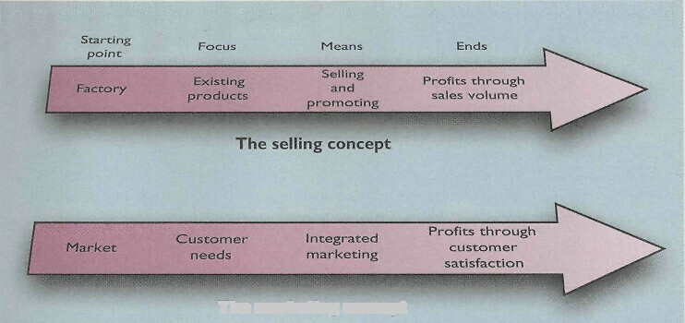
Cont’d…

Slide 30
Marketing mix Elements
Marketers use numerous tools to elicit the desired responses from their target markets. These tools constitute a marketing mix.
Marketing mix is the set of marketing tools that the firm uses to pursue its marketing objectives in the target market.
McCarthy classified these tools into four broad groups that he called the four Ps of marketing: product, price, place, and promotion.
Marketing-mix decisions must be made to influence the trade channels as well as the final consumers.

Slide 31
Cont’d…
The firm can change its price, sales-force size, and advertising expenditures in the short run.
However, it can develop new products and modify its distribution channels only in the long run..

Slide 32
Cont’d…
Four Ps Four Cs
Product Customer solution
Price Customer cost
Place Convenience
Promotion Communication
Winning companies are those that meet customer needs economically and conveniently and with effective communication.

Slide 33
END OF CHAPTER ONE

Slide 34
Chapter Two
The Marketing Environment

Slide 35
Learning Goals
Understand environmental forces
Learn how demographic and economic factors affect marketing
Identify trends in the firm’s natural and technological environments
Explore key changes in political and cultural environments

Slide 36
Definition of Marketing Environment
The actors and forces outside marketing that affect marketing management’s ability to build and maintain successful relationships with target customers and are two types
Microenvironment: Includes the actors close to the company
Macro environment: Involves larger societal forces
The marketing environment offers both opportunities and threats.
A company's marketers take the major responsibility of identifying significant changes in the environment.

Slide 37
Organization’s Environment
Macro or Far Environment
Near or Operating Environment
Economic Factors
Technological Factors
Customers
Partners
Clients
ORGANIZATION
Suppliers
Political Factors
Social Factors
Competitors

Slide 38
Cont’d…
Although every manager in an organization needs to observe the outside environment, marketers have two special skill.
They have disciplined methods - marketing intelligence and marketing research - for collecting information about the marketing environment.
They also normally spend more time in the customer and competitor environment.

Slide 39
Cont’d…
By conducting systematic environmental scanning, marketers are able to revise and adapt marketing strategies to meet new challenges and opportunities in the marketplace.
The wise marketing manager knows that he or she cannot always affect environmental forces.
However, smart managers can take a proactive, rather than reactive, approach to the marketing environment.

Slide 40
2.1. Microenvironment
Marketing management's job is to create attractive offers for target markets. However, marketing managers cannot simply focus on the target market's needs.
Their success will also be affected by actors in the company's microenvironment.
The micro-environment consists of forces close to the company that affect its ability to serve its customers.

Slide 41
Cont’d…
For most companies, the micro environmental components are:
Company,
Suppliers,
Marketing channel firms (intermediaries),
Customer markets,
Competitors, and
Publics

Slide 42
2.1.1. COMPANY
In designing marketing plans, marketing management should take other company groups, such as top management, finance, research and development (R & D), purchasing, manufacturing and accounting, into consideration.
Top management is responsible for setting the company’s mission, objectives, broad strategies, and policies.

Slide 43
Cont’d…
Marketing managers must make decisions within the parameters established by top management.
Marketing managers must also work closely with other company departments.
All departments must “think consumer” if the firm is to be successful. The goal is to provide superior customer value and satisfaction.

Slide 44
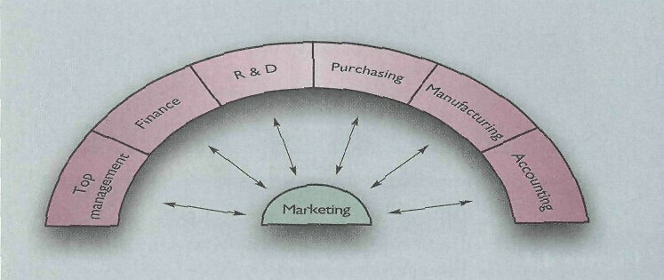
Cont’d…

Slide 45
2.1.2. Suppliers
Suppliers are firms and individuals that provide the resources needed by the company and its competitors to produce goods and services.
Marketing managers should
Consideration supply availability (such as supply shortages).
Another point of concern is the monitoring of price trends of key inputs. Rising supply costs must be carefully monitored which lead to price rising.

Slide 46
2.1.3. Marketing Intermediaries
Marketing intermediaries are firms that help the company to promote, sell and distribute its goods to final buyers. They include:
Resellers are distribution channel firms that help the company find customers or make sales to them.
These include wholesalers and retailers who buy and resell merchandise.
Resellers often perform important functions more cheaply than the company can perform itself.
However, seeking and working with resellers is not easy because of the power that some demand and use.

Slide 47
Cont’d…
Physical distribution firms: include warehouse, transportation and other firms that help a company to stock and move goods from their points of origin to their destinations.
Marketing services agencies: are the marketing research firms, advertising agencies, media firms and marketing consultancies that help the company target and promote its products to the right markets (vary in creativity, quality, service and price).
Financial intermediaries (such as banks, credit companies, insurance, etc.) help finance transactions and insure against risks (E.g. rising credit costs and limited credit.)

Slide 48
2.1.4. Customers
The company must study its customer markets closely since each market has its own special characteristics.
These markets normally include:
  Consumer markets (individuals and households that buy goods and services for personal consumption).
  Business markets (buy goods and services for further processing or for use in their production process).
  Reseller markets (buy goods and services in order to resell them at a profit).
  Government markets (agencies that buy goods and services in order to produce public services or transfer them to those that need them).
  International markets (buyers of all types in foreign countries).

Slide 49
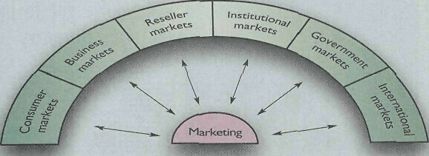
Cont’d…

Slide 50
2.1.5. Competitors
The marketing concept states that, to be successful, a company must provide greater customer value and satisfaction than its competitors do.
Thus, marketers must do more than simply adapt to the needs of target consumers.
They must also gain strategic advantage by positioning their offerings strongly against competitors‘ offerings in the minds of consumers.
No single competitive marketing strategy is best for all companies.

Slide 51
2.1.6. Publics
A public is any group that has an actual or potential interest in or impact on an organization’s ability to achieve its objectives. Can be
  Financial publics--influence the company’s ability to obtain funds.
  Media publics--carry news, features, and editorial opinion.
  Government public: Management must take government developments into account. Marketers must often consult the company's lawyers on issues of product safety, truth-in-advertising and other matters (Ethiopian standardization Authority).

Slide 52
Cont’d…
  Citizen action publics. A company's marketing decisions may be questioned by consumer organizations, environmental groups, minority groups and other pressure groups.
  Local publics. Every company has local publics, such as neighborhood residents and community organizations.
  General publics--a company must be concerned about the general public’s attitude toward its products and services.
  Internal publics. A company's internal publics include its workers, managers, volunteers and the board of directors. When employees feel good about their company, this positive attitude spills over to their external publics.

Slide 53
2.2. Macro Environment
The following forces in the Broad/ macro Environment have a major impact on the Task/micro Environment:
  Demographics
  Economics
  Natural environment
  Technological environment
  Political-legal environment
  Social-cultural environment

Slide 54
2.2.1. Demographic Environment
Demography is the study of human population in terms of size, density, location, age, gender, race, occupation... etc
The demographic environment is of major interest to marketers because it involves, people, and people make up markets.
Demographic trends are constantly changing such as:
  Population Age Mix: getting older
  Population Growth: increasing rate
  Ethnic Group: diversity
  Education Status: increased in number
  Household Patterns: married and no children

Slide 55
Economic Environment
Markets require buying power as well as people. The economic environment consists of factors that affect consumer purchasing power and spending patterns.
Economic trend
Changes In Income
Changing consumer spending patterns
Savings, Debt and Credit Availability

Slide 56
Natural Environment
The natural environment involves the natural resources that are needed as inputs by marketers or that are affected by marketing activities.
Trends
Shortage of Raw Materials
Increased Energy Costs: non-renewable
Increased Pollution Levels
Changing Role of Government

Slide 57
Technological Environment
The technological environment is perhaps the most dramatic force now shaping our destiny.
New technologies create new markets and opportunities. The marketer should watch the following trends in technology.
Fast Pace of Technological Change
Innovation Opportunities
High R&D Budgets
Regulations of Technological Change

Slide 58
Political-Legal Environment
The political environment consists of laws, government agencies and pressure groups that influence and limit various organizations and individuals in a given society.
Some trends in the political environment include:
1). Increasing legislation to:
  Protect companies from each other.
  Protecting consumers from unfair business practices.
  Protecting interests of society against unrestrained business behavior.
2). Changing government agency enforcement. New laws and their enforcement will continue or increase.
3). Increased emphasis on ethics and socially responsible actions. (“do the right thing.”)

Slide 59
Social-Cultural Environment
The cultural environment is made up of institutions and other forces that affect society’s basic values, perceptions, preferences, and behaviors.
Among the most dynamic cultural characteristics are:
Persistence of cultural values. People’s core beliefs and values have a high degree of persistence.
Shifts in secondary cultural values: Although core values are fairly persistent, cultural swings do take place.

Slide 60
Responding to the
Marketing Environment
There are three kinds of companies:
those who make things happen,
those who watch things happen, and
those who wonder what’s happened.

Slide 61
End of Chapter Two

