Slide 1
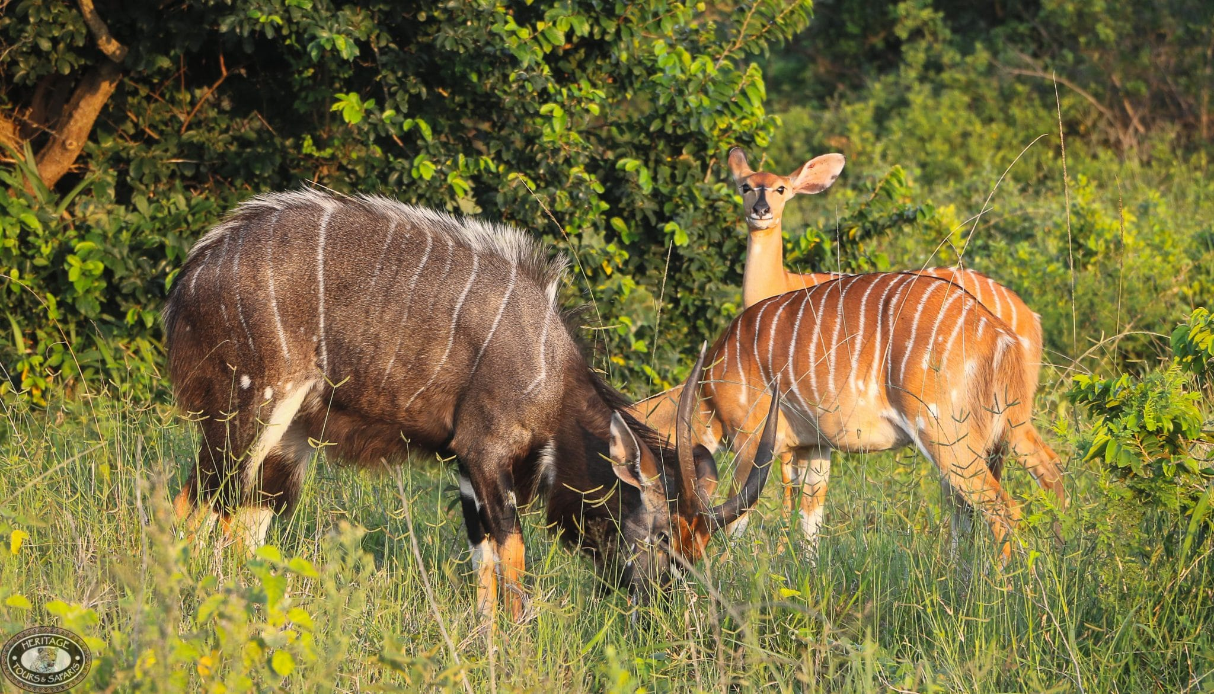
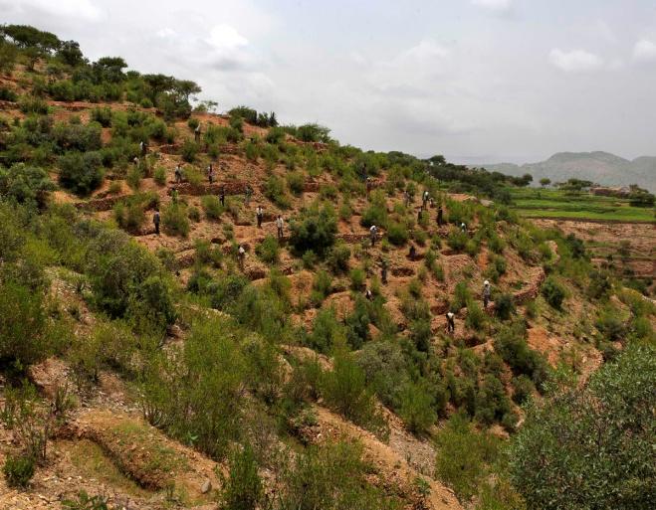
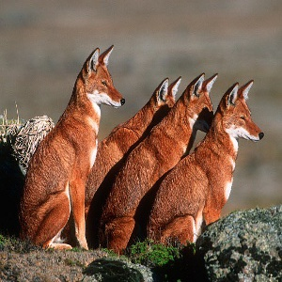
CHAPTER 6
Soils, Natural Vegetation and Wildlife Resources of Ethiopia & the Horn

Slide 2
Chapter Objectives
At the end of this chapter students will be able to;
  Identify major soil types of Ethiopia
  Understand soil degradation and conservation measures
  Describe the distribution of natural vegetations in Ethiopia
  Explain the significance of wildlife resources of Ethiopia

Slide 3
Outlines
Ethiopian Soils:
Meaning, Formation, Types, Degradation and Conservation
Natural Vegetation in Ethiopia
Meaning, Vegetation Types, Degradation and Conservation
Wildlife Resources of Ethiopia
Classification, Conservation

Slide 4
Brainstorming Activity
What is soil?

Slide 5
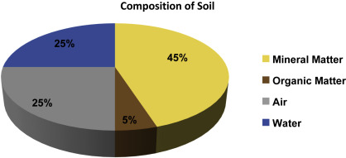
1. Ethiopian Soils
What is Soil?
  A delicate but highly varied composition of mineral particles, organic matter and living organisms in dynamic equilibrium.

Slide 6
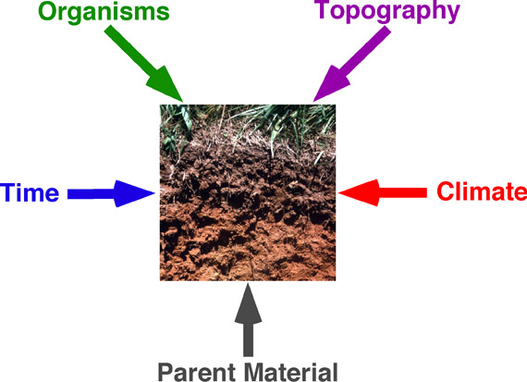
Soil Formation: How soil is formed?
A long-term complex process
  Take several thousands of years to form a single stratum
  The formation depends on the following factors

Slide 7
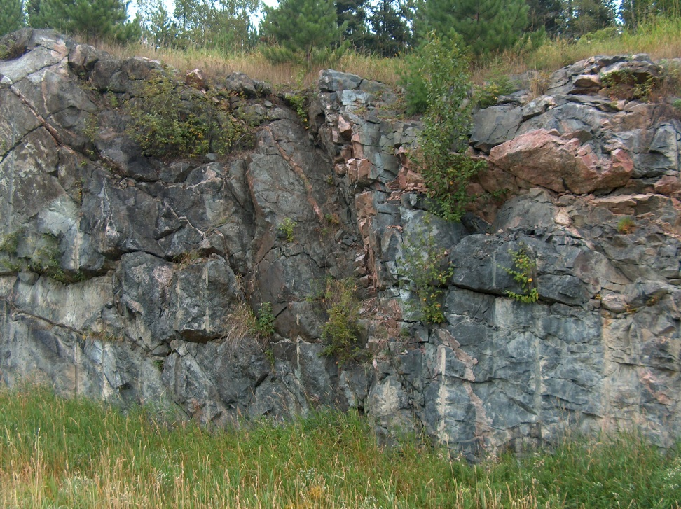
Weathering (as a Soil Formation Process)
The disintegration inorganic substances (rocks)
It is the breakdown of rocks at the Earth's surface, by the action of;
    Rainwater,
    Temperature, &
    Biological Activity

Slide 8
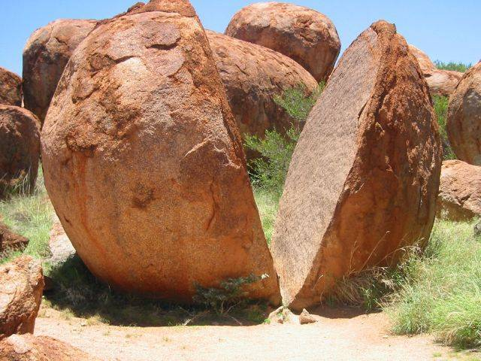
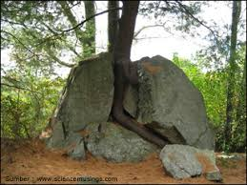
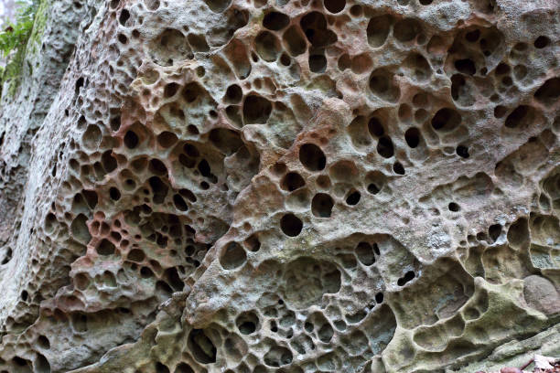
3 Types of Weathering involves in Soil Formation
Mechanical (Physical) Weathering
  Differential stresses due to heating and cooling
Biological Weathering
  Disintegration of rock by plants, animals & microbes
Chemical Weathering
  modification of the chemical & mineralogical composition
    (hydrolysis, oxidation, reduction, hydration, carbonation, and solution)

Slide 9
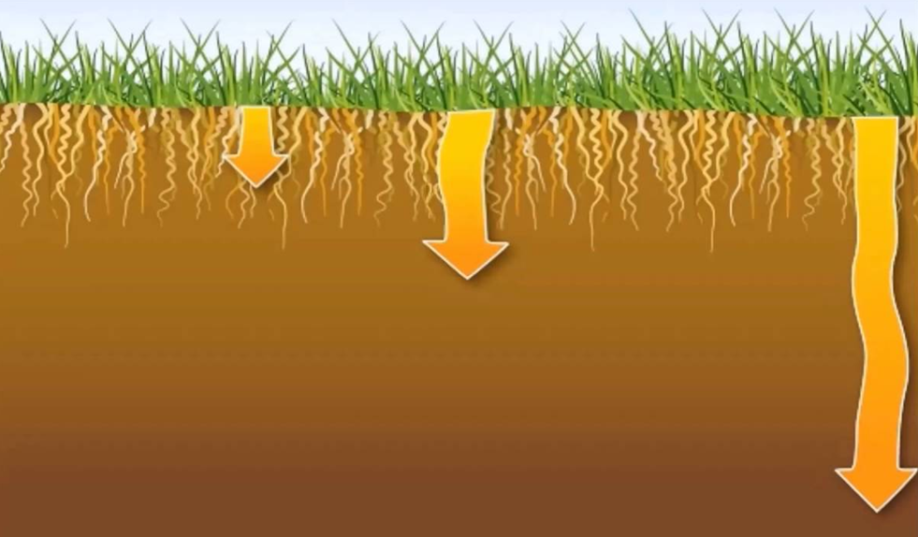
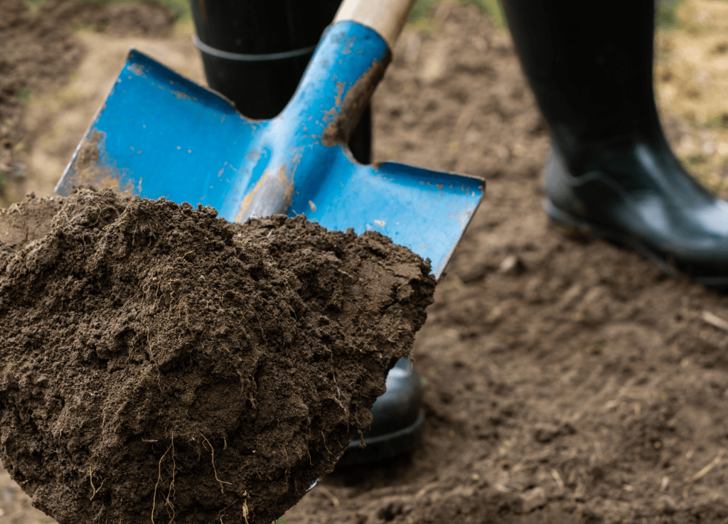
Soil Properties
Physical properties Soil
Chemical Properties
Properties which affect air and water movement in the soil, and thus the soil's ability to function
  Texture,
  Structure,
  Porosity etc.
Chemical constituents which affect soil biological activity and nutrient dynamics
  Availability of minerals,
  Electrical conductivity,
  Soil pH, etc.

Slide 10
Major Soil Types in Ethiopia
Soils of Ethiopia
  are basically derived from crystalline, volcanic and Mesozoic sedimentary rocks.
  FAO has identified 18 soil associations in Ethiopia
  11 soil associations cover about 87.4% of the land area

Slide 11
Cont…
6 major groups of soils in Ethiopia are discussed under the following points:
    Environmental condition i.e. parent material, climatic conditions, topography, the way they were formed.
    Characteristic i.e. significant chemical and physical properties.
    Agricultural suitability in relation to texture, structure, topography, moisture-storage capacity, etc.
    Occurrence: general location of the soil types

Slide 12
Activity
List the major soil types of Ethiopia.

Slide 13
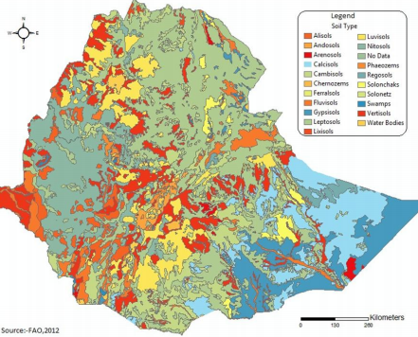
The 6 Major Groups of Soils in Ethiopia
Nitosols and Acrisols
Vertisols
Lithosols, Cambisols & Regosol
Xerosols, Yermosols & Solanchaks
Fluvisols
Luvisols

Slide 14
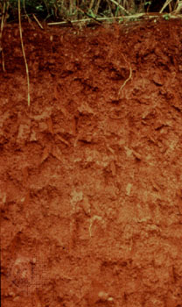
1. Nitosols and Acrisols
Nitosols
Trap series volcanics, volcanic ash, metamorphic rocks parent materials
Associated with highlands with high rainfall
Reddish-brown color
concentration of iron (ferric) oxides due to leaching
    western highlands (Wellega)
    southwestern highlands (Kaffa, Illuababora)
    Southern, Central and Eastern highlands
Acrisols
Most inherently infertile soils
Degraded chemically and organically
Low resilience to degradation
Low productive capacity
Acrisols are found along with nitosols mostly in some pockets of southwestern highlands of Ethiopia where there is high rainfall.

Slide 15
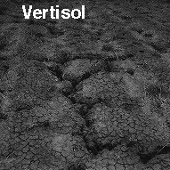
2. Vertisols
Develop on volcanic plateau basalt, trachyte &pyroclastic materials, sedimentary rocks
Heavy clay soils
High natural chemical fertility
Soils of highlands and moderate climates.
Commonly found in parts of;
    Northwestern, Central and Southeastern highlands
    (Gojjam, Shewa, Arsi, Bale and central Hararghe)

Slide 16
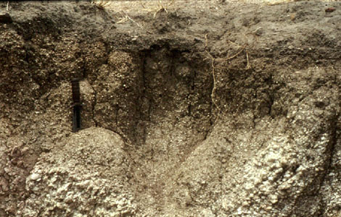
3. Lithosols, Cambisols & Regosol
Mostly found in rugged topography & steep slopes.
Young, shallow and coarse textured
Low water holding capacity
Found in areas of low rainfall
Limited agricultural use
Used for grazing
Mostly found in;
    Central Highlands
    Rift Valley Escarpments
    western Hararghe highlands
Regosol and Lithosols are also found in the Danakil and eastern Ogaden.

Slide 17
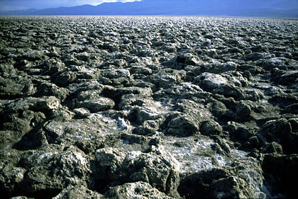
4. Xerosols, Yermosols and Solanchaks
Soils of desert
Available in arid and semiarid areas
High salt content and low organic content and nitrogen
Rich in phosphorus and potash
Can be very fertile if irrigated
Xerosols are found in Ogaden and northeastern escarpments
Yermosols and Solonchaks cover the Ogaden and Afar plains
Solonchaks in salty plains of Afar

Slide 18
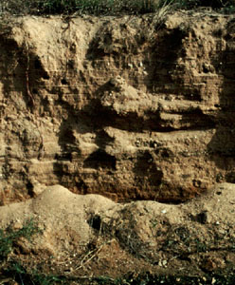
5. Fluvisols
Formed due to deposition of eroded materials from highlands.
Deposits in depressions, lower valleys and lowlands
Much prized for
    Intensive agriculture &
    Large-scale irrigation
Fertile and their fertility is always renewed as a result of deposition of new soil materials.
Mostly found in;
    Lower regions of rivers like Omo, Awash, Abay
    The plains of Akobo and Baro Rivers
    Lakes region (main Ethiopian rift)

Slide 19
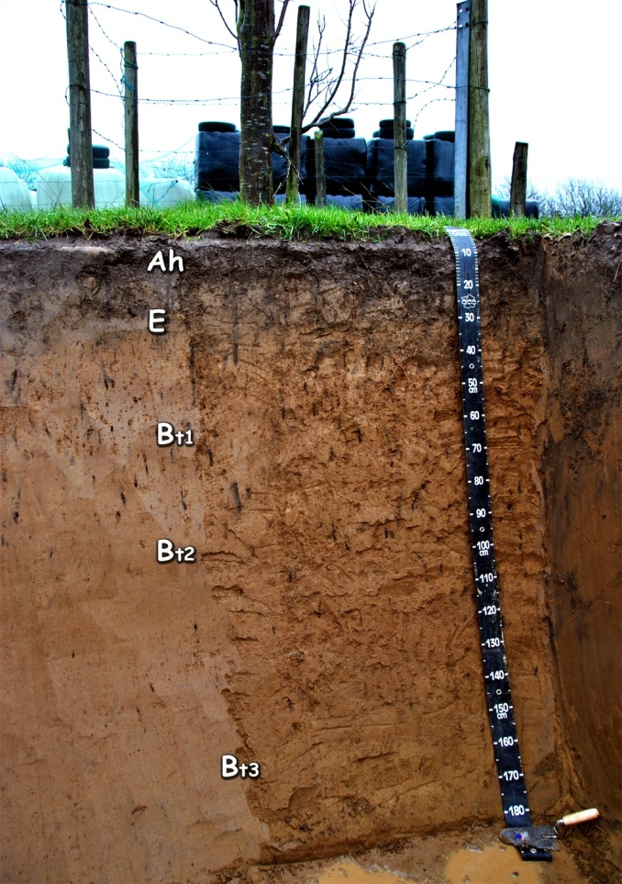
6. Luvisols
Develop in areas where wet and dry seasons occur in alternation
Good chemical nutrients
Among the best agricultural soils in the tropics.
Intensively cultivated
Mostly found in;
  Lake Tana area,
  parts of Northern, Central and Eastern Highlands and
  Southern lowlands

Slide 20
Activity
What is soil degradation?
What are the causes of soil degradation?
Explain the conservation measures of soil from degradation

Slide 21
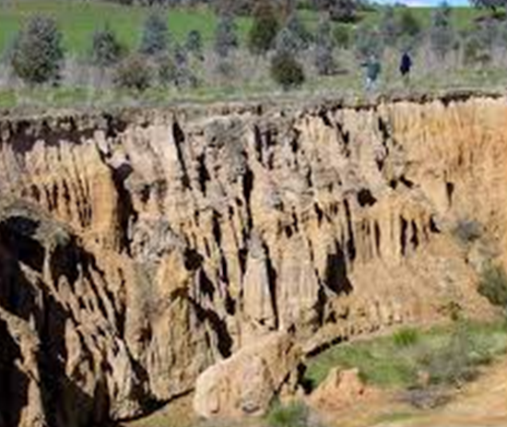
Soil Degradation
A change in any or all of soil status resulting in a diminished capacity of the ecosystem to provide goods and services.
  Deterioration of the physical, chemical and biological properties of soil
It is a major concern for at least 2 reasons
  It undermines the productive capacity of an ecosystem
  It affects global climate through alterations in water and energy balances and disruptions in cycles of carbon, nitrogen, sulfur, and other elements.

Slide 22
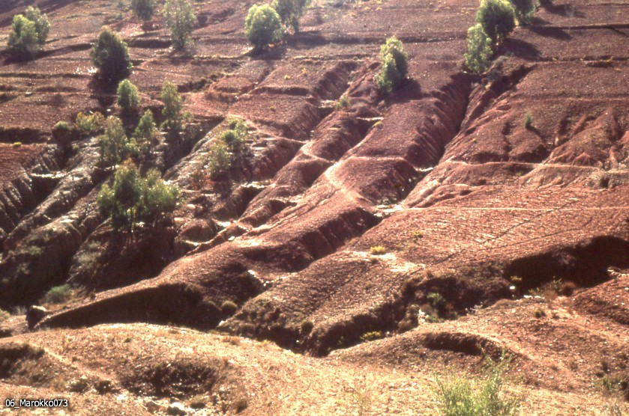
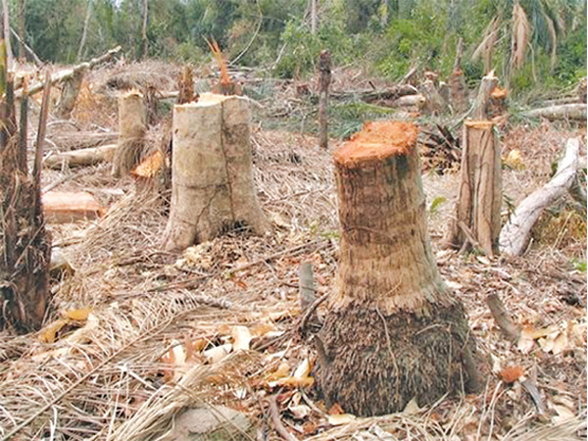
Causes of Soil Degradation
Natural Causes
Human-induced Causes
  Topographic and climatic
    Steep slopes,
    Floods and tornadoes,
    Storms and high-velocity wind
  Deforestation
  Overexploitation of vegetation,
  Overgrazing, etc.

Slide 23
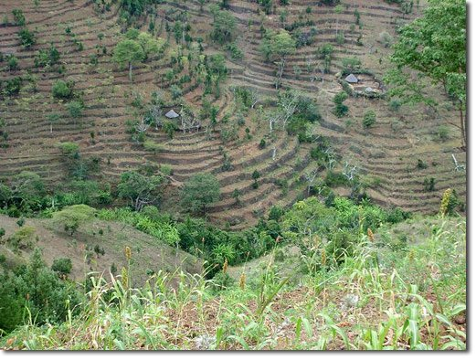
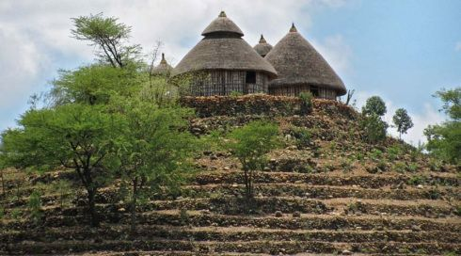
Soil Erosion Control Measures
A. Biological Control Measures
B. Physical control
Used to control the movement of water over the soil surface.
    Terracing,
    Check Dams,
    Gabion,
    Trenches,
    Contour Ploughing,
    Soil Bunds etc.
Prevent splash erosion, reduces the velocity of surface runoff, increases surface roughness, increases infiltration, and etc.
    Vegetative strips,
    Plantation &
    Reforestation

Slide 24
Natural Vegetation of Ethiopia
Natural Vegetation (Meaning)
  Original plant cover grown in an area
  Develops with little or no human interference.
Ethiopia's Natural Vegetation
  An estimated number of 6000 species of higher plants (10% are endemic)
  The spatial distribution of natural vegetation in the country is strongly correlated to elevation + (temperature and rainfall).
  Lowlands are characterized by xeromorphic plants (plants which are adapted to drought).
  Highlands (up to 3000 m) = a variety of forests

Slide 25
Major Natural Vegetation Types of Ethiopia
Afro-alpine and sub-afro alpine Region
Forest Region
Woodland Savannah Region
Steppe Region
Semi-desert Region
    (Taking altitude into consideration)

Slide 26
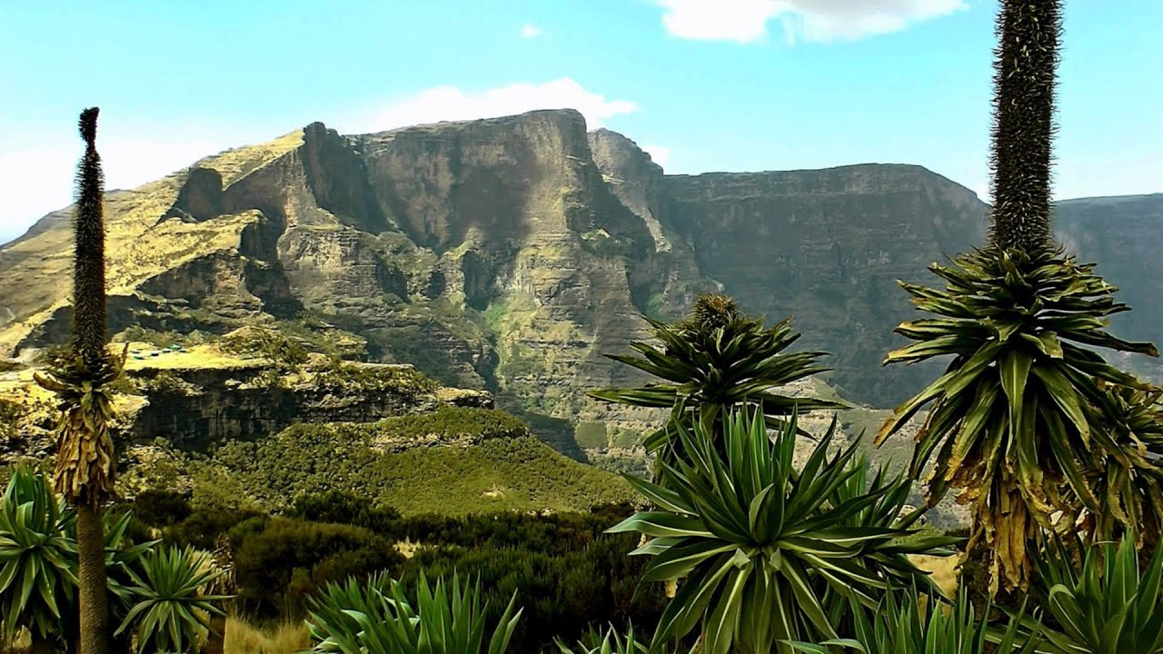
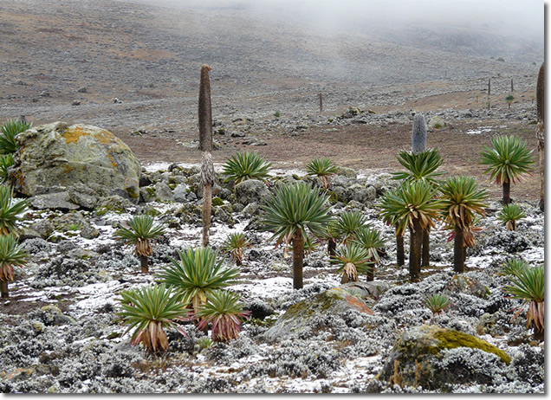
1. Afro-alpine & Sub-afro Alpine Region
    High mountain vegetation (3,200 and 4,620 m asl)
    similar to the Alpine vegetation in temperate regions
    covers 1.3 % of the total landmass of Ethiopia
    Temperature records of 0 ºC and below
    Soils mostly shallow and eroded
    Eg. Vegetations in Bale and Semein mountains
      tussock grasslands, scrub, scattered mosses and lichens
      Lobelia rhynchopetalum (giberra)

Slide 27
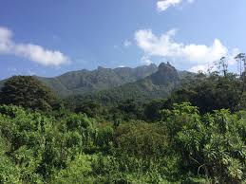
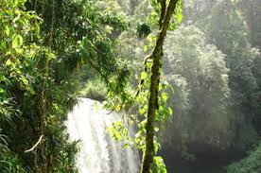
2. Forest Region
In Ethiopia, forests are found at different elevations &rainfall,
  450 to 3,500m in humid parts &
  2,300 to 3,300 m in most arid parts.
  Mean Annual Rainfall 200 to 2,200mm.
Hence Ethiopian forests can classified as:
1. Highland forests include
  Hagenia Abyssinia (Kosso),
  Juniper procera (tid),
  Arundinaria Alpina(kerkha),
  Podocarpus falcatus (zigba),
  Aningeria adolfi-friedericii (keraro) and
  Olea africana (Weyra) forests;
2. lowland forests
  Baphia , Ficus sur (sholla), acacia trees
  Gallery (Riverine) Forests (forests that stretch along the banks of the lower courses of rivers)
    found in the banks of Awash, Wabishebelle, Ghenale etc..

Slide 28
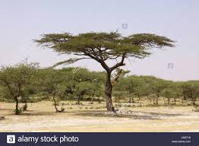

3. Woodland Savannah Region
  found (250 to 2,300 m) altitudinal ranges
  MAR 200 - 1,400 mm
  plants of Xeromorphic characteristics (shading of leaves during the dry season
  Shrublands and Bushlands
  can be broadly classified into 3 divisions:
    Juniper procera (tid)
    Acacia woodlands
    Mixed deciduous woodlands

Slide 29
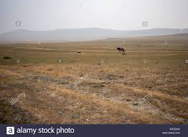
4. Steppe and Semi Desert Regions
    Arid and semiarid parts of the country where the
    temperature is very high and the rainfall very low
    low elevations 100 to1,400 m asl
      the semi-deserts 125 m bsl to 600 m asl.
    Mean Annual Rainfall
      The steppe gets MAR 100 to 550 mm
      The semi desert 50 to 300 mm
    Growing period
      2 months for the steppe
      one month for the semi-deserts
    Soils in both regions are generally alkaline and saline.
    xerophytic (i.e. drought-resisting plants) are the dominant vegetations.

Slide 30
Natural vegetation Degradation
In Ethiopia
  Dense Population
  Rapid growth of the already dense population
  Overexploitation of the land
  New land has been cleared at the expense of forests.
  Forest resources have been disappearing at an alarming rate.
  A century ago, forests covered about 40 percent of the total land area.
Dense Population
High Population growth rate
Pressure on land
Over exploitation of land
Natural vegetation degradation

Slide 31
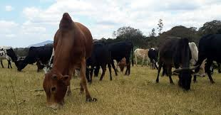
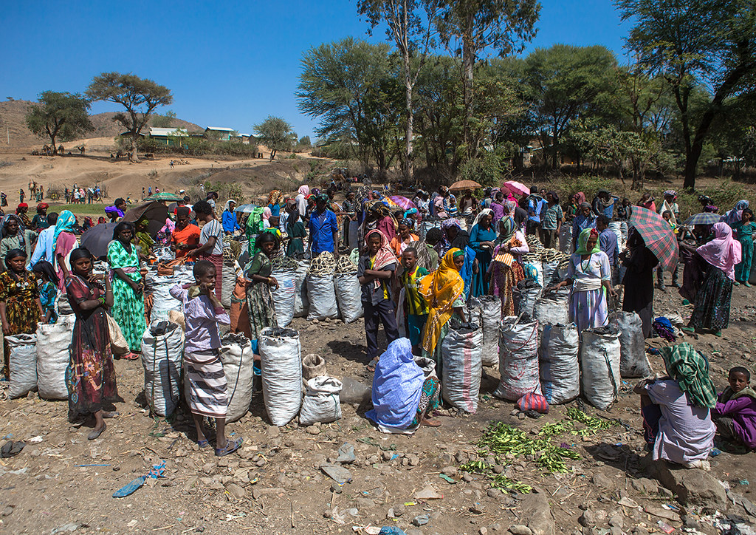
Major Causes
    Clearing of forests for cultivation
    Timber exploitation practices
    Charcoal burning and cutting for fuel
    Extensions of coffee and tea production areas
    Overgrazing
    Expansion of settlements both rural and urban, and
    Clearing for construction.

Slide 32
Natural Vegetation Conservation
To maintain at least its current status and derive sustainable benefits for the present and future generation.
3 Approaches of Biodiversity Conservation
  Protection
      Through designation of sanctuaries, national parks, and community conservation areas.
  Sustainable forest management
      Sustainable harvesting of forest products to provide a source of financial income
  Restoration or rehabilitation
      The process of assisting the recovery of a forest ecosystem that has been degraded, damaged, or destroyed.

Slide 33
Wild Life in Ethiopia
Ethiopia’s Wild Life Overview
  Existence of wide range of ecosystems
  Great varieties of habitats
  High faunal diversity
  High level of endemicity
  Data on faunal resource of the country
    860 avian species (16 endemic species and 2 endemic genera)
    279 mammalian species (31 endemic species & 6 endemic genera)
    201 species of reptiles (14 endemic species),
    23 species of amphibians (23 endemic species),
    150 freshwater fish (6 endemic species)
The main wild life concentrations in the southern and western parts

Slide 34
Ethiopia’s Wild Life Classification
5 Major Groups:
  Common Wild Animals;
      Animals found in many parts of the country (hyenas, jackals)
  Game (Lowland) Animal
      Herbivores like giraffes, wild asses, zebras etc. and
      Carnivores like lions, leopards, and cheetahs)
  Tree Animals /Arboreals
      Monkeys, baboons
  Variety of Birds
      Found in the Rift Valley lakes

Slide 35
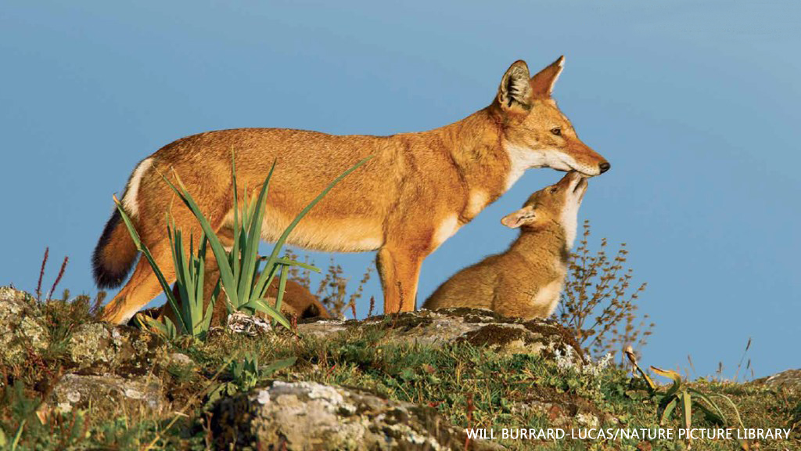
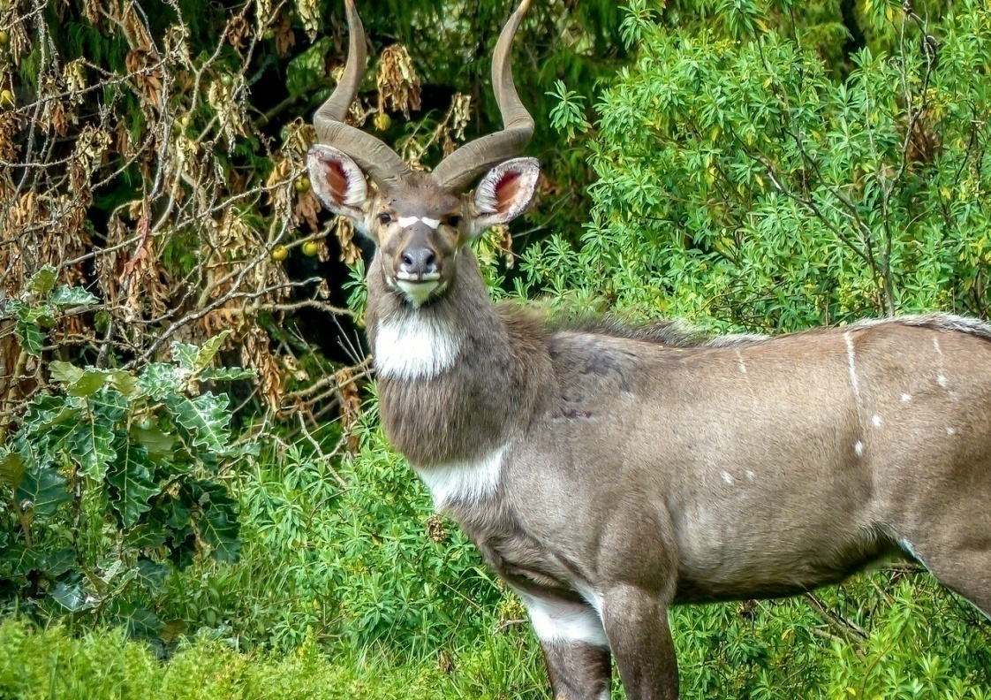
5. Rare Animals
  Walia Ibex (Capra walie),
  Gelada Baboon (Theropithecus gelada),
  Mountain Nyala (Tragelaphus buxtoni),
  Ethiopian Wolf (Canissimensis),
  Starck’s Hare (Lepus starcki)
Notes:
Gelada baboon and Semien fox) scattered in highlands; walia- ibex in the Semien Massifs, Nyala in the Arsi Bale massifs).

Slide 36
According to Ethiopian wildlife conservation
African elephant
African Wild Dog
Beira (Antelope)
Dibatag or Clarke's Gazelle
Dorcas Gazelle
Ethiopian Wolf
Gelada
Grevy's Zebra
Mountain Nyala
Pale Tawny Hartebeest
Red-fronted Gazelle
Soemmerring's Gazelle
Somali Wild Ass
Speke's Gazelle
Swayne's Hartebeest
Walia Ibex

Slide 37
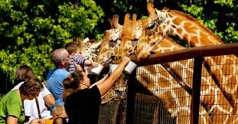
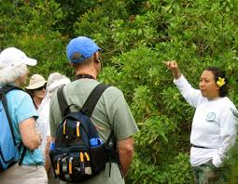
Wildlife Conservation
Why Conservation?
Wild animals can be used for:
    Scientific and educational researches
    Physical and mental recreation (aesthetic value)
    Promotion of tourism (economic value)
    Maintaining ecological balance

Slide 38
Wildlife Conservation in Ethiopia
    21 major national parks
    2 major wildlife sanctuaries
    3 wildlife reserves
    6 community conservation areas
    2 wildlife rescue centers
    22 controlled hunting areas
    2 botanical gardens, and
    3 biosphere reserves

Slide 39
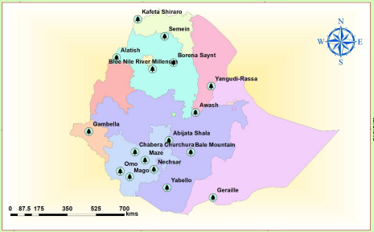
Major National Parks in Ethiopia

Slide 40
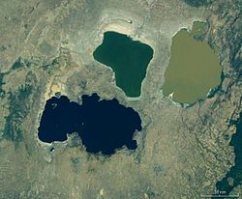
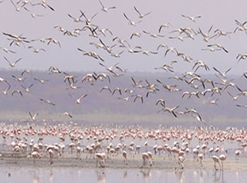
Some of the national parks are unique in their wild animals they have.
    Abiyatta-Shalla lakes National Park
      predominantly Bird Sanctuary (flamingos and pelicans)

Slide 41
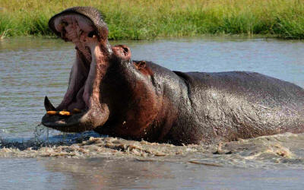
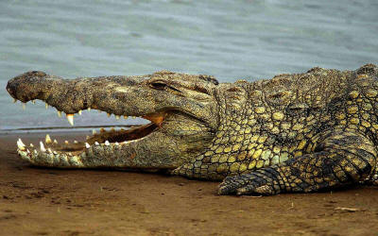
  Omo, Mago, and Gambela National Parks
    have hippopotamus and crocodiles in rivers and lakes.

Slide 42
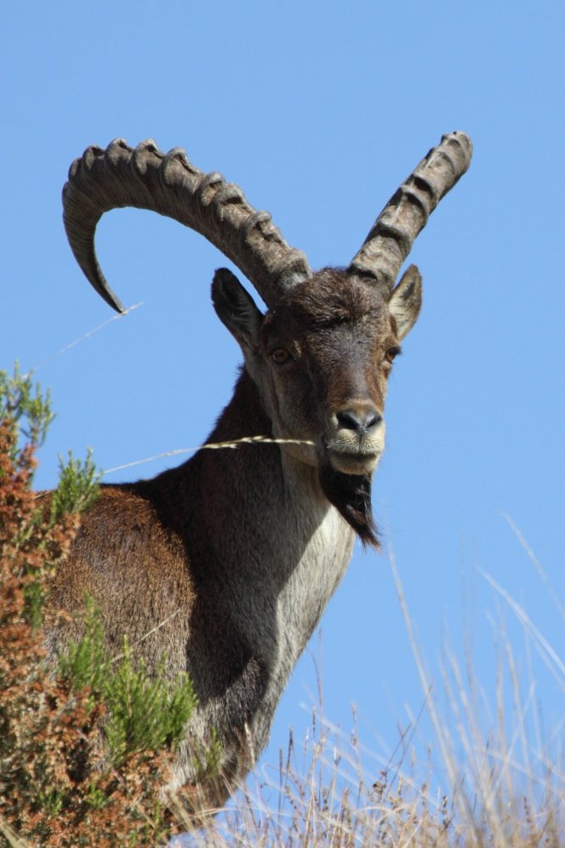
Semien & Bale Mountains National Parks
  Rare animals like Walia ibex, Semien fox, gelada baboon & Nyala

Slide 43
Challenges of Wildlife Conservation in Ethiopia
What are the challenges of wildlife conservation in Ethiopia?

Slide 44
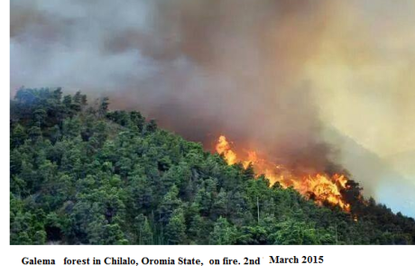
Major challenges Ethiopian protected areas facing;
    Limited awareness on the importance of wild life
    Expansion of human settlement in protected areas.
    Conflict over resource
    Overgrazing (fodder and wood)
    Illegal wildlife trade
    Excessive hunting
    Tourism and recreational pressure
    Mining and construction material extraction
    Forest fire

Slide 45
End of Chapter 6!
Do you know that if you leave nature to its own system, it has notable system of taking care of itself!

