Slide 1
CHAPTER FIVE
RECEIVABLES

Slide 2
ACCOUNTS RECEIVABLE
Receivables - Claims held against customers and others for money, goods, or services.
Oral promises of the purchaser to pay for goods and services sold.
Written promises to pay a certain sum of money on a specified future date.
Accounts Receivable
Notes
Receivable
LO 3

Slide 3
ACCOUNTS RECEIVABLE
Non-Trade Receivables
Advances to officers and employees.
Advances to subsidiaries.
Deposits paid to cover potential damages or losses.
Deposits paid as a guarantee of performance or payment.
Dividends and interest receivable.
Claims against: Insurance companies for casualties sustained; defendants under suit; governmental bodies for tax refunds; common carriers for damaged or lost goods; creditors for returned, damaged, or lost goods; customers for returnable items (crates, containers, etc.).
LO 3

Slide 4
Recognition of Accounts Receivable
Trade Discounts
Use to:
Avoid frequent changes in catalogs.
Alter prices for different quantities purchased.
Hide the true invoice price from competitors.
10 % Discount for new Retail Store Customers
LO 4

Slide 5
Recognition of Accounts Receivable
Cash Discounts (Sales Discounts)
Offered to induce prompt payment.
Terms such as 2/10, n/30, 2/10, E.O.M., or net 30, E.O.M.
IFRS needs the Net Method.
Payment terms are 2/10, n/30
LO 4

Slide 6
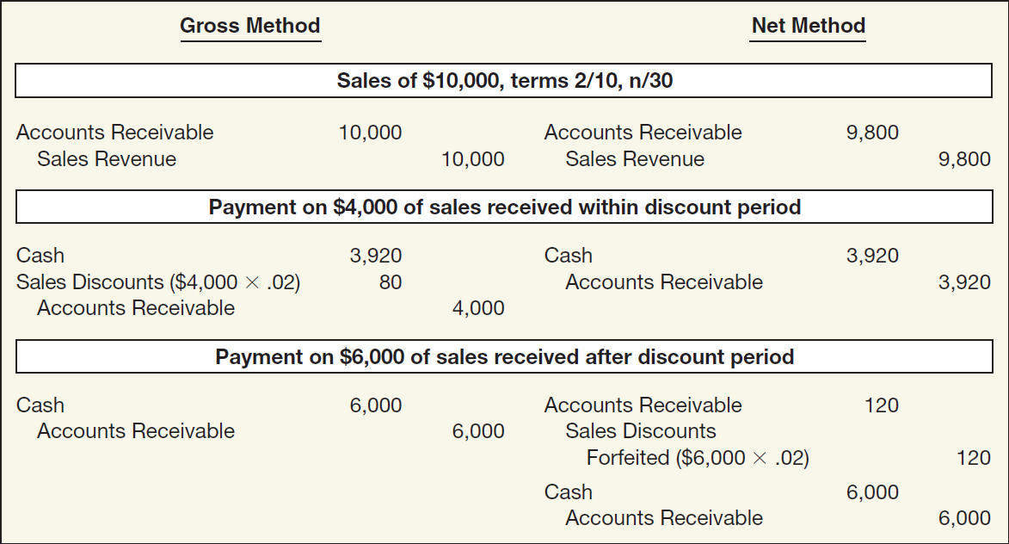
Cash Discounts (Sales Discounts)
ILLUSTRATION 7-5
Entries under Gross
and Net Methods
LO 4

Slide 7
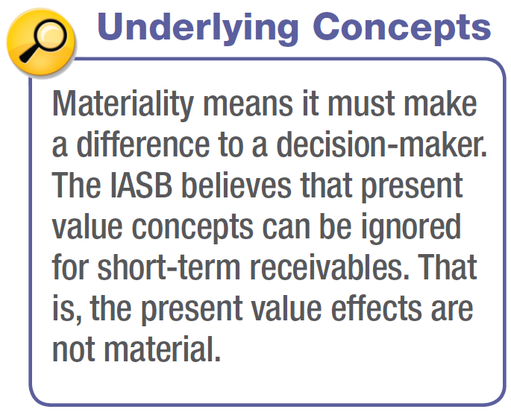
Recognition of Accounts Receivable
Non-Recognition of Interest Element
A company should measure receivables in terms of their present value.
In practice, companies ignore interest revenue related to accounts receivable because, for current assets, the amount of the discount is not usually material in relation to the net income for the period.
LO 4

Slide 8
ACCOUNTS RECEIVABLE
How are these accounts presented on the Statement of Financial Position?
Allowance for Doubtful Accounts
Accounts Receivable
Beg. 500
25 Beg.
End. 500
25 End.
LO 4

Slide 9
ACCOUNTS RECEIVABLE
LO 4

Slide 10
ACCOUNTS RECEIVABLE
LO 4

Slide 11
ACCOUNTS RECEIVABLE
Journal entry for credit sale of $100?
Accounts Receivable 100
Sales Revenue 100
Allowance for Doubtful Accounts
Accounts Receivable
Beg. 500
25 Beg.
End. 500
25 End.
LO 4

Slide 12
ACCOUNTS RECEIVABLE
Journal entry for credit sale of $100?
Accounts Receivable 100
Sales Revenue 100
Allowance for Doubtful Accounts
Accounts Receivable
Beg. 500
25 Beg.
Sale 100
End. 600
25 End.
LO 4

Slide 13
ACCOUNTS RECEIVABLE
Collected $333 on account?
Cash 333
Accounts Receivable 333
Allowance for Doubtful Accounts
Accounts Receivable
Beg. 500
25 Beg.
Sale 100
End. 600
25 End.
LO 4

Slide 14
ACCOUNTS RECEIVABLE
Collected $333 on account?
Cash 333
Accounts Receivable 333
Allowance for Doubtful Accounts
Accounts Receivable
Beg. 500
25 Beg.
Sale 100
333 Coll.
End. 267
25 End.
LO 4

Slide 15
ACCOUNTS RECEIVABLE
Adjustment of $15 for estimated bad debts?
Bad Debt Expense 15
Allowance for Doubtful Accounts 15
Allowance for Doubtful Accounts
Accounts Receivable
Beg. 500
25 Beg.
Sale 100
333 Coll.
End. 267
25 End.
LO 4

Slide 16
ACCOUNTS RECEIVABLE
Adjustment of $15 for estimated bad debts?
Bad Debt Expense 15
Allowance for Doubtful Accounts 15
Allowance for Doubtful Accounts
Accounts Receivable
Beg. 500
25 Beg.
Sale 100
333 Coll.
15 Est.
End. 267
40 End.
LO 4

Slide 17
ACCOUNTS RECEIVABLE
Write-off of uncollectible accounts for $10?
Allowance for Doubtful accounts 10
Accounts Receivable 10
Allowance for Doubtful Accounts
Accounts Receivable
Beg. 500
25 Beg.
Sale 100
333 Coll.
15 Est.
End. 267
40 End.
LO 4

Slide 18
ACCOUNTS RECEIVABLE
Write-off of uncollectible accounts for $10?
Allowance for Doubtful accounts 10
Accounts Receivable 10
Allowance for Doubtful Accounts
Accounts Receivable
Beg. 500
25 Beg.
Sale 100
333 Coll.
15 Est.
10 W/O
W/O 10
End. 257
30 End.
LO 4

Slide 19
ACCOUNTS RECEIVABLE
LO 4

Slide 20
ACCOUNTS RECEIVABLE
Valuation of Accounts Receivable
Reporting of receivables involves
classification and
valuation on the statement of financial position.
Classification involves determining the length of time each receivable will be outstanding.
Value and report short-term receivables at cash realizable value.
LO 5

Slide 21
Valuation of Accounts Receivable
Uncollectible Accounts Receivable
Record credit losses as debits to Bad Debt Expense (or Uncollectible Accounts Expense).
Normal and necessary risk of doing business on credit.
Two methods to account for uncollectible accounts:
Direct write-off method
Allowance method
LO 5

Slide 22
Valuation of Accounts Receivable
Methods of Accounting for Uncollectible Accounts
Direct Write-Off
Theoretically deficient:
  No matching.
  Receivable not stated at cash realizable value.
  Not appropriate when amount uncollectible is material.
Allowance Method
Losses are estimated:
  Percentage-of-sales.
  Percentage-of-receivables.
  IFRS requires when bad debts are material in amount.
LO 5

Slide 23
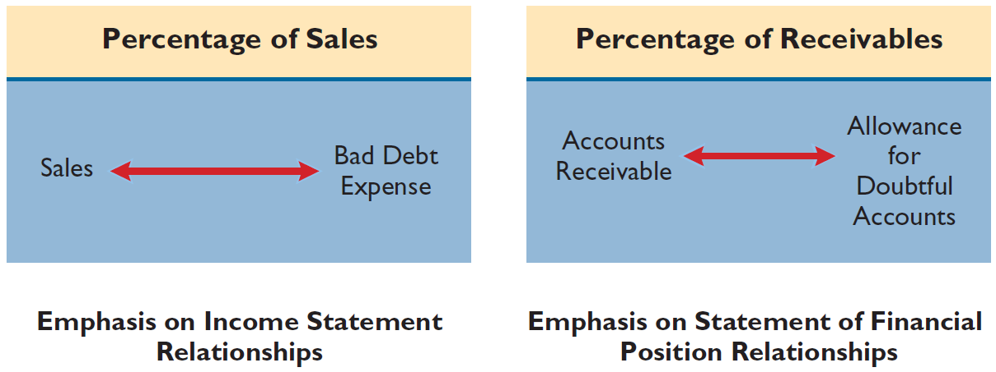
Allowance Method
ILLUSTRATION 7-7
Comparison of Bases for
Estimating Uncollectibles
The percentage-of-sales basis results in a better matching of expenses with revenues
The percentage-of-receivables
basis produces the better estimate of cash realizable value
LO 5

Slide 24
Allowance Method
Percentage-of-Sales Approach
  Percentage based upon past experience and anticipate credit policy.
  Achieves better matching of cost and revenues.
  Any balance in Allowance for Doubtful Accounts is ignored.
  Method frequently referred to as the income statement approach.
LO 5

Slide 25
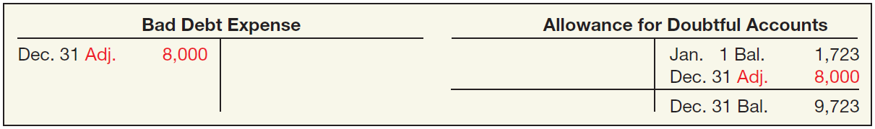
Percentage-of-Sales Approach
Illustration: Gonzalez Company estimates that about 1% of net credit sales will become uncollectible. If net credit sales are R$800,000 for the year, it records bad debt expense as follows.
Bad Debt Expense (1% x R$800,000) 8,000
Allowance for Doubtful Accounts 8,000
ILLUSTRATION 7-8
LO 5

Slide 26
Allowance Method
Percentage-of-Receivables Approach
  Not matching.
  Estimate of the receivables’ realizable value.
Companies may apply this method using
  one composite rate, or
  an aging schedule using different rates.
LO 5

Slide 27
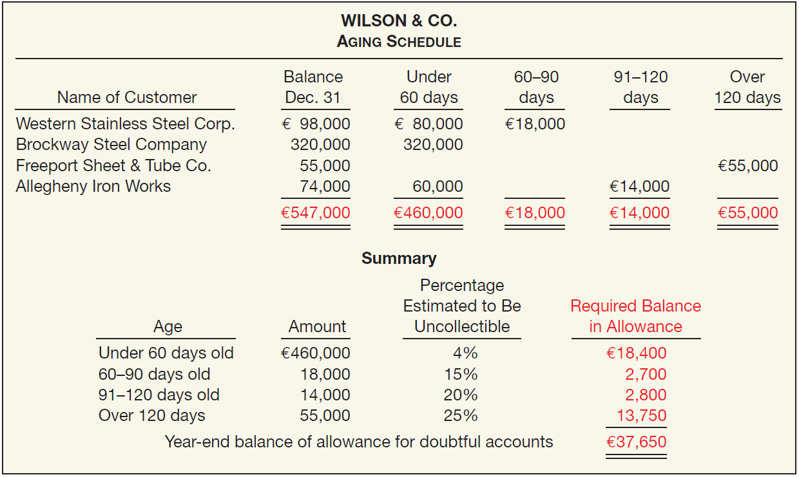
Percentage-of-Receivables Approach
ILLUSTRATION 7-9
Accounts Receivable Aging Schedule
What entry would Wilson make assuming that the allowance account had a zero balance?
Bad Debt Expense 37,650
Allowance for Doubtful Accounts 37,650
LO 5

Slide 28
Percentage-of-Receivables Approach
ILLUSTRATION 7-9
Accounts Receivable Aging Schedule
What entry would Wilson make assuming the allowance account had a credit balance of €800 before adjustment?
Bad Debt Expense (€37,650 – €800) 36,850
Allowance for Doubtful Accounts 36,850
LO 5

Slide 29
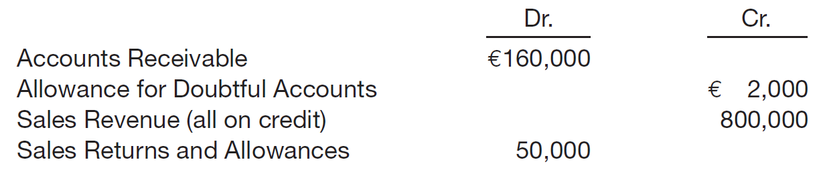
Allowance Method
Illustration: Sandel Company reports the following financial information before adjustments.
Instructions: Prepare the journal entry to record bad debt expense assuming Sandel Company estimates bad debts at (a) 1% of net sales and (b) 5% of accounts receivable.
LO 5

Slide 30
Allowance Method
Illustration: Sandel Company reports the following financial information before adjustments.
Instructions: Prepare the journal entry assuming Sandel estimates bad debts at (b) 1% of net sales.
Bad Debt Expense 7,500
Allowance for Doubtful Accounts 7,500
(€800,000 – €50,000) x 1% = €7,500
LO 5

Slide 31
Allowance Method
Illustration: Sandel Company reports the following financial information before adjustments.
Instructions: Prepare the journal entry assuming Sandel estimates bad debts at (b) 5% of accounts receivable.
Bad Debt Expense 6,000
Allowance for Doubtful Accounts 6,000
(€160,000 x 5%) – €2,000) = €6,000
LO 5

Slide 32
Write-Off of Uncollectible Accounts
Illustration: The financial vice president of Brown Furniture authorizes a write-off of the £1,000 balance owed by Randall Co. on March 1. The entry to record the write-off is:
Allowance for Doubtful Accounts 1,000
Accounts Receivable 1,000
Assume that on July 1, Randall Co. pays the £1,000 amount that Brown had written off on March 1. These are the entries:
Accounts Receivable 1,000
Allowance for Doubtful Accounts 1,000
Cash 1,000
Accounts Receivable 1,000
LO 5

Slide 33
NOTES RECEIVABLE
Supported by a formal promissory note.
A negotiable instrument.
Maker signs in favor of a Payee.
Interest-bearing (has a stated rate of interest) OR
Zero-interest-bearing (interest included in face amount).
LO 6

Slide 34
NOTES RECEIVABLE
Generally originate from:
Customers who need to extend payment period of an outstanding receivable.
High-risk or new customers.
Loans to employees and subsidiaries.
Sales of property, plant, and equipment.
Lending transactions (the majority of notes).
LO 6

Slide 35
Recognition of Notes Receivable
Short-Term
Long-Term
Record at
Face Value,
less allowance
Record at
Present Value
of cash expected
to be collected
Interest Rates
Stated rate = Market rate
Stated rate > Market rate
Stated rate < Market rate
Note Issued at
Face Value
Premium
Discount
LO 6

