Slide 1
CHAPTER ONE
THE NATURE OF ENTREPRENEURSHIP

Slide 2
1.1 INTRODUCTION
The word ‘entrepreneur Is originated from a French word, entreprender, was considered as an individual commissioned to undertake a particular commercial project.
Entrepreneur is someone who undertakes certain projects.
Entrepreneurship is then what the entrepreneur does.
Entrepreneurial is an adjective describing how the entrepreneur undertakes what he or she does.

Slide 3
Con’t…
In ancient period, the word entrepreneur was used to refer to a person managing large commercial projects through the resources provided to him.
In the 17th Century a person who has signed a contractual agreement with the government to provide products or service was considered as entrepreneur.
In the 18th Century the first theory of entrepreneur has been developed by Richard Cantillon and He said that an entrepreneur is a risk taker.

Slide 4
Con’t…
The other development during the 18th Century is the differentiation of the entrepreneurial role from capital providing role.
In the late 19th and early 20th century, the entrepreneur was defined as one who organizes and operates an enterprise for personal gain.
In the middle of the 20th Century, the notion of an entrepreneur as an inventor was established.
From the historical development it is possible to understand the fact that the perception of the word entrepreneur was evolved from managing commercial project to the application of innovation (creativity) in the business idea.

Slide 5
1.3 Definitions of Entrepreneurship and Entrepreneur
Entrepreneurship is a process of identifying opportunities and investing the resources to exploit it for a profit.
Is the processes through which individuals become aware of business ownership, then develop ideas for, and initiate a business.
Entrepreneurship is a process of creating something different and better with value by devoting the necessary time and effort by assuming the accompanying financial, psychic and social risks and receiving the resulting monetary reward and personal satisfaction.
Entrepreneurship is the art of identifying viable business opportunities and mobilizing resources to convert those opportunities into a successful enterprise through creativity, innovation, risk taking and progressive imagination.

Slide 6
Con’t…
It refers to an individual’s: ability to turn ideas into action involving and engaging in socially-useful wealth creation through application of innovative thinking and execution to meet consumer needs, using one’s own labor, time and ideas.
In General, the process of entrepreneurship includes five critical elements. i.e:
  The ability to perceive an opportunity.
  The ability to commercialize the perceived opportunity i.e. innovation
  The ability to pursue it on a sustainable basis.
  The ability to pursue it through systematic means.
  The acceptance of risk or failure.

Slide 7
Definition of Entrepreneur from different perspectives i.e. from the economist, psychologist and capitalist philosopher’s point of view.
To an economist, one who brings resource, labor, materials, and other assets into combination that makes their value greater than before.
To a psychologist, a person typically driven by certain forces need to obtain or attain something, to experiment, to accomplish or perhaps to escape the authority of others.
For capitalist philosopher, one who creates wealth for others, who finds better way to utilize resources and reduce waste and who produce job others are glad to get.
In general, entrepreneur refers to the person and entrepreneurship defines the process.
All entrepreneurs are business persons, but not all business persons are entrepreneurs.

Slide 8
1.4 Types of Entrepreneurs
The individual entrepreneur: is someone who started; acquired or franchised his/her own independent organization.
Intrapreneur: is a person who does entrepreneurial work within large organization.
The Entrepreneurial Organization: An organization that create an environment in which all of its members can contribute in some function to the entrepreneurial function.

Slide 9
  1.5 Role of Entrepreneurs in Economic Development
    Improvement in per capita Income/Wealth Generation
    Generation of Employment Opportunities
    Inspire others towards Entrepreneurship
    Balanced Regional Development
    Enhance the Number of Enterprise
    Provide Diversity in Firms
    Economic Independence
    Combine Economic factors
    Provide Market efficiency
    Accepting Risk
    Maximize Investor’s Return

Slide 10
    1.6 Entrepreneurial Competence and Environment
    1.6.1 Entrepreneurial Mindset
1.6.1.1 Who Becomes an Entrepreneur?
    The Young Professional
    The Inventor
    The Excluded

Slide 11
1.6.1.2 Qualities of an Entrepreneur
To be successful, an entrepreneur should have the following qualities:
  Opportunity-seeking
  Persevering
  Risk Taking
  Demanding for efficiency and quality
  Information-seeking
  Goal Setting
  Planning
  Persuasion and networking
  Building self-confidence
  Listening to others
  Demonstrating leadership
Notes:
Quality plays an important role in this new era of globalization because it confer s certain benefits which include:
F Reduction of waste:
Cost-effectiveness:
An increase in market share:
Better profitability:
Social responsibility:
Reputation:

Slide 12
1.6.1.3 Entrepreneurial Skills
General Management Skills: are skills required to organize the physical & financial resources needed to run the venture. i.e:
      Strategy Skills
      Planning Skills
      Marketing Skills
      Financial Skills
      Project Management Skills
      Time Management Skills

Slide 13
People Management Skills
      Communication Skills
      Leadership Skills
      Motivation Skills
      Delegation Skills
      Negotiation Skills
All these different people skills are interrelated.
Here entrepreneurial performance results from a combination of industry knowledge, general management skills; people skills and personal motivation.

Slide 14
1.6.1.4 The Entrepreneurial Tasks
Owning Organizations
Founding New Organizations
Bringing Innovations to Market
Identification of Market Opportunity
Application of Expertise
Provision of leadership
The entrepreneur as manager

Slide 15
1.6.1.5 Wealth of the Entrepreneur
Wealth is money and anything that money can buy.
Who Benefits from the entrepreneur’s Wealth?
    Employees:
    Investors: stockholders/lenders.
    Suppliers
    Customers
    The local community
    Government

Slide 16
1.6.2 Entrepreneurship and Environment
1.6.2.1 Phases of Business Environment
Business environment may be classified into two broad categories; namely external and internal environment.
External Environment
  Economic Environment
  Legal Environment
  Political Environment
  Socio-Cultural Environment
  Demographic Environment
Internal Environment;
  Raw Material
  Production/Operation
  Finance
  Human Resource

Slide 17
1.6.2.2 Environmental Factors Affecting Entrepreneurship
Environmental factors which hinder entrepreneurial growth are;
Sudden changes in Government policy.
Sudden political upsurge.
Outbreak of war or regional conflicts.
Political instability or hostile Government attitude towards industry.
Excessive corruption among Government agencies.

Slide 18
con’t…
Ideological and social conflicts.
Unreliable supply of power, materials, finance, labor and other inputs.
Rise in the cost of inputs.
Unfavorable market fluctuations.
Non-cooperative attitude of banks and financial institutions.
Entrepreneurship is environmentally determined.

Slide 19
1.7 Creativity, Innovation and Entrepreneurship
1.7.1 Creativity; is a process of assembling ideas by recombining elements already known but wrongly assumed to be unrelated to each other.
key elements of this definition;
Process: implies that, it is more likely a skill than an attitude, and that you can get better at it with practice.
Ideas: creativity results in ideas that have potential value.
Recombining: the creative process is one of putting things together in unexpected ways.

Slide 20
1.7.1.1 Steps in the Creative Process
Step 1: Opportunity or problem Recognition; A person discovers that a new opportunity exists or a problem needs resolution.
Step 2: Immersion; the individual concentrates on the problem and becomes immersed in it.
Step 3: Incubation; a person does not appear to be working on the problem actively; however, the subconscious mind is still engaged.
Step 4: Insight; the problem-conquering solution flashes into the person’s mind at an unexpected time, such as on the verge of sleep, during a shower, or while running. Insight is also called the Aha! Experience.
Step 5: Verification and Application; the individual sets out to prove that the creative solution has merit.

Slide 21
1.7.1.2 Barriers to Creativity
There are a numerous barriers to creativity, i.e.
Searching for the one ‘right’ answer
Focusing on being logical
Blindly following the rules
Constantly being practical
Viewing play as frivolous
Becoming overly specialized
Avoiding Ambiguity
Fearing looking Foolish
Fearing mistakes and failure
Believing that ‘I’m not creative

Slide 22
1.7. 2 Innovation
Innovation is the implementation of new idea at the individual, group or organizational level.
It is a process of intentional change made to rate value by meeting opportunity and seeking advantage
Types of Innovation; there are 4 types of innovation.
  Invention - the creation of a new product, service or process
  Extension - the expansion of a product, service or process
  Duplication - replication of already existing product, service or process
  Synthesis - the combination of existing concepts and factors into a new formulation.

Slide 23
1.7.2.1 The Innovation Process
Analytical planning: carefully identifying the product or service features, design as well as the resources that will be needed.
Resources organization: obtaining the required resources, materials, technology, human or capital resources
Implementation: applying the resources in order to accomplish the plans
Commercial application: the provision of values to customers, reward employees and satisfy the stakeholders.

Slide 24
1.7.2.2 Areas of Innovation
New product
New Services
New Production Techniques
New Way of Delivering the Product or Service to the Customer
New Operating Practices
New Means of Informing the Customer about the Product
New Means of Managing Relationship within the Organization
New Ways of Managing Relationships between Organizations

Slide 25
1.7.3 From Creativity to Entrepreneurship
Creativity, is the ability to develop new ideas and to discover new ways of looking at problems and opportunities.
Innovation, is the ability to apply creative solution to those problems and opportunities in order to enhance people’s lives or to enrich society.
Entrepreneurship = creativity + innovation.

Slide 26
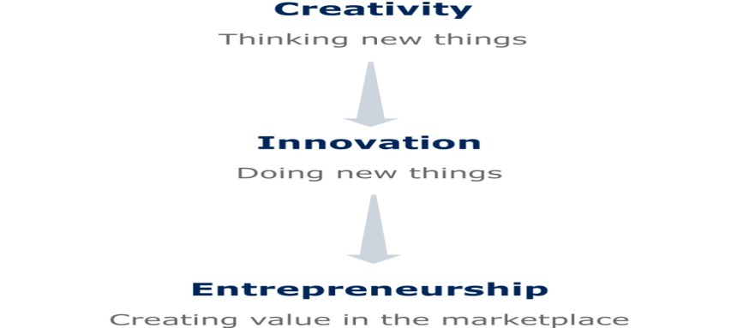
Con’t…

Slide 27


